Slide 1
Estimating the impact of audio-visual link on being granted bail
2021 Winter Seminar Series

Slide 2
Agenda
01
Who uses audio-visual link, and what is it like?
02
Why does it matter if defendants appear via audio-visual link?
03
How did we study the impact of AVL on bail outcomes?
04
What did we find?
04
What can we take away from this?

Slide 3
There has been a steady increase of the proportion of people appearing at court via AVL, with a recent spike due to the COVID-19 pandemic
AVL usage by Legal Aid has increased by roughly 30% in five years (from 20,000 in 2013-14 to 28,000 in 2018-2019)
18,657 cases had their first bail hearing via AVL between Jan 2018 – Feb 2020, approximately one third of all bail hearings
Since the COVID-19 pandemic started, hearings in the local and higher courts have been seen via AVL by default

Slide 4
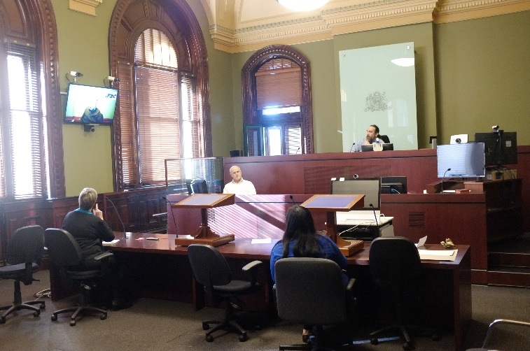
Audio-visual link (AVL) is the term used for the video conferencing equipment used at courts and custodial facilities
AVL from the perspective of the courtroom (Kashyap et. al 2018, photo provided by UTS Design Innovation Research Centre)
Notes:
Barring any technical failures, the matter otherwise proceeds as if the defendant were present in person. The majority of courts and custodial facilities in NSW have AVL equipment available, allowing for defendants and witnesses to appear at court remotely.

Slide 5
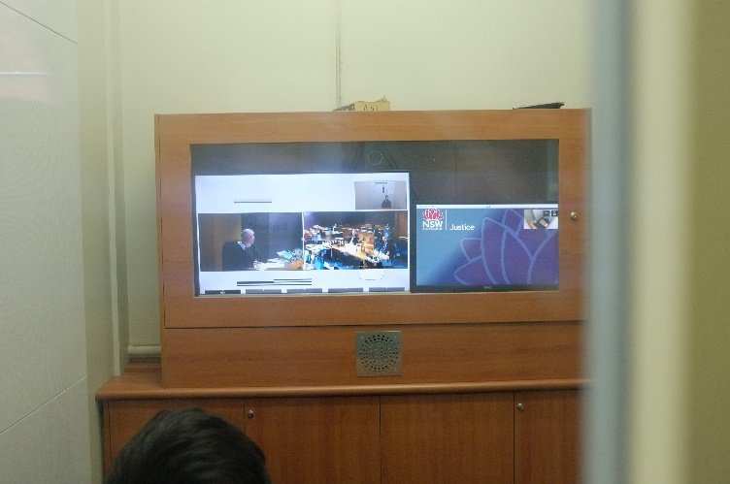
Audio-visual link (AVL) is the term used for the video conferencing equipment used at courts and custodial facilities
AVL from the perspective of the individual in custody (Kashyap et. al 2018, photo provided by UTS Design Innovation Research Centre)
Notes:
Barring any technical failures, the matter otherwise proceeds as if the defendant were present in person. The majority of courts and custodial facilities in NSW have AVL equipment available, allowing for defendants and witnesses to appear at court remotely.

Slide 6
Appearing at court via changes the interaction and framing of the court hearing for both the defendant and those in the court
AVL changes the way the court interacts with the defendant
De-humanisation of the defendant
Changes the framing of the defendant
Technical issues
AVL changes the experience of the defendant with the justice system
Adds a barrier to engagement
Lack of privacy and/or comfort
May represent themselves differently

Slide 7
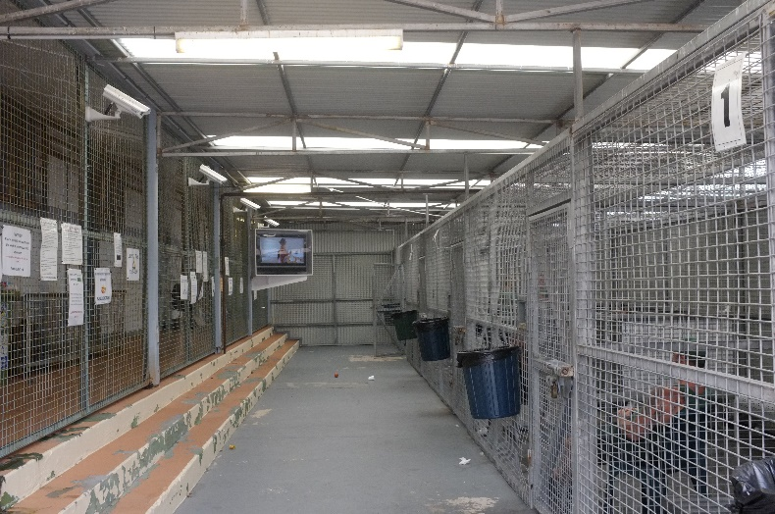
Previous research suggests that there is a ‘critical need to improve the amenity and quality’ of the AVL experience for defendants
Kashyap (2018) notes that many facilities are too small, lack basic amenities such as cooling / heating and do not portray a sense of human dignity
McKay (2016) reports chronic technical issues, reducing understanding and causing stress
Rowden et al (2013) find that even when the technology is working as intended, audio can be hard to hear, out of sync and feel like it’s coming from different locations.
Long Bay holding yard (Kashyap et. al 2018, photo provided by UTS Design Innovation Research Centre)

Slide 8
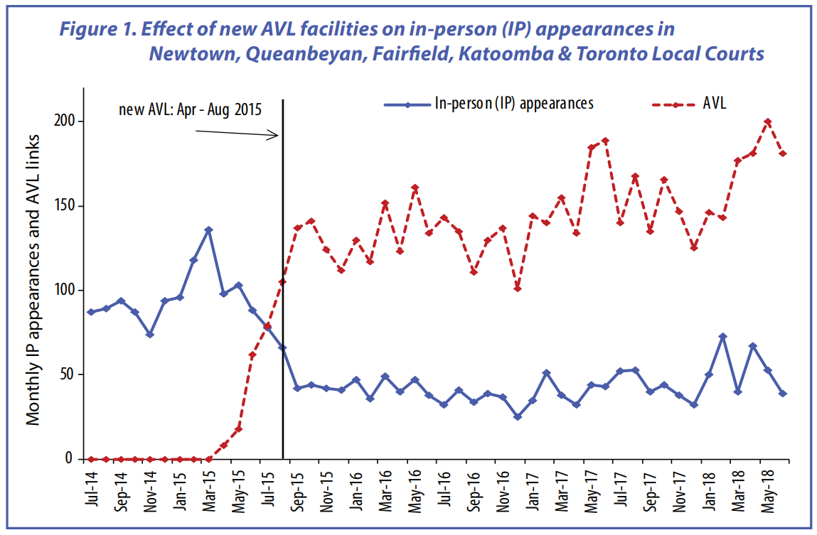
The reduction in transport and security costs is a key reason for the expansion in AVL in courts.
AVL reduces in person appearances by approximately 55 – 65%
across nine local courts in the three years after AVL is introduced
This saves roughly $460,000 over the first 3 years:
2,271 appearances avoided.
2.13 trips per appearance
$95 per trip
This does not capture other benefits such as:
Improved access to services / court in remote areas
Benefits to both defendants and staff by avoiding transport

Slide 9
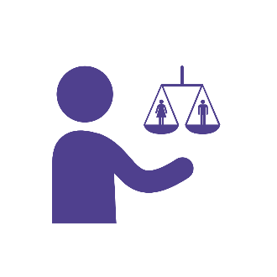
Appearing at court via AVL could impact the experience of defendants, procedural justice, court outcomes and whole-of-government costs
Experience of defendants: Appearing via audio-visual link may be a considerably more stressful and alienating experience than appearing in person. This may be somewhat ameliorated by avoiding travel to the court.
Procedural justice: The defendant may not feel that they have been provided a fair and/or sufficiently thorough process when seen via AVL. This could then impact engagement with legal services and the justice system more broadly
Court outcomes: Appearing via AVL may influence the perceptions of those in the courtroom, and in turn influence the outcomes of the court hearing
Whole-of-government costs: Appearing via AVL, through both logistical factors and the mechanisms outlined above, will have an impact on whole-of-government costs.

Slide 10
Appearing at court via AVL could impact the experience of defendants, procedural justice, court outcomes and whole-of-government costs
Experience of defendants: Appearing via audio-visual link may be a considerably more stressful and alienating experience than appearing in person. This may be somewhat ameliorated by avoiding travel to the court.
Procedural justice: The defendant may not feel that they have been provided a fair and/or sufficiently thorough process when seen via AVL. This could then impact engagement with legal services and the justice system more broadly
Court outcomes: Appearing via AVL may influence the perceptions of those in the courtroom, and in turn influence the outcomes of the court hearing
Whole-of-government costs: Appearing via AVL, through both logistical factors and the mechanisms outlined above, will have an impact on whole-of-government costs.
McKay, Kashyap

Slide 11
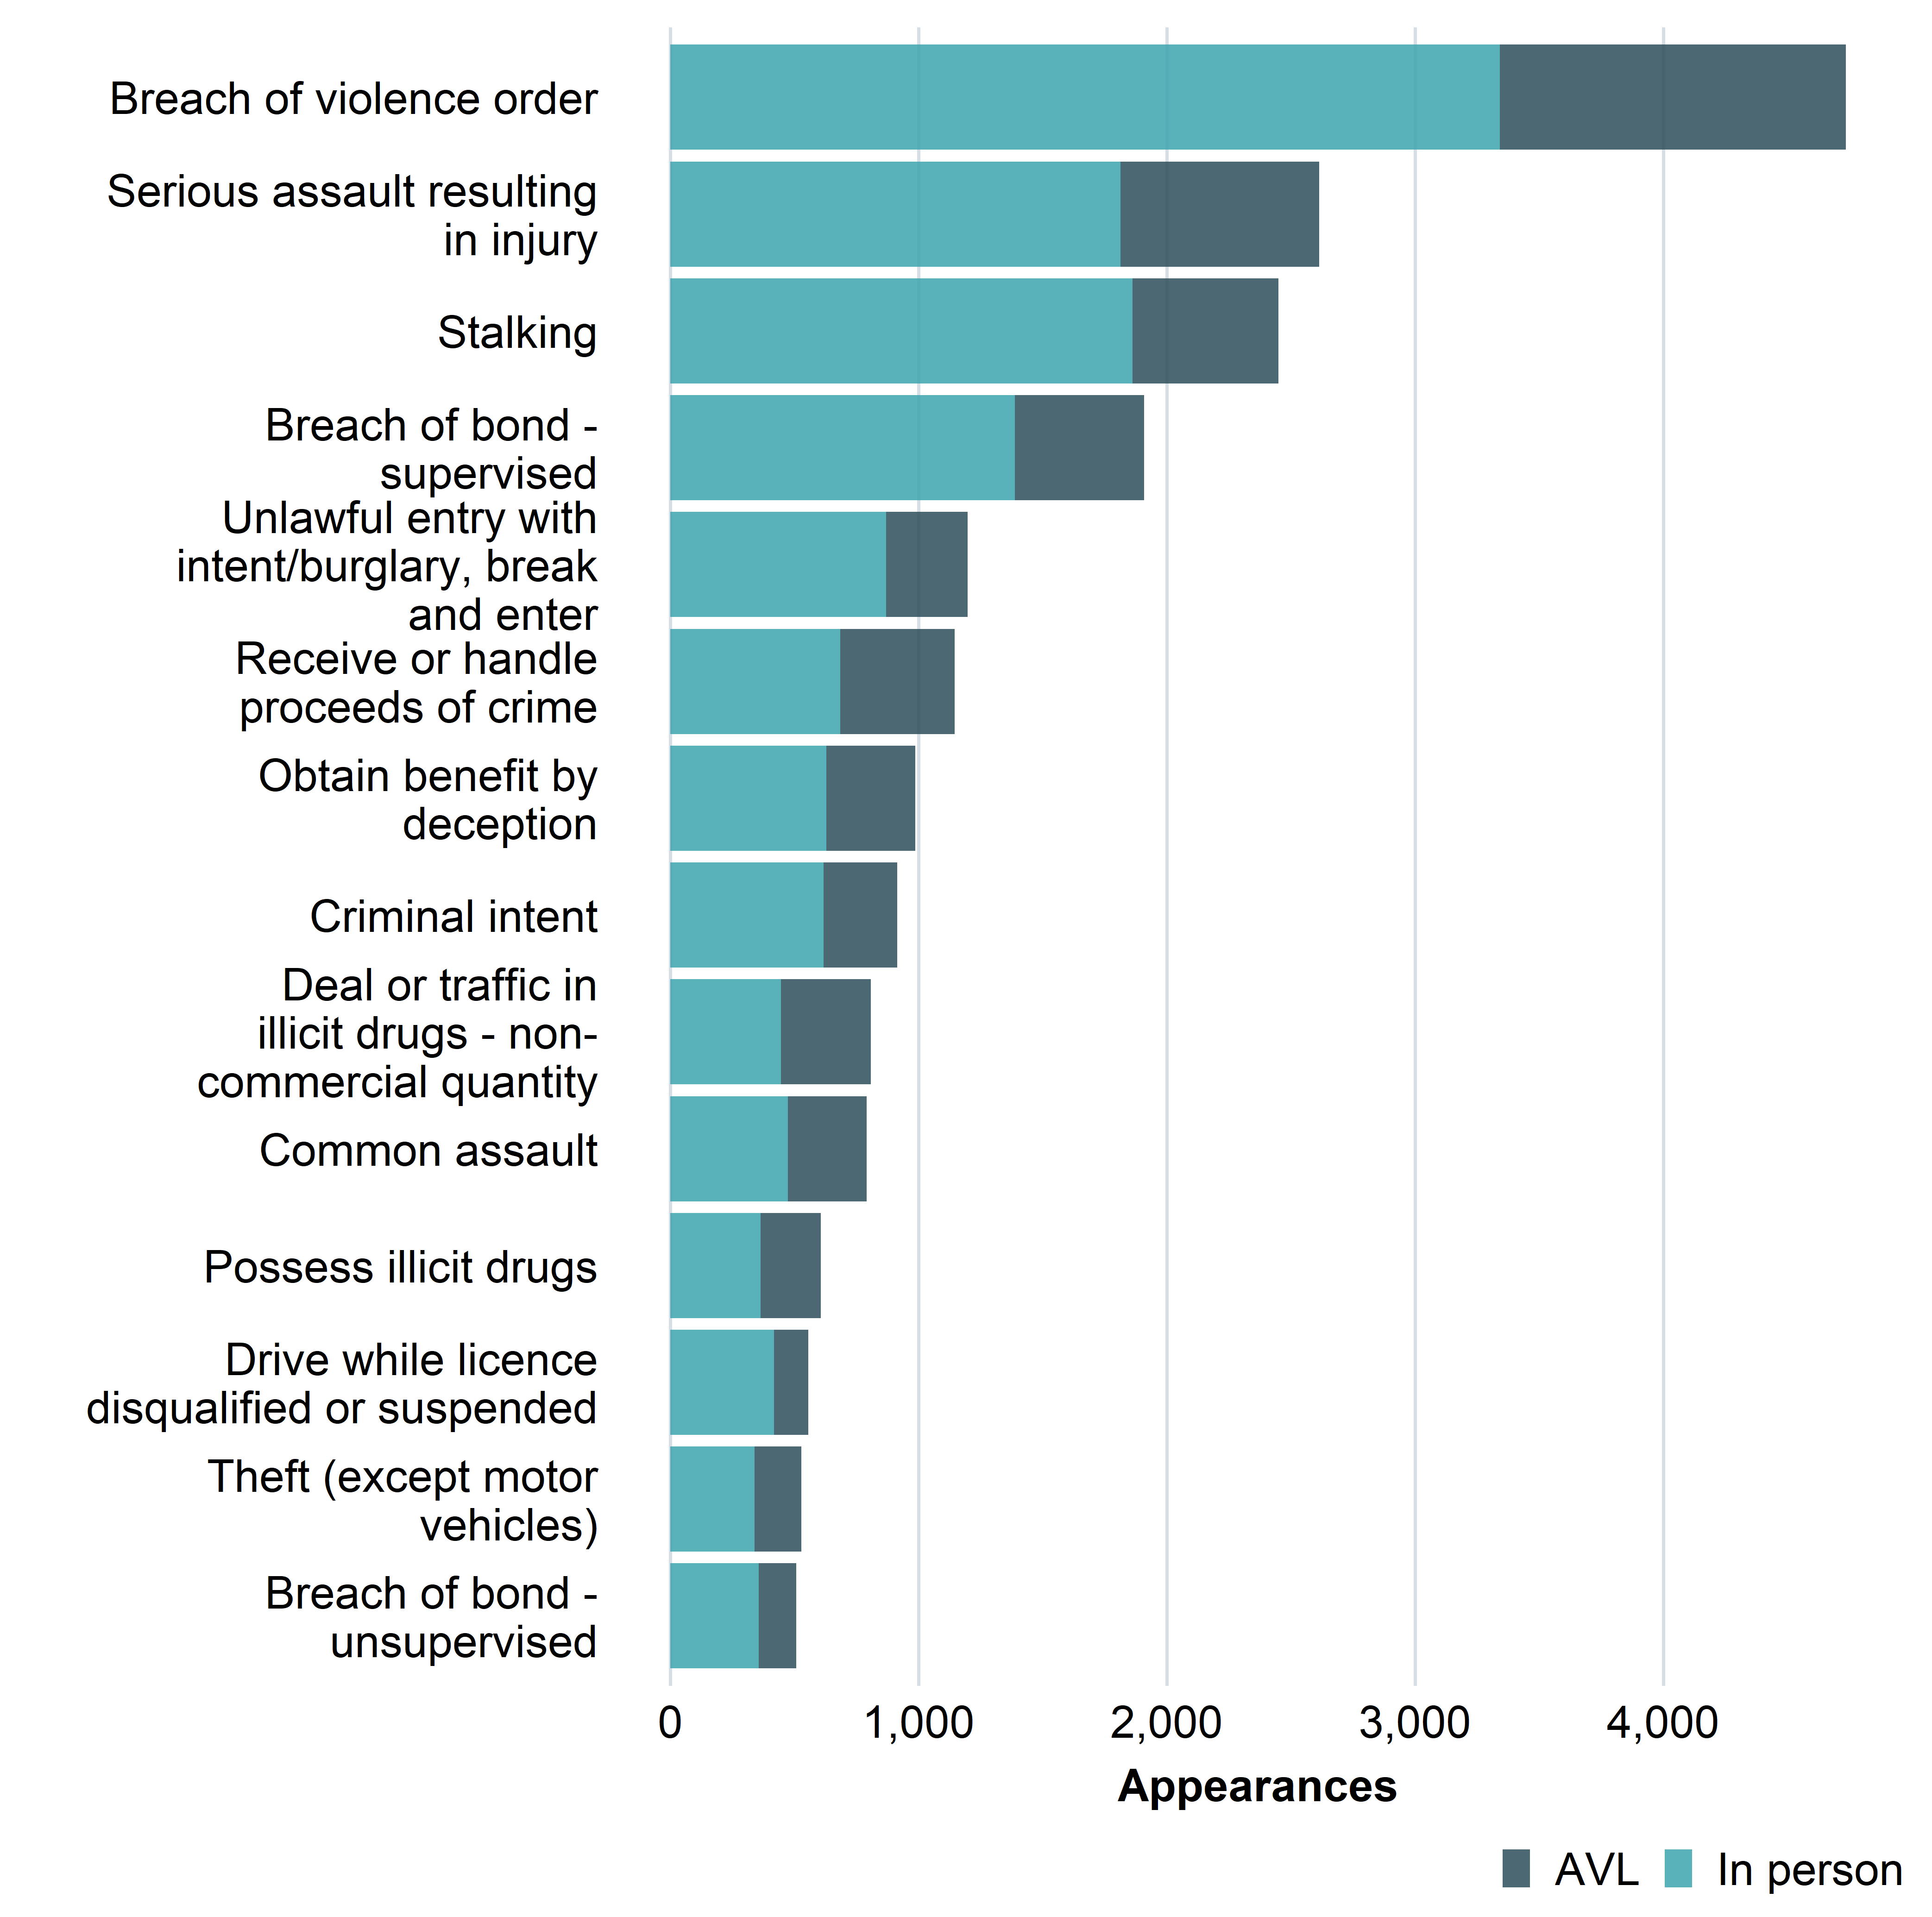
This study aims to estimate the causal impact of AVL on the outcome of the first bail hearing for adult defendants who have been refused bail by police
We narrowly consider the causal impact of appearing via AVL on being granted bail, relative to appearing in person
We only consider defendants who have already been refused bail by police
Each observation is a first bail hearing, which means that individuals can appear multiple times
Our data has 25,926 hearings across 18,653 individuals

Slide 12
Appearing via AVL could frame the defendant negatively, reduce their presence in the courtroom and change how they behave and interact
Framing hypothesis: The defendant may be implicitly perceived as less human (and thus deserving of sympathy), as a prisoner (making prison the default option) or more violent.
Low presence hypothesis: Appearing via AVL may cause judges to make the bail decision based less on the individual in the courtroom (as they have less presence) and based more on the captured characteristics
Technical issues hypothesis: Defendants may represent themselves more negatively due to the technical issues, appearing more agitated, socially inept and less ‘appropriate’ due to the lack of context clues for behaviour

Slide 13
We were worried about two different ways a simple comparison between those who appeared via AVL and those who didn’t could be misleading
Do different types of people get seen via AVL?
People who are seen as more trouble to transport?
People who opt to be seen via AVL?
Do different types of cases get seen by AVL?
Save the more serious / complex cases for in person?

Slide 14
Our research design exploits the ‘natural experiment’ caused by the way AVL is allocated at Amber Laurel and Surry Hills correctional centres
Police
Corrections
Courts
Arrested and police bail refused
YES
Bail hearing at Court
Transport
Arrive before cut-off time?
Charge process
NO
Bail hearing via AVL

Slide 15
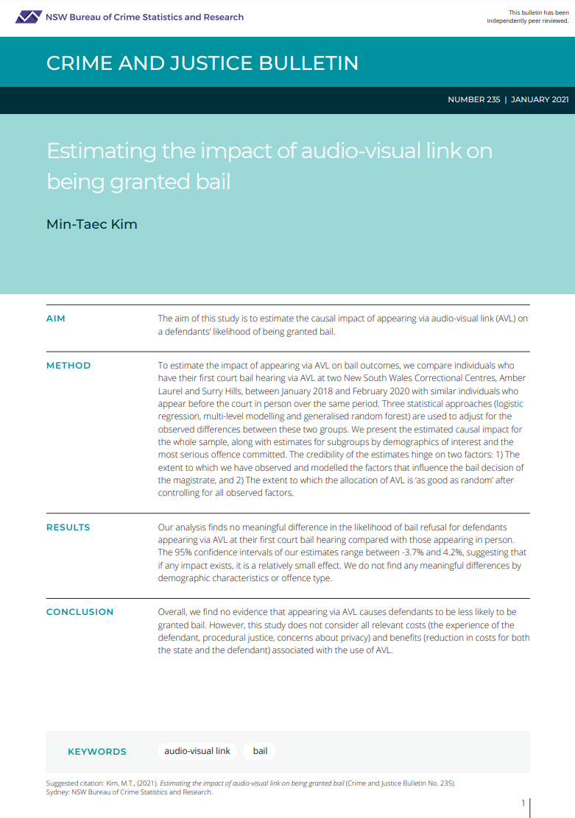
We estimate the approach using three different approaches, adjusting for the characteristics of the offence, hearing and the individual
Outcome: Was the individual granted bail?
Predictors:
Characteristics of the offence
Characteristics of the hearing
Characteristics of the individual
Demographics
Prior offending history
Estimation approaches:
Logistic regression
Multi-level model
Generalised random forest
All estimates can be interpreted as the estimated causal impact of appearing via AVL (relative to appearing in person) on the probability of being granted bail.

Slide 16
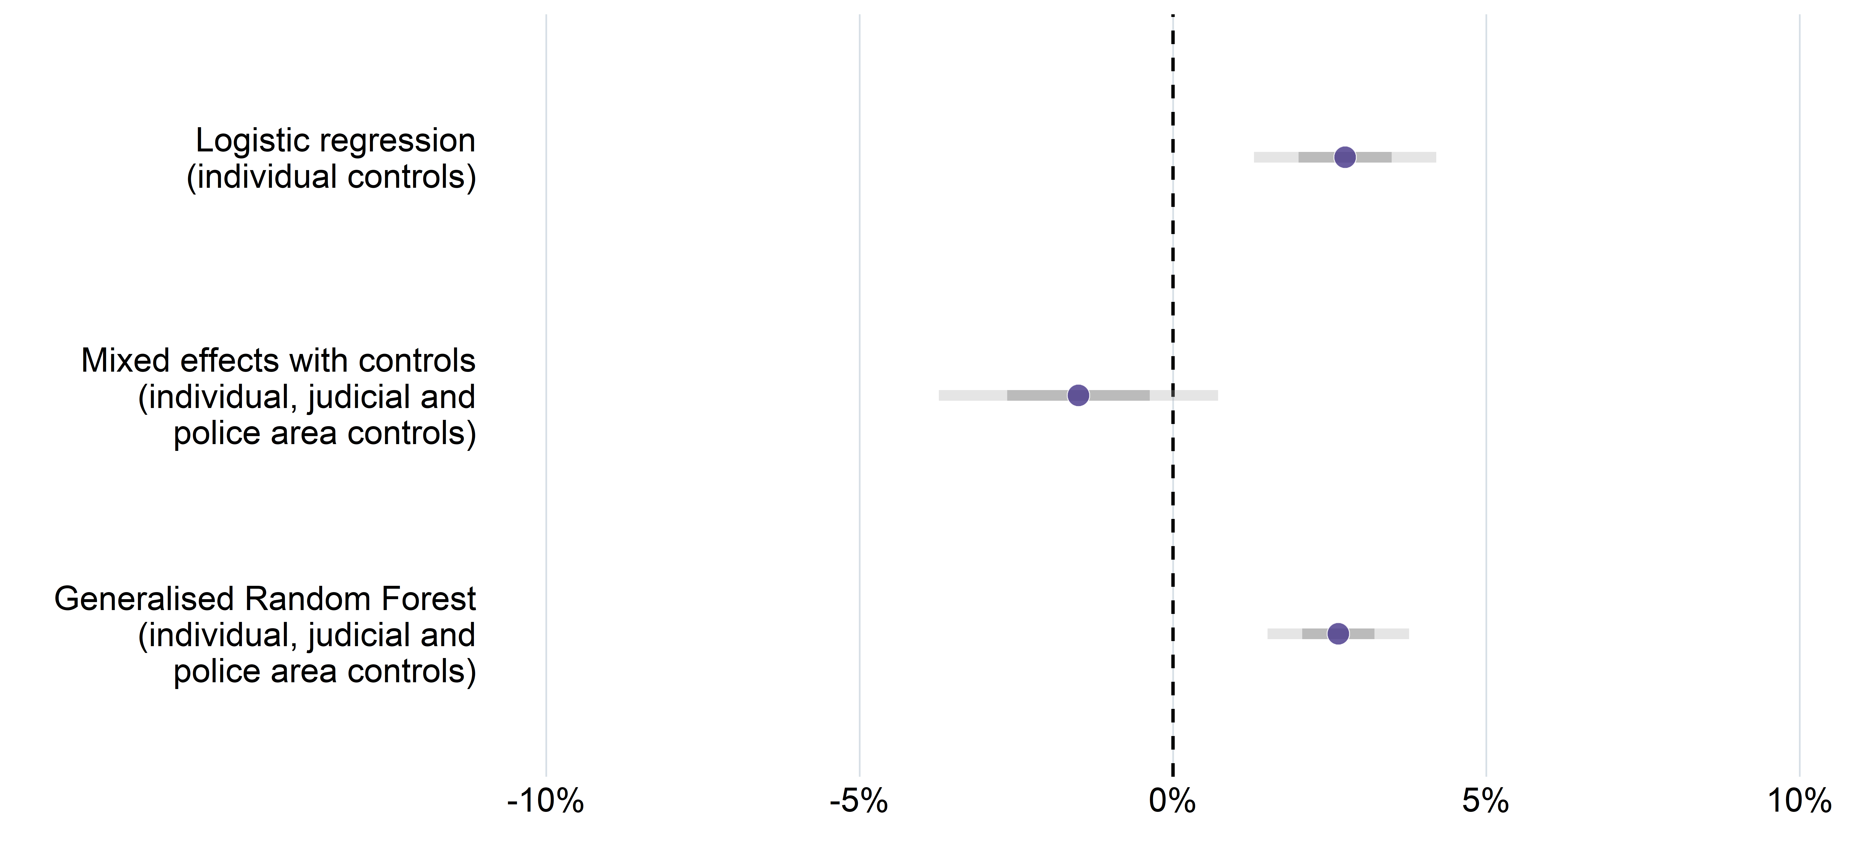
We find no evidence of disadvantage when appearing via AVL when considering all appearances in aggregate
Less likely to be granted bail when appearing via AVL
More likely to be granted bail when appearing via AVL

Slide 17
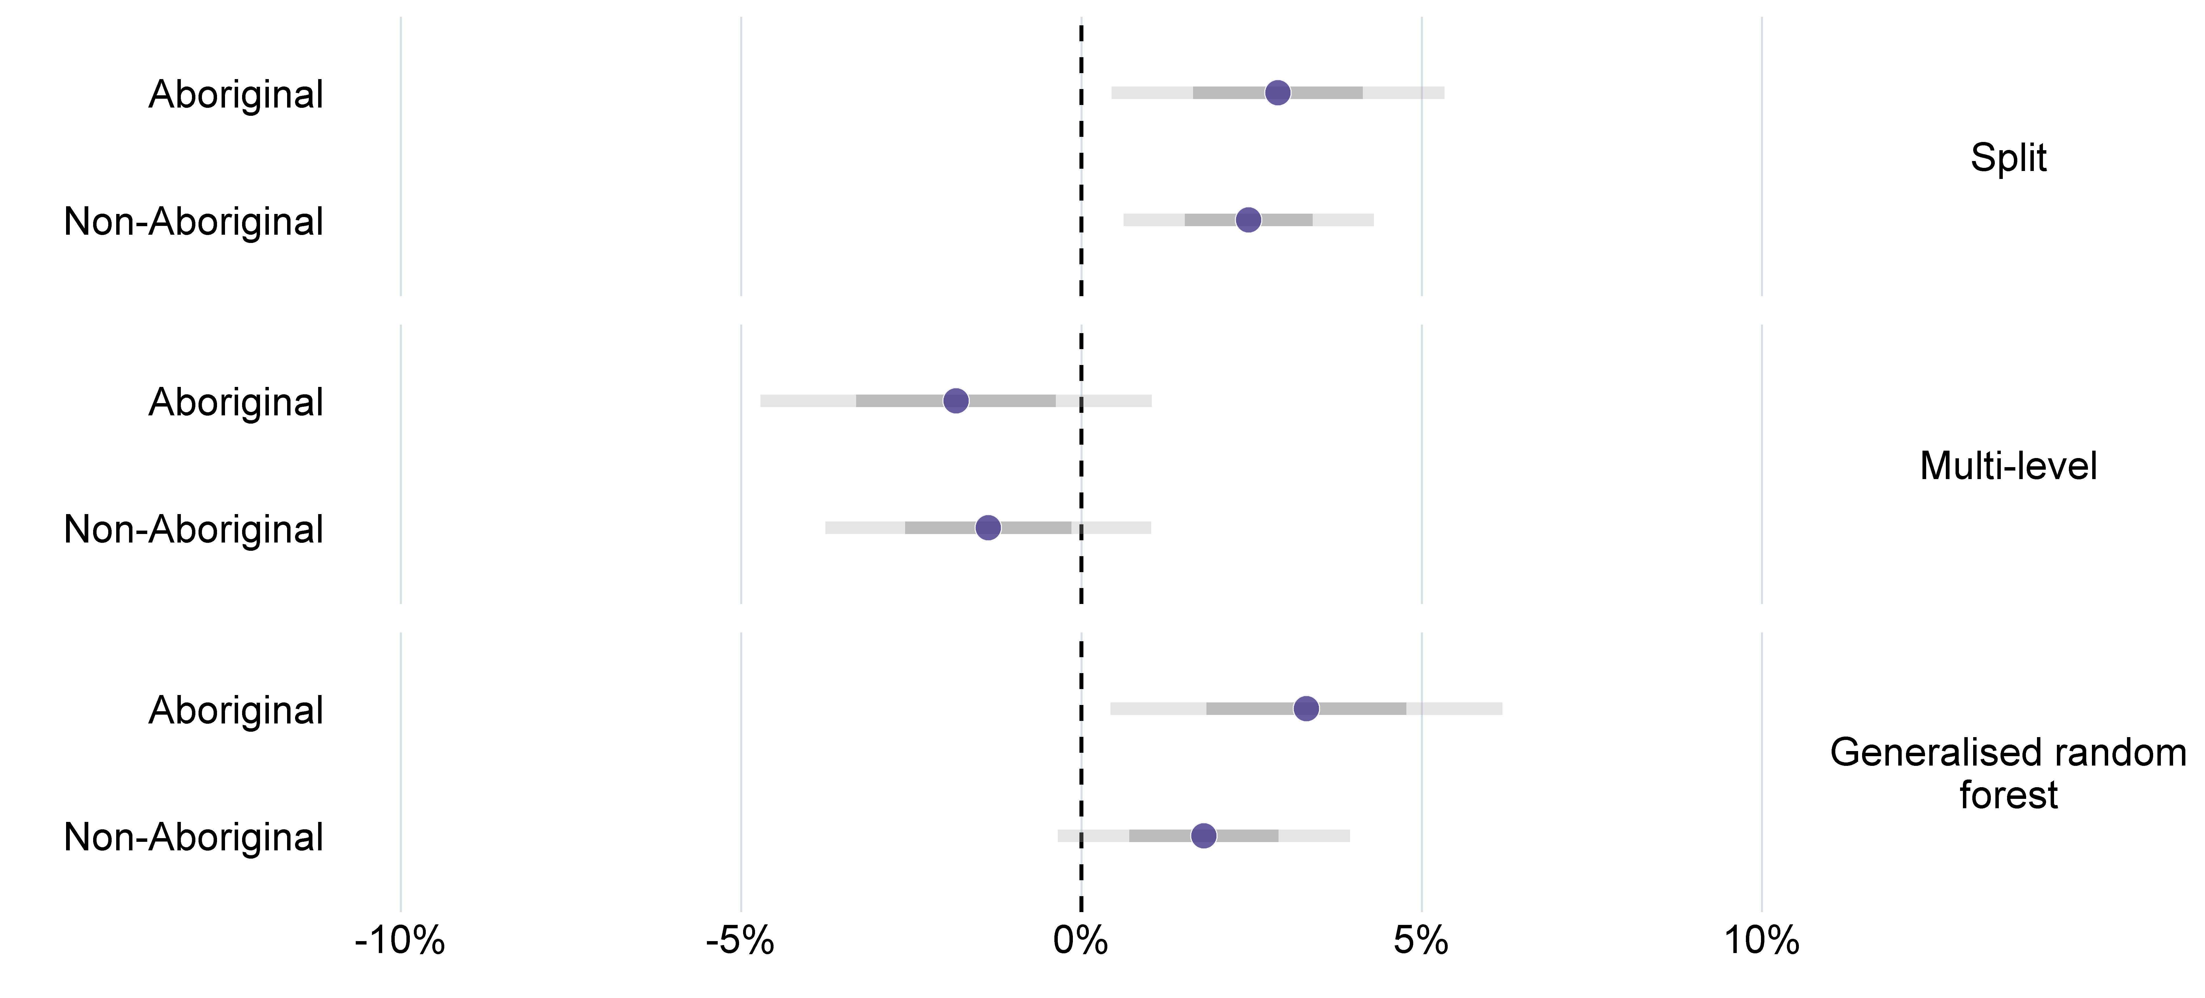
We find no evidence that the impact of appearing via AVL differs between Aboriginal and non-Aboriginal defendants
Aboriginal
Non-Aboriginal
Aboriginal
Non-Aboriginal
Aboriginal
Non-Aboriginal
Less likely to be granted bail when appearing via AVL
More likely to be granted bail when appearing via AVL

Slide 18
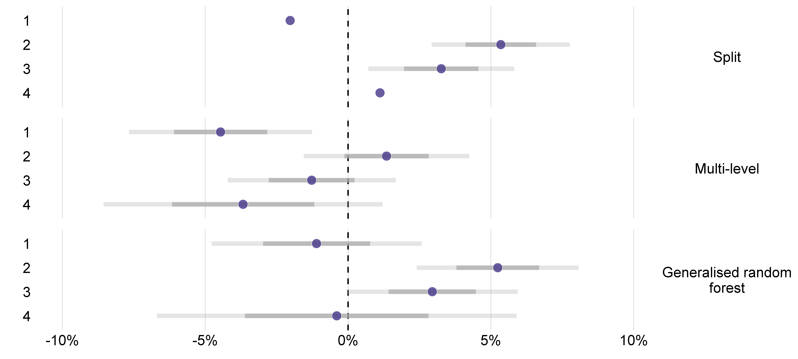
We find small differences between SEIFA quartiles, but still do not estimate a disadvantage for defendants
Lowest
Highest
Less likely to be granted bail when appearing via AVL
More likely to be granted bail when appearing via AVL

Slide 19
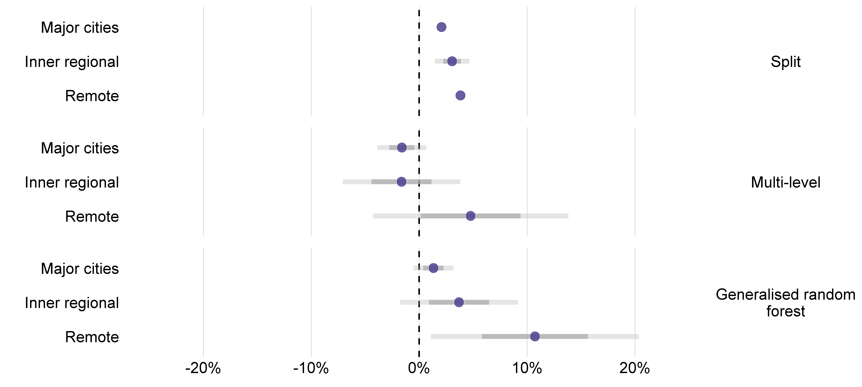
We are more likely to observe an advantage due to appearing via AVL for defendants in remote areas, but our estimates are noisy and imprecise.
Less likely to be granted bail when appearing via AVL
More likely to be granted bail when appearing via AVL

Slide 20
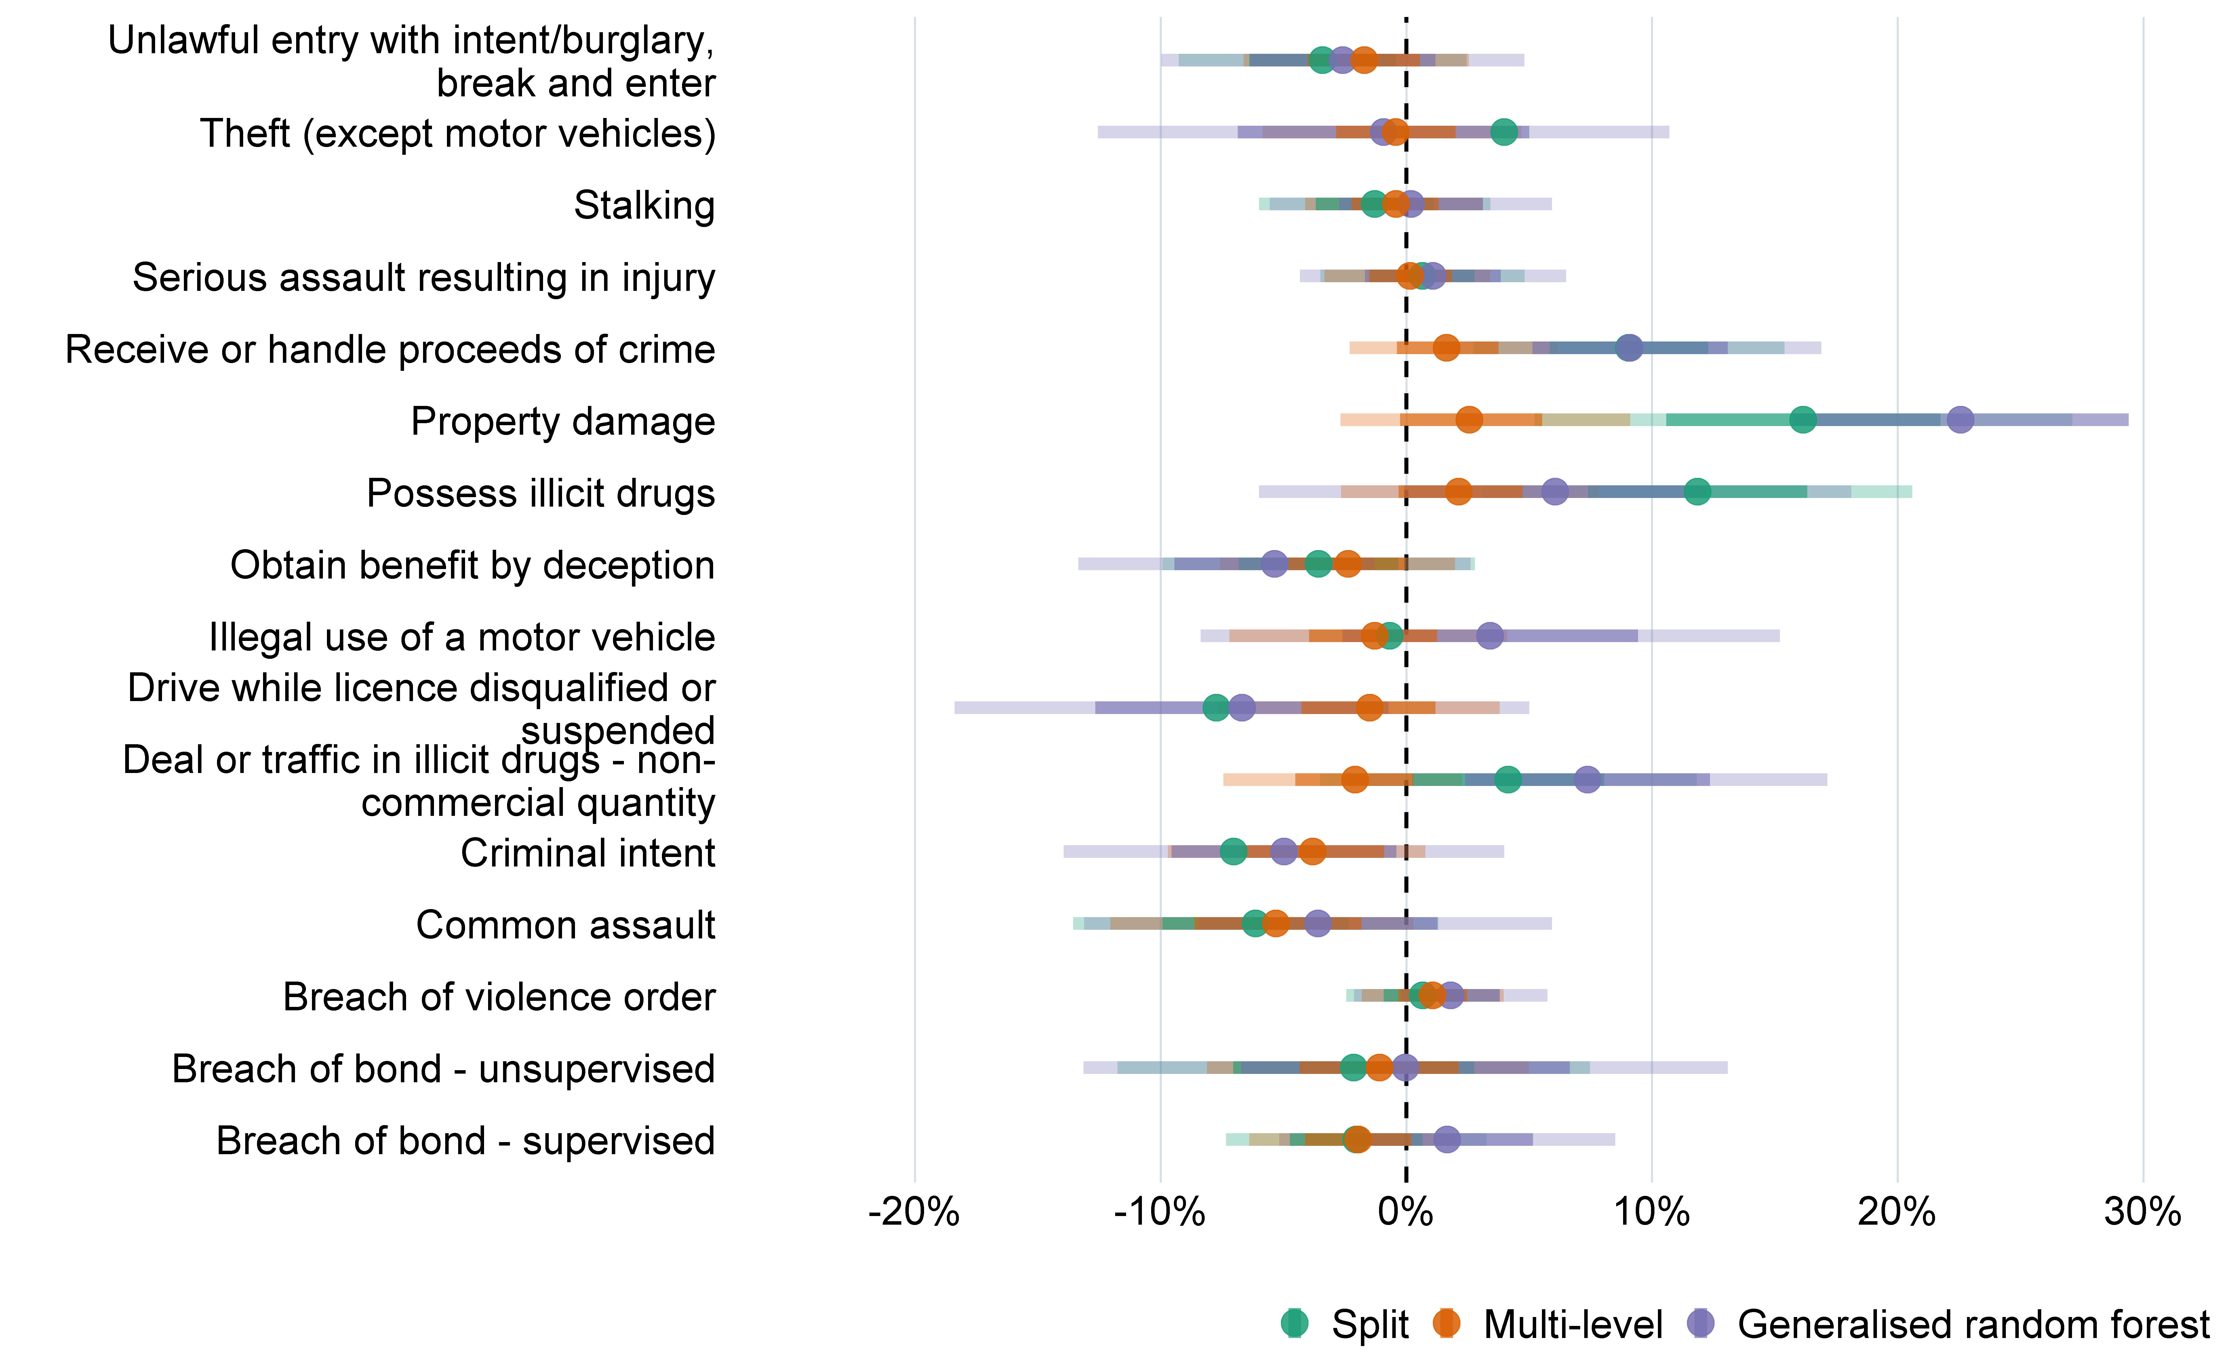
We do not find a meaningful disadvantage across the 16 most common offence types

Slide 21
Our study does not provide any evidence that appearing via AVL creates a disadvantage for defendants being granted bail
8%
No differences in bail rates in aggregate
At an aggregate level, there is no evidence that appearing via AVL disadvantaged defendants
Weak evidence for differences by region
We see small imprecisely estimated differences by region (and SEIFA, a variable captured at the region level) but does not suggest disadvantage
No offence with an estimated disadvantage larger than 8%
There are small differences by offence, but these are none provide meaningful evidence of disadvantage

Slide 22
Our study does not provide any evidence that appearing via AVL creates a disadvantage for defendants being granted bail
We find no evidence that appearing via AVL is disadvantaging defendants relative to appearing in person in being granted bail
Appearing via AVL may still be impacting defendants experiences, particularly their engagement with the justice system
Appearing via AVL will likely result in a net cost reduction, given the reduction in transport cost and no offsetting increase in the remand

Slide 23
THANK YOU

