Slide 1
Testing the Waters:
What can waste water tell us about illicit drug use?
Wayne Hall
Centre for Youth Substance Abuse Research
University of Queensland Centre
and
National Addiction Centre
Kings College London

Slide 2
Why Monitor Illicit Drug Use?
Illegality of drug use makes it difficult to
    Monitor drug use in the population
    Effects of drug use on users and others
Essential to evaluate the effectiveness of:
    preventive interventions e.g. media campaigns
    law enforcement efforts to reduce supply
    Increasing access to treatment

Slide 3
Existing Monitoring Methods
Household and school surveys
    Trends in lifetime and past year use
    Declining response rate: now under 50%
    Sampling and response biases
    Requires large N: a year to report; expensive; 3 yearly
Annual surveys of sentinel populations:
    Illicit Drug Reporting System
    Ecstasy Related Reporting System
      Good data on patterns of heavy users
      Uncertain who they represent
      Depend upon self-report of what drugs used
    Drug Use Monitoring of prisoners
      All regular users so much higher rates of recent use

Slide 4
Wastewater (WWA) Analysis of Illicit Drugs
(Daughton, 2001)
Illicit drugs can be detected using LC-MS in ng/L
Levels can be used to back-calculate
    Total quantity of drug consumed in WW catchment
    Potentially rates of illicit drug use in catchment population
Provides estimates of drug use:
    that do not depend on self-report
    cover drug use in the population of WW catchment
    in principle, near real time and continuous
    probably cheaper than population surveys
    provide a useful adjunct to survey methods

Slide 5
Estimating illicit drug consumption via WWA
Population (N )who
contribute to sample
A given catchment
Drug intake
Est. mg/day/1000 people
C_{DR}
X
F
=
X
CF
P
Correction factor (excreted/consumed)
Excretion as parent drugs and/or metabolites
F (L/s)
Sewage treatment plant (STP)
Inlet
Toilet flushing
Sampling
C_{DR} (ng/L – μg/L)
Sample extraction and analysis
Measured
Assumed
Estimated
Prepared by F.Y. Lai (ENTOX, UQ)
Notes:
5

Slide 6
Technical Challenges 1
Waste water sampling
    Need good estimate of daily excretion
    Must specify sampling frequency and volume
    Depends on nature of waste water system
Deciding which chemicals to measure
    residues i.e. unmetabolised drug?
    metabolites, preferably unique?
    Ideally do both : to triangulate estimates

Slide 7
Technical Challenges 2
Analytical issues
    Average rates of excretion of drug (CF)
    Rate of degradation of drugs in WW systems
Back-calculation of per capita consumption
    Composition of the catchment population
      N, age, sex: using biomarkers?
      How many light vs regular drug users?
    What is the average dose used?
    Has drug purity changed?

Slide 8
Potential Benefits for Monitoring
Useful in monitoring illicit drug use
Useful in evaluating
    Supply control
    Prevention
    Demand reduction
    Harm reduction
Information of value to illicit drug users
    What drugs are they using?
    What are their possible risks?

Slide 9
Support for Utility
Rank ordering of metabolites in WW:
    Cannabis > MDMA> cocaine
Temporal variations in levels:
    Over weekends vs other days of week :
      cannabis & heroin stable; > cocaine & MDMA weekends
    Reduction between 2007 and 2009 in Milan (GFC)
Geographic variations within countries:
    Usually higher levels in large cities
Rank order concordance with survey prevalence
    Sometimes higher in WW estimates
.

Slide 10
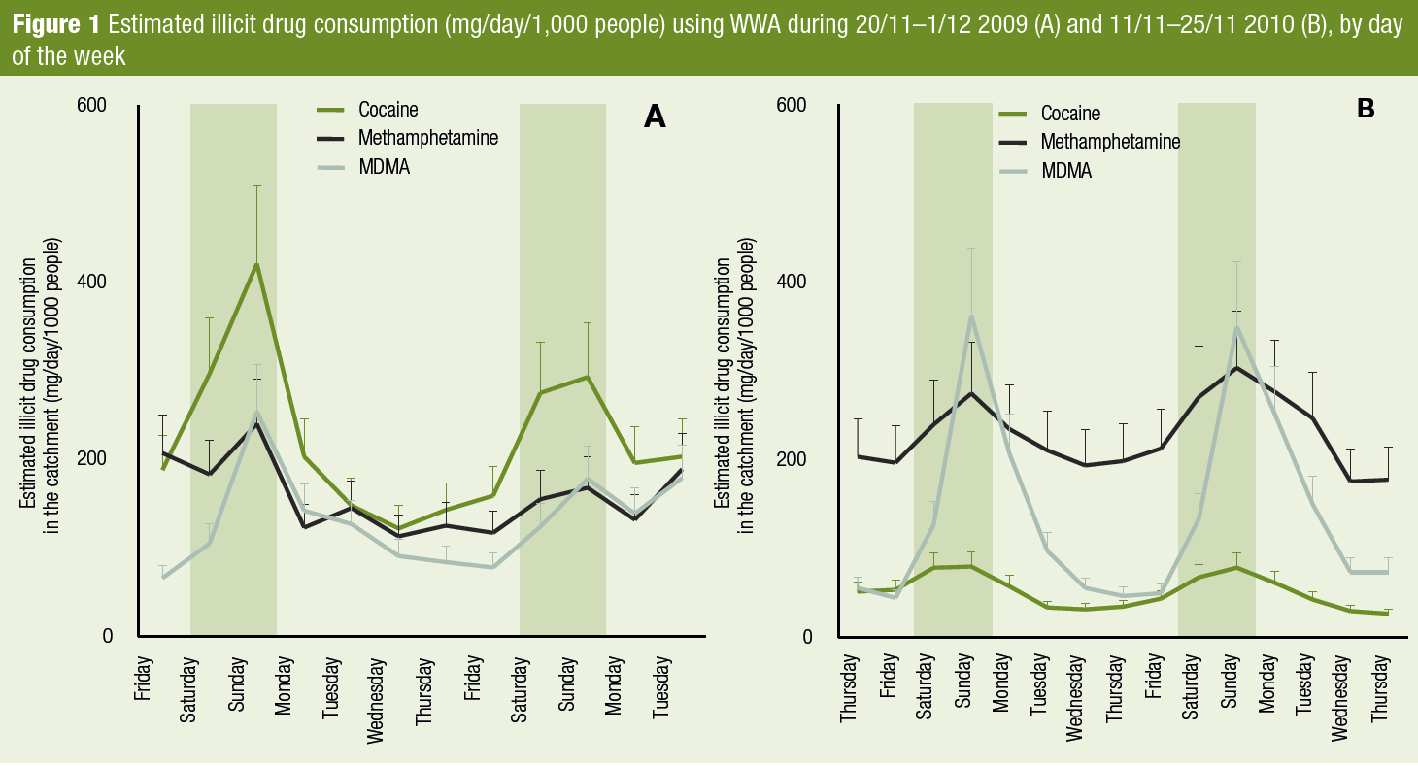
Greatest consumption on Fridays and Saturdays
Decline in cocaine use between 2009 and 2010
Increase in methamphetamine use 2009 to 2010

Slide 11
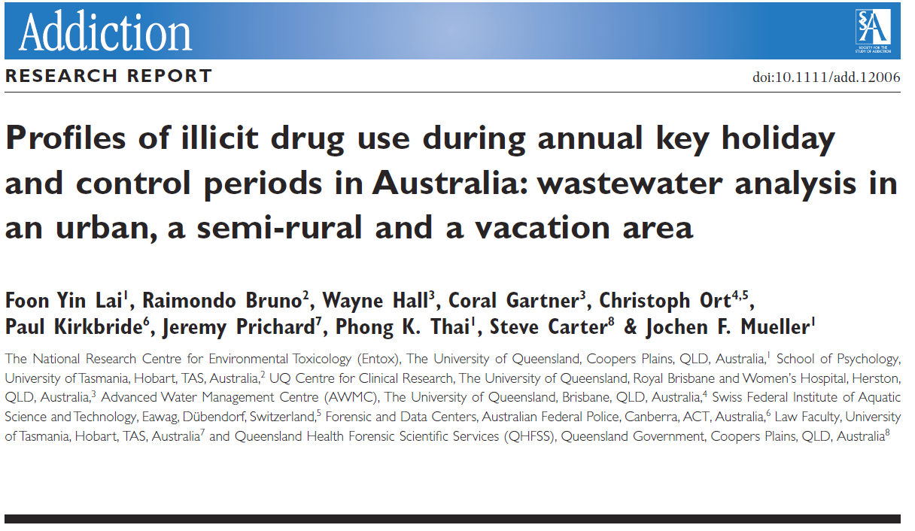
Three geographic locations
  Inland semi-rural area
  Coastal urban area
  Island holiday area
Two time periods
  Christmas/New Year Holidays (23/12-3/3)
  Control period (26/2-3/3)

Slide 12
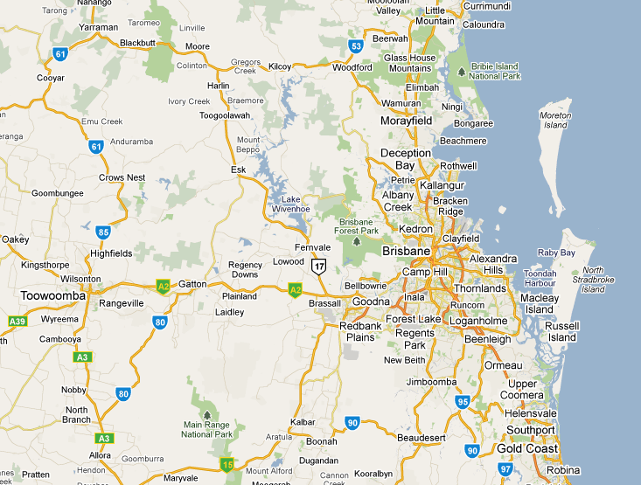
Spatial variation / musical event
D
23rd Dec 2010 – 4th Jan 2011
Musical events
Cocaine
Meth-
amphetamine
C
Vacation destination
B
Estimated consumption (mg/day/1000 people)
MDMA
THC
Semi-rural
A
Urban
Lai et al. preparing manuscript

Slide 13
Ethical Issues in Population Surveillance
Promising evidence for potential benefit in catchment areas of 100,000+
Consent is not an issue:
    Ethics committees do not require it
    Impossible to obtain it
Neither is privacy:
    Individuals are not identified
    No direct risk to individuals from study results
Ethics review committees have waived review
    But some critics uneasy

Slide 14
Ethical Issues in Population Surveillance
Possible adverse consequences of findings?
    Stigmatisation of residents of sampled areas?
    Economic consequences for businesses?
Arguably no more harmful than existing data
    surveys , police arrests or tabloid stories?
    better data on use may moderate claims
Strategies for mitigation:
    Anonymity in reporting study sites?
    Sampling only in areas with elevated drug use
    Researchers being clear about study limitations

Slide 15
Special Settings
Clubs, pubs, schools and workplaces etc
    Individuals not identified but fewer of them
Possible advantages?
    Less intrusive than other options
      Urinalyses, cell searches, drug dogs?
Possible disadvantages
    More variability in estimates
    Need many more fine-grained observations
Possible adverse consequences of findings
    Sampling likely to be resisted e.g. owners, unions
    Stigmatisation of patrons, residents of locales?

Slide 16
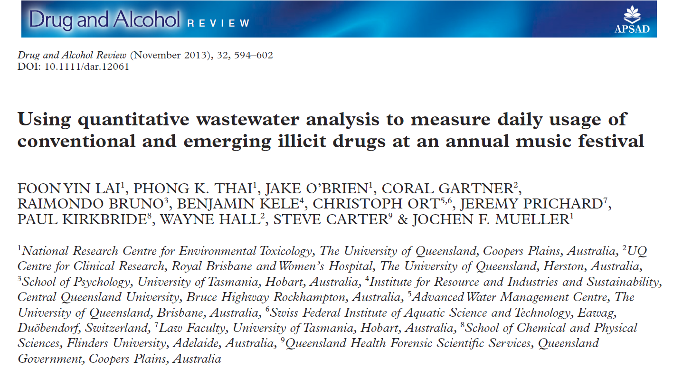
6 day annual music festival
2010 and 2011 festivals analysed
Cannabis, cocaine, methamphetamine, MDMA, Benzylpiperazine, mephedrone and methylone

Slide 17
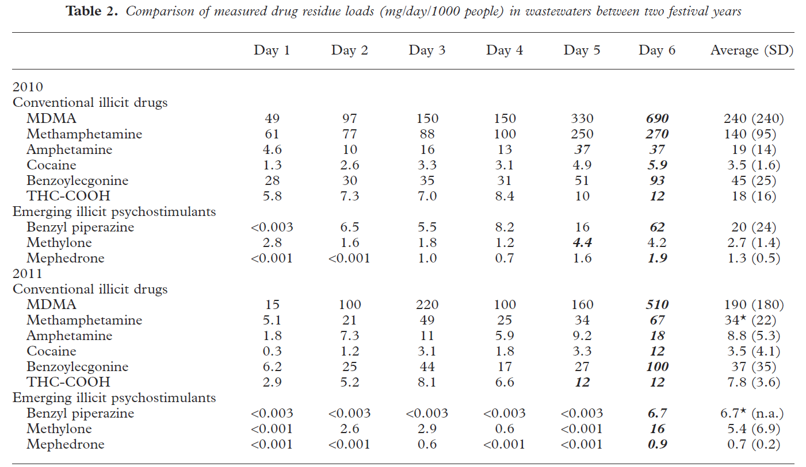
Fewer positive samples for emerging illicits in 2011 than 2010

Slide 18
WWA in Drug law Enforcement
Individual surveillance an unrealistic concern:
  Technical limitations of WWA
  Proving that X is the drug user
  WWA is resource and expertise intensive
  Overkill to use WWA to detect illicit drug use
  Drugs in possession much better evidence

Slide 19
Better uses of WWA
To estimate the size of illicit drug markets
    which drugs are most often used?
    time trends in their use
To identify new psychoactive substances & set LE priorities
    Which new drugs are being most widely used?
    Is their use increasing?
Monitor alcohol consumption:
    As an alternative to
      self-reported alcohol use and sales data
    Catchments covering entertainment precincts
    Time series with injuries, assaults and arrests

Slide 20
Conclusions
WWA is a promising method for monitoring
    population illicit drug use
    Emerging new psychoactive substances
    Alcohol use in population
    Possibly drug use in prisons
Technical issues to be solved
    Likely a very useful addition to survey methods
    A potentially important public health innovation
Ethical issues:
    Privacy and consent not major issues
    May be much less intrusive than some current methods
    Use in some settings requires more debate
      prisons, schools, workplaces

Slide 21
Acknowledgments
Environmental toxicology: Foon Yin Lai, Phong Thai, and Jochen Mueller
Sewage engineering: Christoph Ort
Environmental public health: Coral Gartner
Law: Jeremy Prichard
Forensic and legal toxicology: Paul Kirkbride
Epidemiology: Raimondo Bruno and Wayne Hall
Notes:
2

