Slide 1
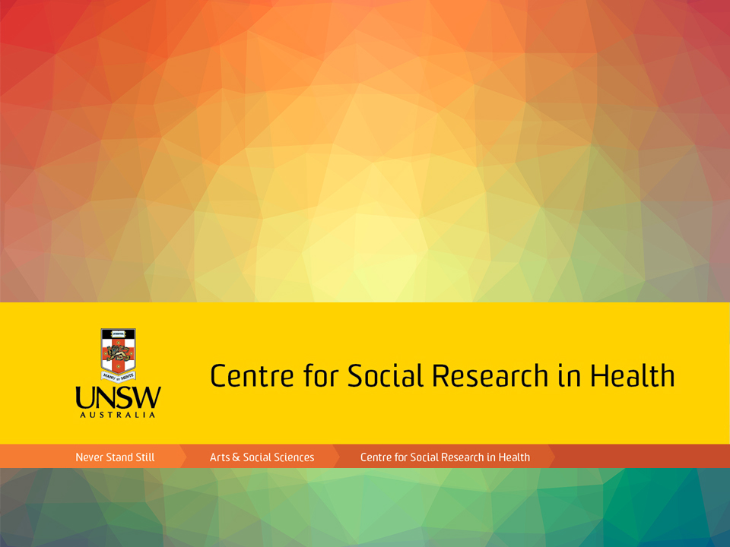
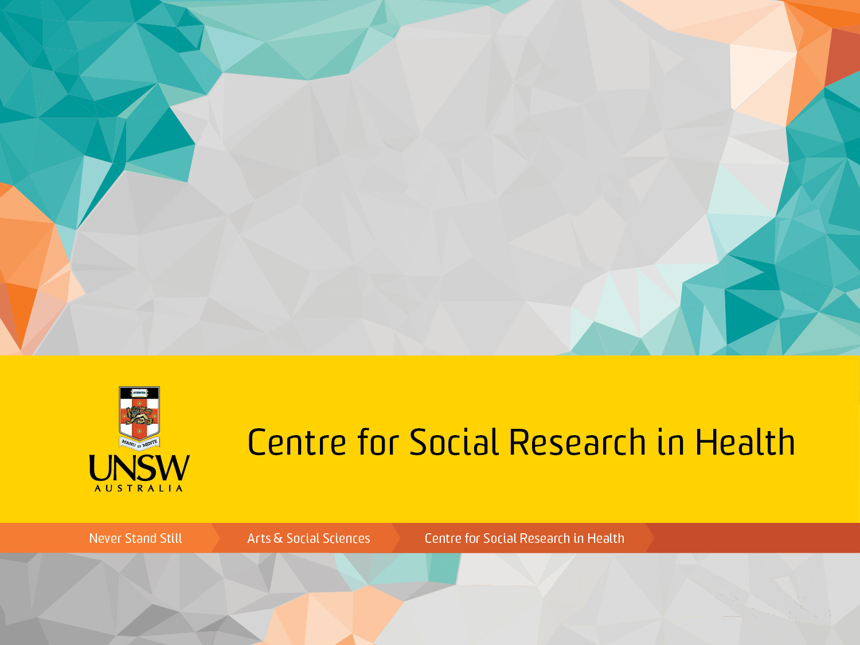

Slide 2
Housing, agency and luck in a qualitative study of men in the post-prison release period
Carla Treloar¹, Annie Madden¹, Eileen Baldry², Peter Higgs³, Paul Dietze⁴, Mark Stoove⁴
¹CSRH, UNSW
²SOSS, UNSW
³La Trobe University
⁴Burnet Institute

Slide 3
Transitions post-release
Complex intersection
Health
Social
Criminogenic factors
Drug use
High rates of drug use history among prisoners
High rates of recidivism
Issues beyond drug use
Physical and mental health
Housing – associations with return to prison
Other indicators of disadvantage – unemployment, debt
Need a sophisticated approach
Unpack trajectories
Inform responses

Slide 4
Methods design
Large NHMRC-funded project
Innovative design, positive deviance approach
Individual, social relationships, structural conditions
Qual data will also inform data linkages questions
 | Post-release housing status
Post-release drug use | Stable | Vulnerable | Transient
No use of illicit drugs | 10 | 10 | 10 | 30
Illicit drug use, no injecting | 10 | 10 | 10 | 30
Injecting drug use | 10 | 10 | 10 | 30
 | 30 | 30 | 30 | 90

Slide 5
This project
A qualitative pilot study, n=15
Piggy-back from PATH cohort
Men released from Victorian prisons
All with histories of injecting drug use
Recruited 2 weeks – 22 months post-release
Recruited from Melbourne metro

Slide 6
This project
Sample achieved
 | Post-release housing status
Post-release drug use | Stable | Vulnerable | Transient
No use of illicit drugs | 1 | 1 | 0 | 2
Illicit drug use, no injecting | 0 | 0 | 0 | 0
Injecting drug use | 4 | 5 | 4 | 13
 | 5 | 6 | 4 | 15

Slide 7
Preliminary findings
Release from prison can be overwhelming, an assault on all the senses, how to cope?
Like before I was out of prison, I spent the most of the last end of the sentence in the slot. So I got out from being locked down for 23 hours a day, to everything just … like my mum was driving at 60 km’s down the road leaving the prison and I was like holding onto the roof of the car and … Stop flying and that, “I’m doing the speed limit, it’s only 60km’s” … I was freaking out. It’s hard to just get thrown out into the real world. Even just walking through the city at the time, you know the commotion, I was freaking out. It was too much. Massive headache. And clean air there and then all of a sudden, all this pollution. … It’s probably why everyone ends back in. … They end up getting straight back into the drugs just to be able to adapt and then all of a sudden, before you know it they were doing the same shit they were before they went in. (#1, 35 years, last sentence 5 years, unstable housing)

Slide 8
Preliminary findings
Pre-release planning – absent, unhelpful
And when you were coming up for release from prison, did you find the prison services were helpful for planning your release or did you do that mostly yourself?
They were shit. I got fuck all help. I got [public transport pass] and my Medicare card.
So did you ask for help and not get it?
Yeah, they said “it’s being processed”, “it’s being processed”, but it never happened. (#10, 38 years, last sentence 11 months, living with partner)

Slide 9
Preliminary findings
Post-release services – absent, managed by “luck”
Yeah, but I had to organize the mental health worker myself. I’m lucky I’ve got a really good proactive parole officer, but she could turn around and say, “I don’t care”. Instead, she’s the one who got me the housing worker. I can sit down and talk to her about anything and we nut it out. She knows about my doctor. They even have care meetings, where it’s my parole officer, my mental health worker, my housing worker, my doctor, they all get together once a month and we are all on the right page here and yeah. (#3, 52 years, last sentence 12.5 years, sleeping on ex-partner’s couch)

Slide 10
Preliminary findings
Probation and parole – support vs pressure
What sort of support or help do you get from probation and parole?
Yeah, they call it support. I call it pressure. At first I didn’t think there was any support at all, but now that I’ve gotten to know my officer, it’s okay, she’s working with me now, she knows about my health, getting the cure for hepatitis. … Like if I wasn’t me, I’d be in prison, I would’ve been back in prison ages ago, because the way my parole, no one can handle this while working. I’ve been lucky too with family, with family friends, they know the situation, they’ll let me leave but in the end it didn’t work out. They say it’s all fine, but when you get a phone call, “you have to go do a urine now” and you’re the only one in the shop and you have to close the shop and they’re not making money and they can’t pay the wages, they just say “oh look I can’t do this”. (#12, 35 years, last sentence 3 years 3 months, living with partner)

Slide 11
Preliminary findings
The intersection of accommodation and drug use
I sort of knew I would find somewhere to stay, but the risk of using was increased by who I stayed with and there wasn’t pretty much anyone left you know from years ago that came back to me and then went away and then wanted to come back again, so I didn’t have too many places to go (#9, 47 years, last sentence 9 months, couch surfing)
If I stuff up, there’s a chance that she can just turn around and say, “pack your stuff and go home”, so that’s why I’m not doing drugs or I’m not going down that path. (#15, 32 years, last sentence 6 months, living with ex-partner and their children)

Slide 12
Preliminary findings
The intersection of accommodation and drug use
That’s the reason I stayed out so long, is I got housing through [a release support program] in jail. That was the last time. It wasn’t this time. They found me a house and I lived there for 5 years and because my housing was good, my life was good you know. Everything else fell into place. Then I [was physically attacked and my house was robbed] and things started to go a bit pear-shaped after that, I started using again and ended up in jail. (#10, 38 years, last sentence 11 months, living with a parent and girlfriend)
I went to [a supported accommodation service] from release, I was there for roughly about 8 weeks. I had an incident there … I ended up being on the streets for 6 days … in that 6-7 days I did use, my drug of choice is ice so you know, being so angry and frustrated … I did the 7 days, I did the binge thing, I did the drugs every day for 7 days (#13, 48 years, last sentence 4.5 years, living at supported accommodation)

Slide 13
Preliminary findings
Agency in making things happen, help but not help
once I got out and I was at my parents for the 4 days, I rang the jail back and asked them how do I go about getting accommodation now I’ve just been released from jail, they told me to go to [a particular block of housing flats] and it’s full of jail birds. Everyone who’s on parole just goes there. I just thought, “no, not happening”, so I ended up on the streets. (#6, 43 years, last sentence 2 years, homeless)

Slide 14
Other themes to explore
Masculinities, relationships
“Providers”, relationships with ex/partners and children (housing)
Cumulative disadvantage
Poverty, deprivation, exclusion, life course and stratification
Co-occur: produce deep social disadvantage
Multiple, interlocking social identities
individual reflect macro-level structural inequality
Complex support needs – left to CJ system to manage (or not)
Create a structural pathway to re-imprisonment

Slide 15
Other themes to explore
Systemic failures of support
Boundaries between services
“No one’s problem”, no coordination of multiple care needs
Individualises the problem, obscures structural
Transitions and drug use
Violence, unplanned housing moves, social dislocations
Drug use in prison b/c inadequate in-prison AOD programs
Visibility (homelessness) assoc with increased policing
Next steps
Beginning 3 year NHMRC grant to complete sample

Slide 16
Acknowledgements
Funding
UNSW Gold Star Award
Colleagues:
Paul Dietze, Mark Stoove, Eileen Baldry, Peter Higgs, Annie Madden, Lise Lafferty
PATH Cohort Study
Field work team at Burnet Institute
Participants

