Slide 1

Identifying policy options to prevent family violence and incarceration using longitudinal cohort and return-on investment data

Slide 2
Identifying policy options to prevent family violence and incarceration using longitudinal cohort and return-on investment data
Professor John W Toumbourou, PhD
Chair in Health Psychology
Faculty of Health
Deakin University Australia

Slide 3
Jessica A Heerde,
John W Toumbourou,
Sheryl A Hemphill,
Ha Le,
Todd I Herrenkohl
Richard F Catalano

Slide 4
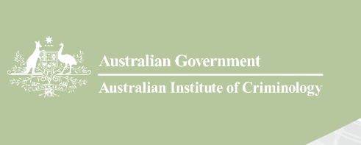
Data collection supported through grants from the National Institute on Drug Abuse (DA-012140-05), the Australian Research Council and the National Health and Medical Research Council.

Slide 5


Slide 6
Prison rates are rising in Victoria, Australia
Victorian prisoners aged 20 – 29
1232 0.0018 in 2004
1797 0.0021 in 2014
$750 Million for prisons 2014
Notes:
Notes

Slide 7
can we prevent crime without increasing incarceration rates?

Slide 8
what would be the effect of spending $150 M (20% of the prison budget) on prevention?

Slide 9
examined prevention effect of investing $150M in six strategies
Nurse Family Partnerships
Triple P Universal
Triple P Level 4 groups
Secondary School Age Alcohol Supply Reduction
Tutoring by Peers
Screening and Brief Intervention for young adult alcohol problems

Slide 10
FINDINGS
RETURN in 2015 if $150 M previously invested
4% reduction in incarceration and detention
3% reduction in intimate partner violence involving physical force
reductions would continue into future years
the net return from the $150 million investment would be conservatively estimated at $148 million

Slide 11
method

Slide 12
combined data from
a 13 year longitudinal study (N = 2,885 Victoria, Australia: International Youth Development Study)
  87% retention in 2015
  risk factor effects on incarceration and intimate partner violence
prevention return on investment estimates from the Washington State Institute of Public Policy
Notes:
Notes

Slide 13
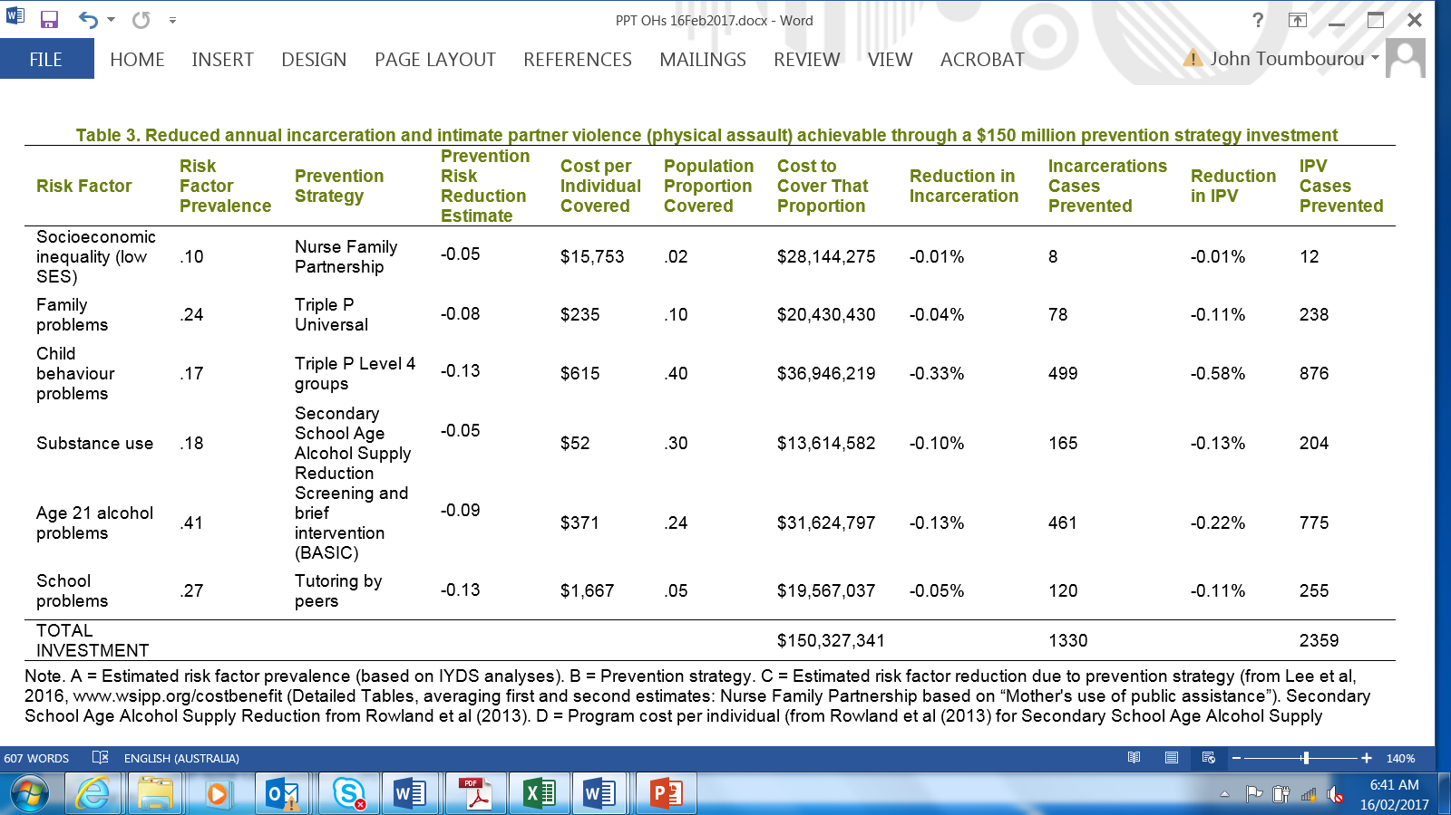

Slide 15
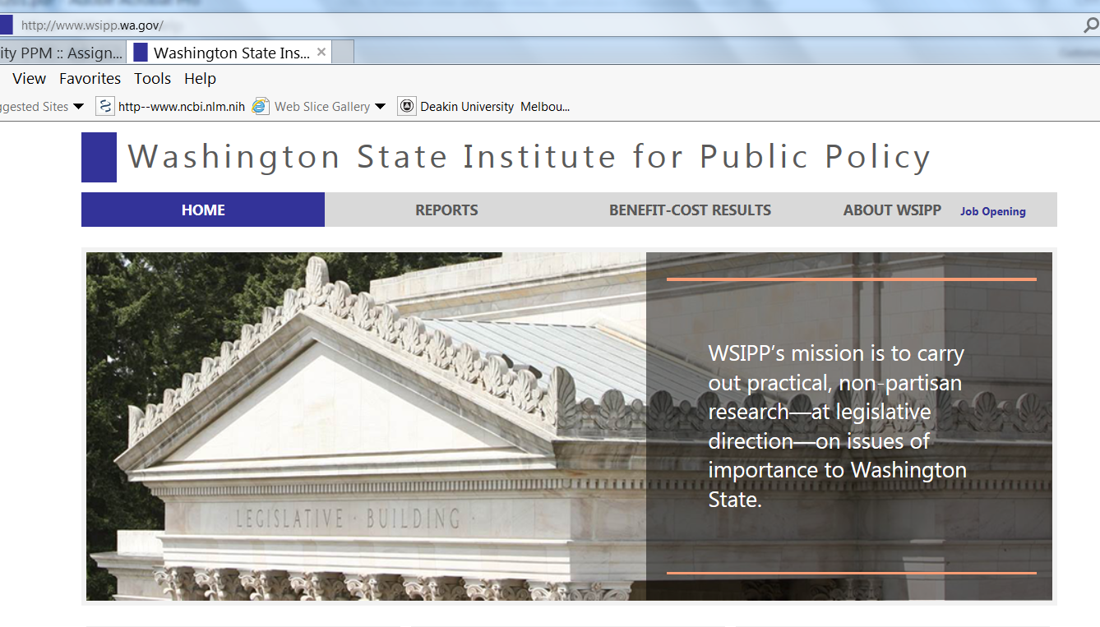
Stephanie Lee and colleagues

Slide 16
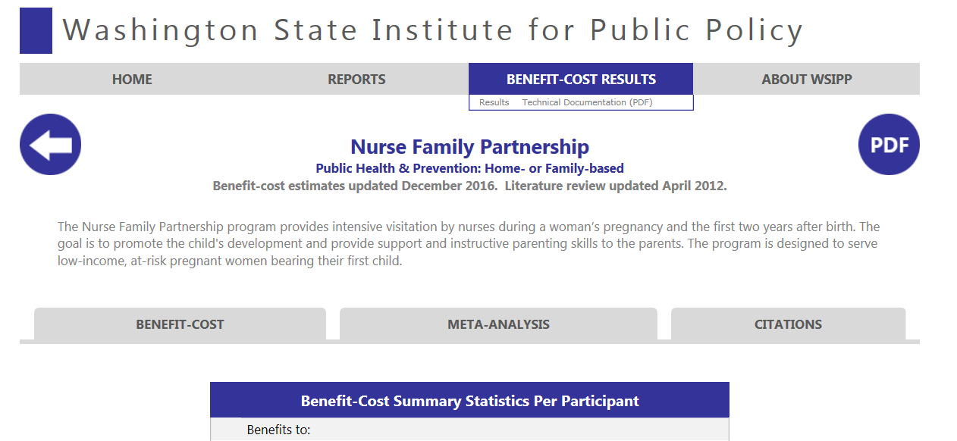

Slide 17
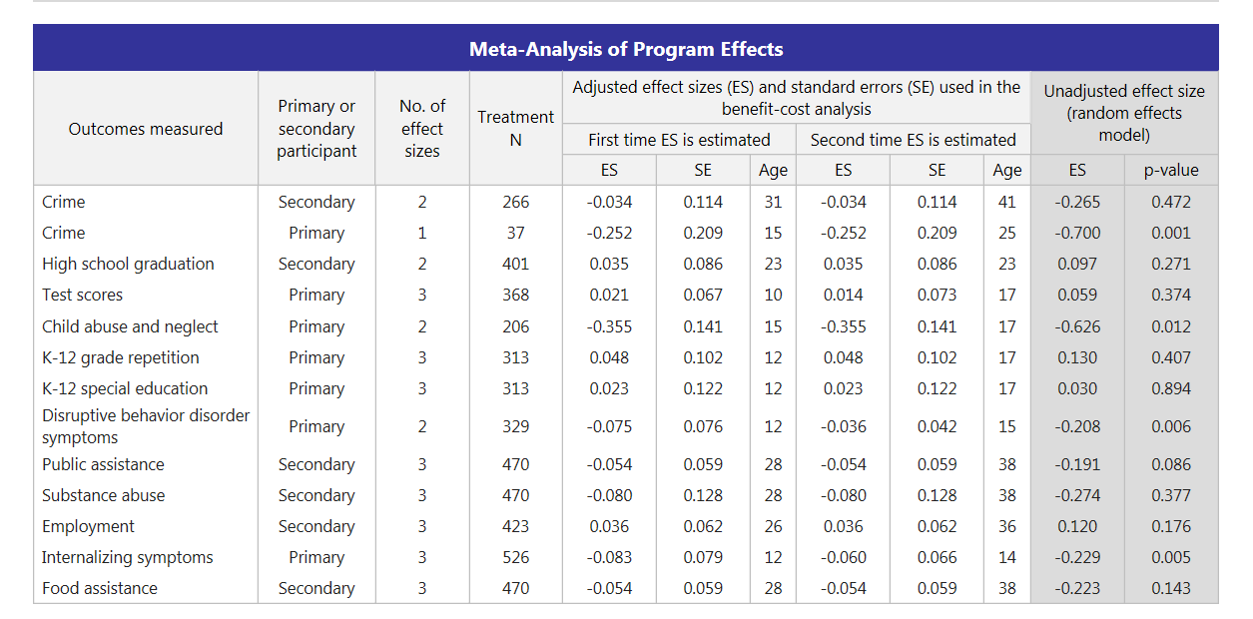

Slide 19
International Youth Development Study
In 2015 “What is the total amount of time you have been detained in a prison or a correctional facility in your lifetime?”
  .035 ever, .01 more than a day
In 2013 Conflict Tactics Scale assessed Intimate Partner Violence
  .085 physical force, 0.03 physical injury
Notes:
Notes

Slide 20
International Youth Development Study
Risk factors
Socioeconomic status (baseline parent report of education and income)
Age 15 report on the Communities That Care Survey of
  family environment
  child behaviour problems
  alcohol and drug use
  school attendance, exclusion
Notes:
Notes

Slide 21
International Youth Development Study
Age 21 report on
  Alcohol problems using AUDIT
Notes:
Notes

Slide 22
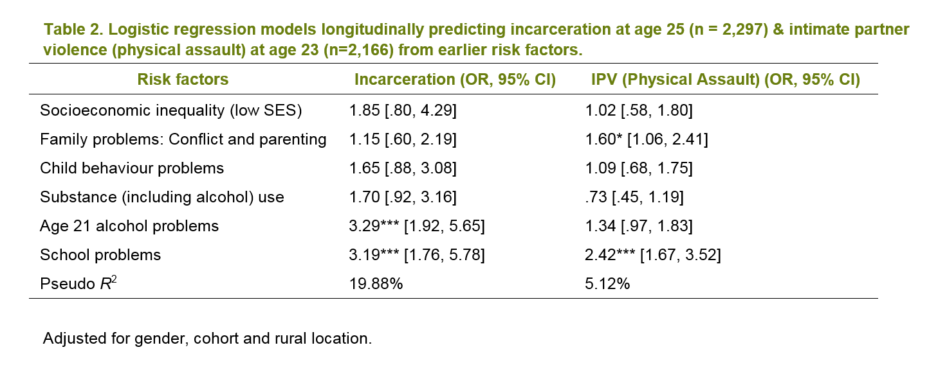

Slide 23
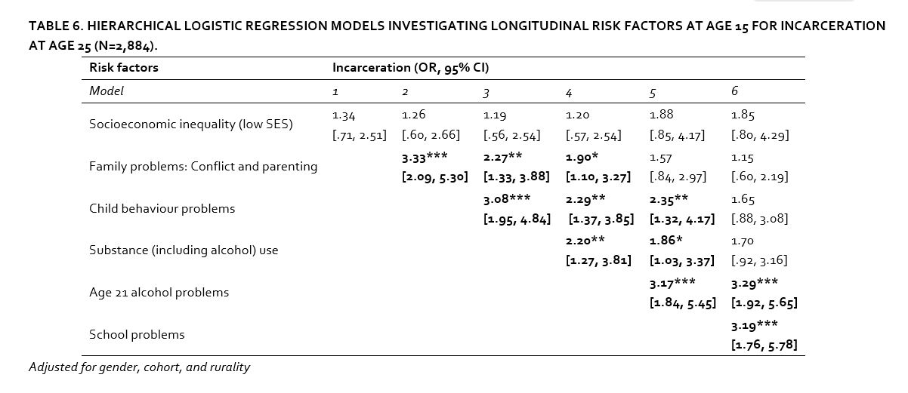

Slide 24
Percentage reduction in incarceration rate in at risk group after treatment. This was calculated as (E* R*PC) *100
where
E = Proportion covered by prevention strategy as in Table
R = the incarceration rate in the at risk group
= (K/((OR*A)+(1-A)))*OR)
where
K = the estimated population proportion incarcerated (0.035 from IYDS)
OR = the Odds Ratio estimated for the relevant risk factor (from IYDS Table),
A = the population proportion exposed to the risk factor (from Table).

Slide 25
Percentage reduction in incarceration rate in at risk group after treatment. This was calculated as (E* R*PC) *100
where
PC is calculated by transforming the Cox Effect Size to a percentage change (reported in Aos et al (2011, Technical Appendix 2, Page 10) using the formula ((EXP(C*1.65) * A) /
(1 - A + A * EXP(C*1.65)) / (A – 1)
where
A = the population proportion exposed to the risk factor (from Table)
C = Prevention Risk Reduction Estimate from WSIPP (as in Table)

Slide 26
For example we calculated the percentage reduction in the incarceration rate in the at risk group after treatment for those exposed to low SES = -0.01%
= (E*R*PC)*100
= (0.02*0.0597* -0.077)*100,
where
E = 0.02 (from Table)
R = 0.0597 =0.035/((1.85* 0.1)+(1-0.1)) * 1.85
PC = -0.077 = (EXP(-0.054*1.65)*0.10)/
(1-0.10+0.10*EXP(-0.054*1.65))/(0.10-1).

Slide 27
Number of incarcerations prevented in 2015.
Calculated using the formula H = A *G * P
where
A = the population proportion exposed to the risk factor (from Table).
G = Percentage reduction in incarceration rate in at risk group after treatment (described above).
P is the population of Victoria aged 20 to 29 (N = 870,686).
For the reduction in the number incarcerated for those exposed to low SES
= 8 = 0.10 x 870686 x -0.01.

Slide 29
RETURN in 2015 if $150 M previously invested
4% reduction in incarceration and detention (1,330 cases)
3% reduction in intimate partner violence involving physical force (2,359 cases
reductions would continue into future years
the net return from the $150 million investment would be conservatively estimated at $148 million
conservative estimates
could be tailored to be more efficient

