Slide 1
Bayesian Optimisation for Police Patrolling
Dr Roman Marchant
Centre for Translational Data Science
Sydney Institute of Criminology
14 February 2019
Applied Research in Crime and Justice Conference

Slide 2
Overview
Background
Predictive Policing
Why is uncertainty quantification important?
Modelling Spatial Temporal Phenomena
Bayesian Optimisation - Decision Making Under Uncertainty
Bayesian Optimisation for Police Patrolling
Current Developments

Slide 3
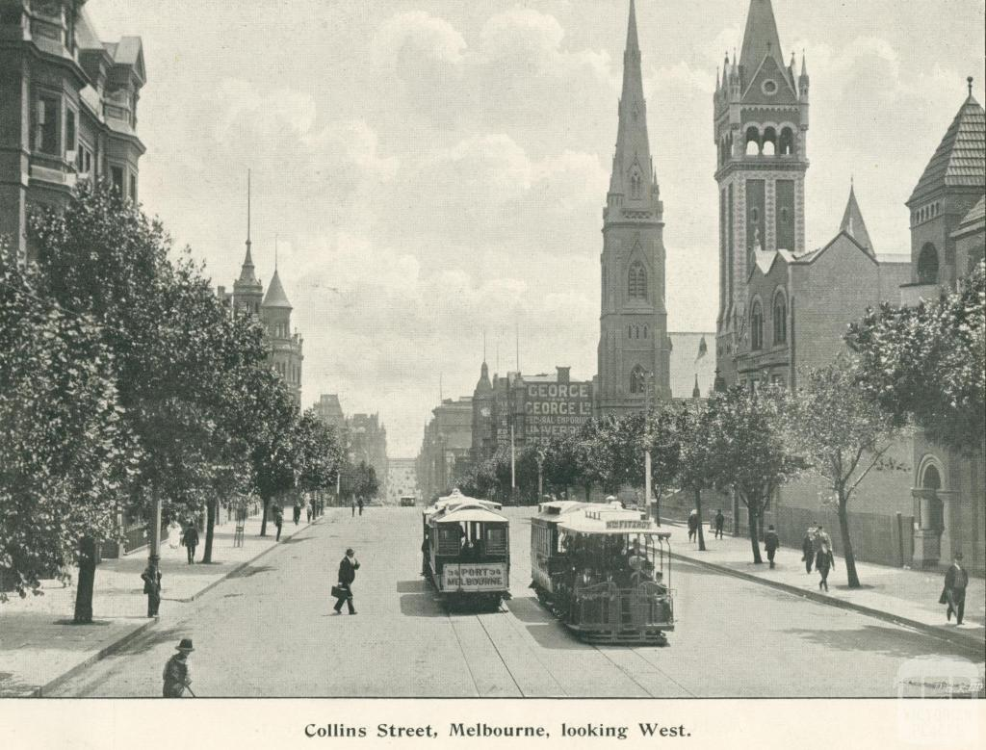
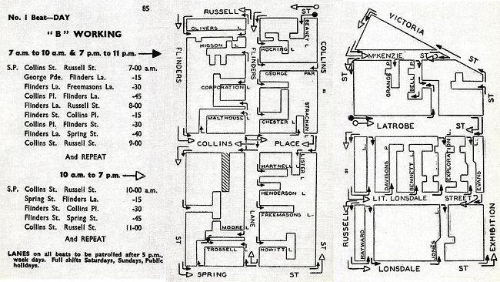
Predictive Policing
Uncovering and understanding patterns in criminal activity to
optimally allocate resources.
Dating back to early 1900’s
Police beat schedule, Melbourne

Slide 4

Literature Review
Spatial-Temporal Dynamic Hotspots
Hotspot-microareas
Gorr and Lee | Mohler et al.
Weisburd
Additional set of tools for proactive policing.
Self-Exciting Point Processes of Crime
Enhance, NOT replace.
Mohler 2011 & 2015
Fitzpatrick et al.
Runaway Feedback Loops in Predictive Policing
Ensign et al.

Slide 5
What if we assume the model is accurate and don’t quantify uncertainty?

Slide 6
Uncertainty Quantification
It is better to be imprecisely right than precisely wrong.
Quantification of uncertainty is crucial for achieving informed decisions.
Uncertainty can drive the process of data acquisition.
Uncertainty help understanding of risk and interpretability of quantitative models.

Slide 7
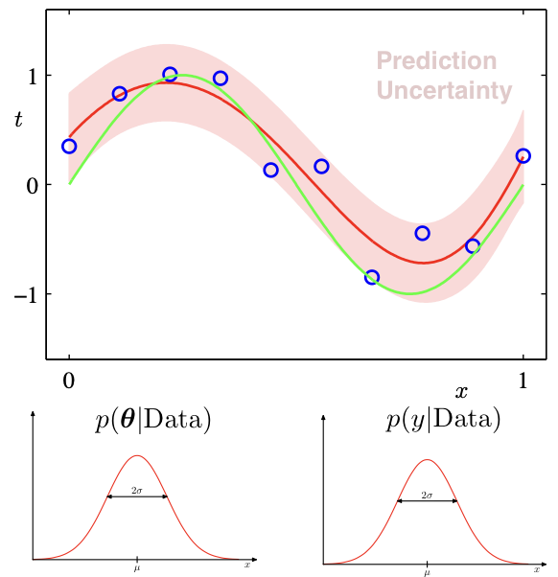

Uncertainty Quantification
Deterministic
Probabilistic
Noisy Data
Model
Fit
Ground
Truth

Slide 8
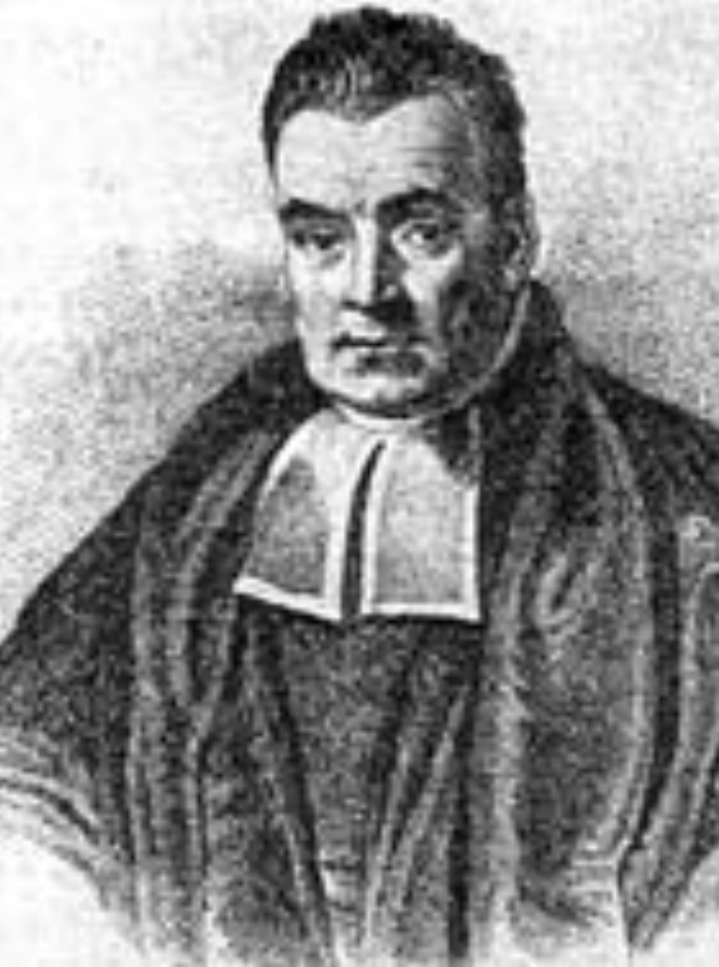






Bayes Theorem
*The data does not speak by itself.
Thomas Bayes
1701–1761
Likelihood
Prior
Posterior Distribution
(Inference)
Normalising Constant
Predictive Distribution
Summing over models.
(integrating over all possible model space)

Slide 9




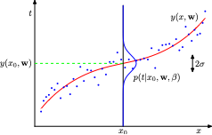







Gaussian Process Regression
, with
Noisy observations from the function
Observations Dataset
Predict the value of
Predictive
Posterior
Distribution
Mean
Variance
Log Marginal Likelihood

Slide 10
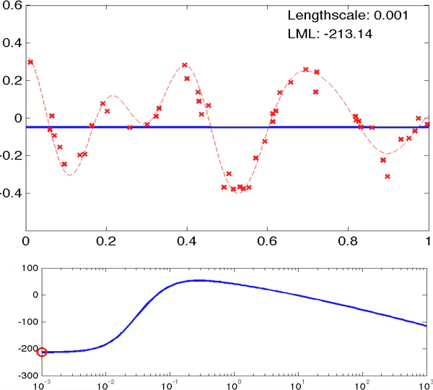


Gaussian Process Regression

Slide 11
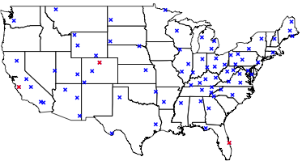

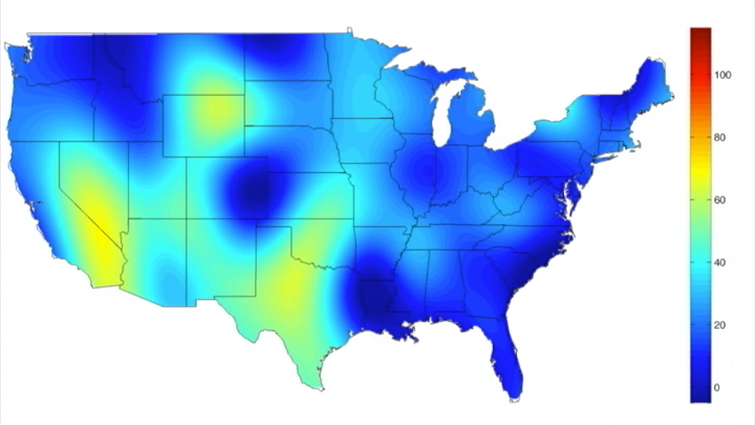
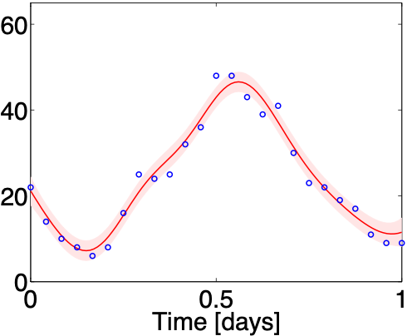
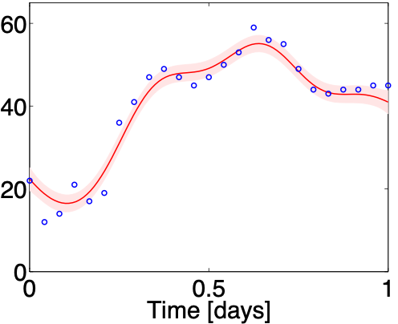
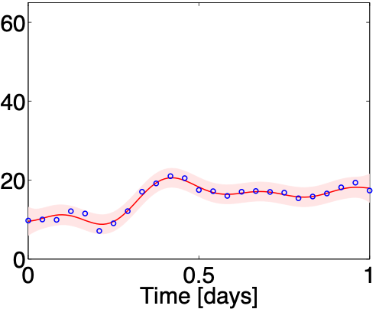
Space Time Gaussian Processes

Slide 12
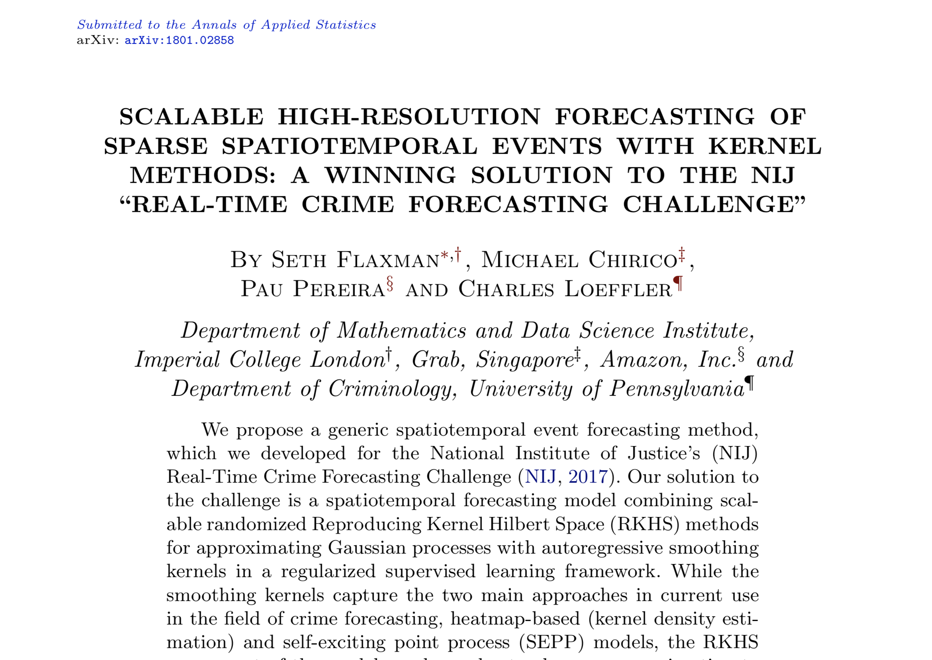
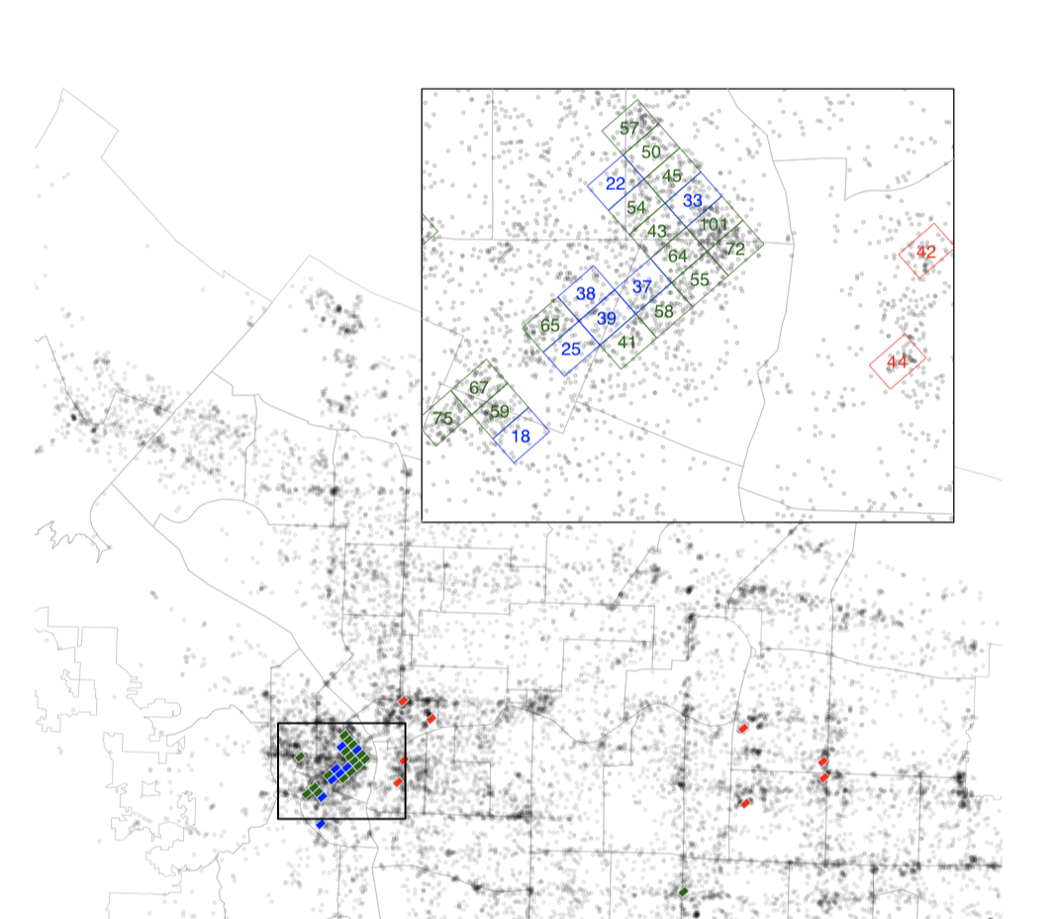
Space Time Gaussian Processes for Crime

Slide 13
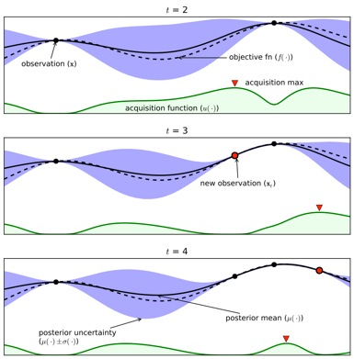
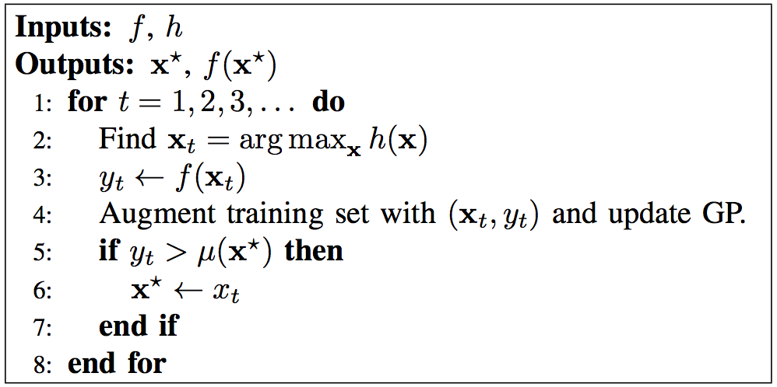
Background: Bayesian Optimisation
Find the maximum of an unknown, noisy and costly to evaluate function.
Key idea: Choose next sampling location x by maximising an acquisition function h over the domain of the GP model of the function.
Unknown Function
Acquisition Function
The acquisition function represents an expected reward for sampling at a certain location.
[Brochu, Cora, de Freitas 2010]

Slide 14
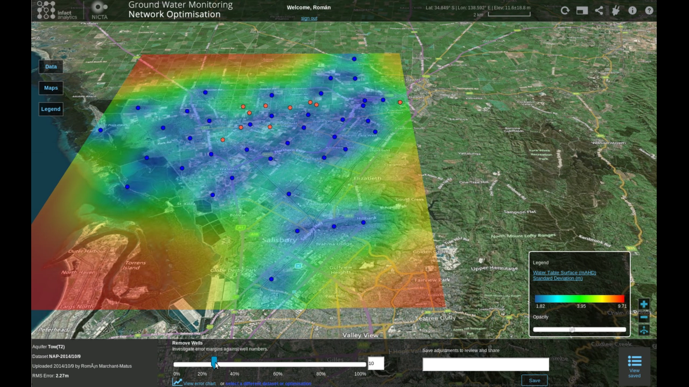
Ground Water Well Optimisation

Slide 15

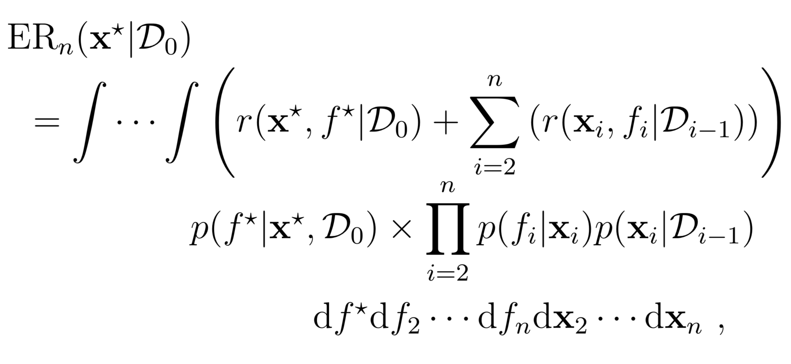
Sequential Bayesian Optimisation (SBO)
[Marchant and Ramos, UAI 2014]
Previous data
Candidate location
Output value
Reward
Notes:
Remember to explain what the variables are.

Slide 16

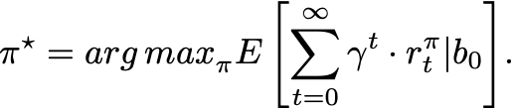
Partially Observable Markov Decision Process
Unified framework for sequential decision making under uncertainty when the state is not directly observable.
Fully represented by the tuple:
S : State space.
POMDPs places a probability distribution (or belief) over S , b(s).
A : Action space.
Full solution: find the policy , that maps belief space to actions, that results in maximising the expected reward.
T : Transition function.
R : Reward function.
Z : Observation space.
O : Observation function.

Slide 17
Monte Carlo Tree Search
An online solving for large POMDPs.
Efficient approximation using samples from full tree.
Only search over 'promising' parts of the tree.
Initial belief and side state.
(Best Child UCT)
(Expand)
Tree Policy
(Expand)
(Expand)
Default Policy
BackUp Reward

Slide 18
Bayesian Optimisation for Police Patrolling
Decision Making under Uncertainty

Slide 19

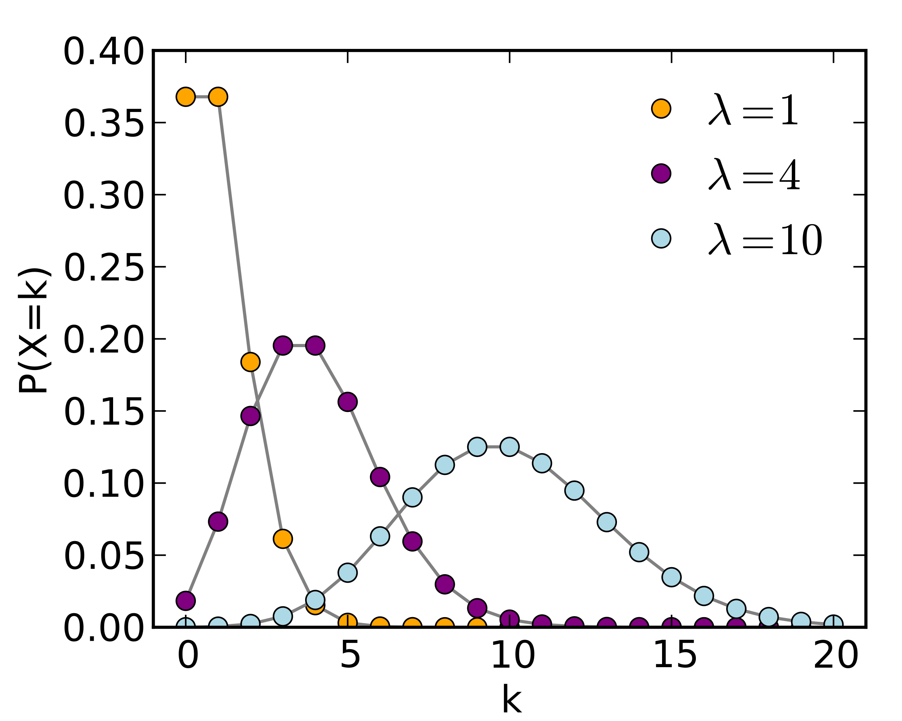

Counts of crime
Intensity function
Log-intensity
(Always Positive)
Poisson Distribution
Covariance or Kernel Function
Unknown parameters
Data
Variational Inference
Predicted intensity
Expected Value
Standard Deviation

Slide 20
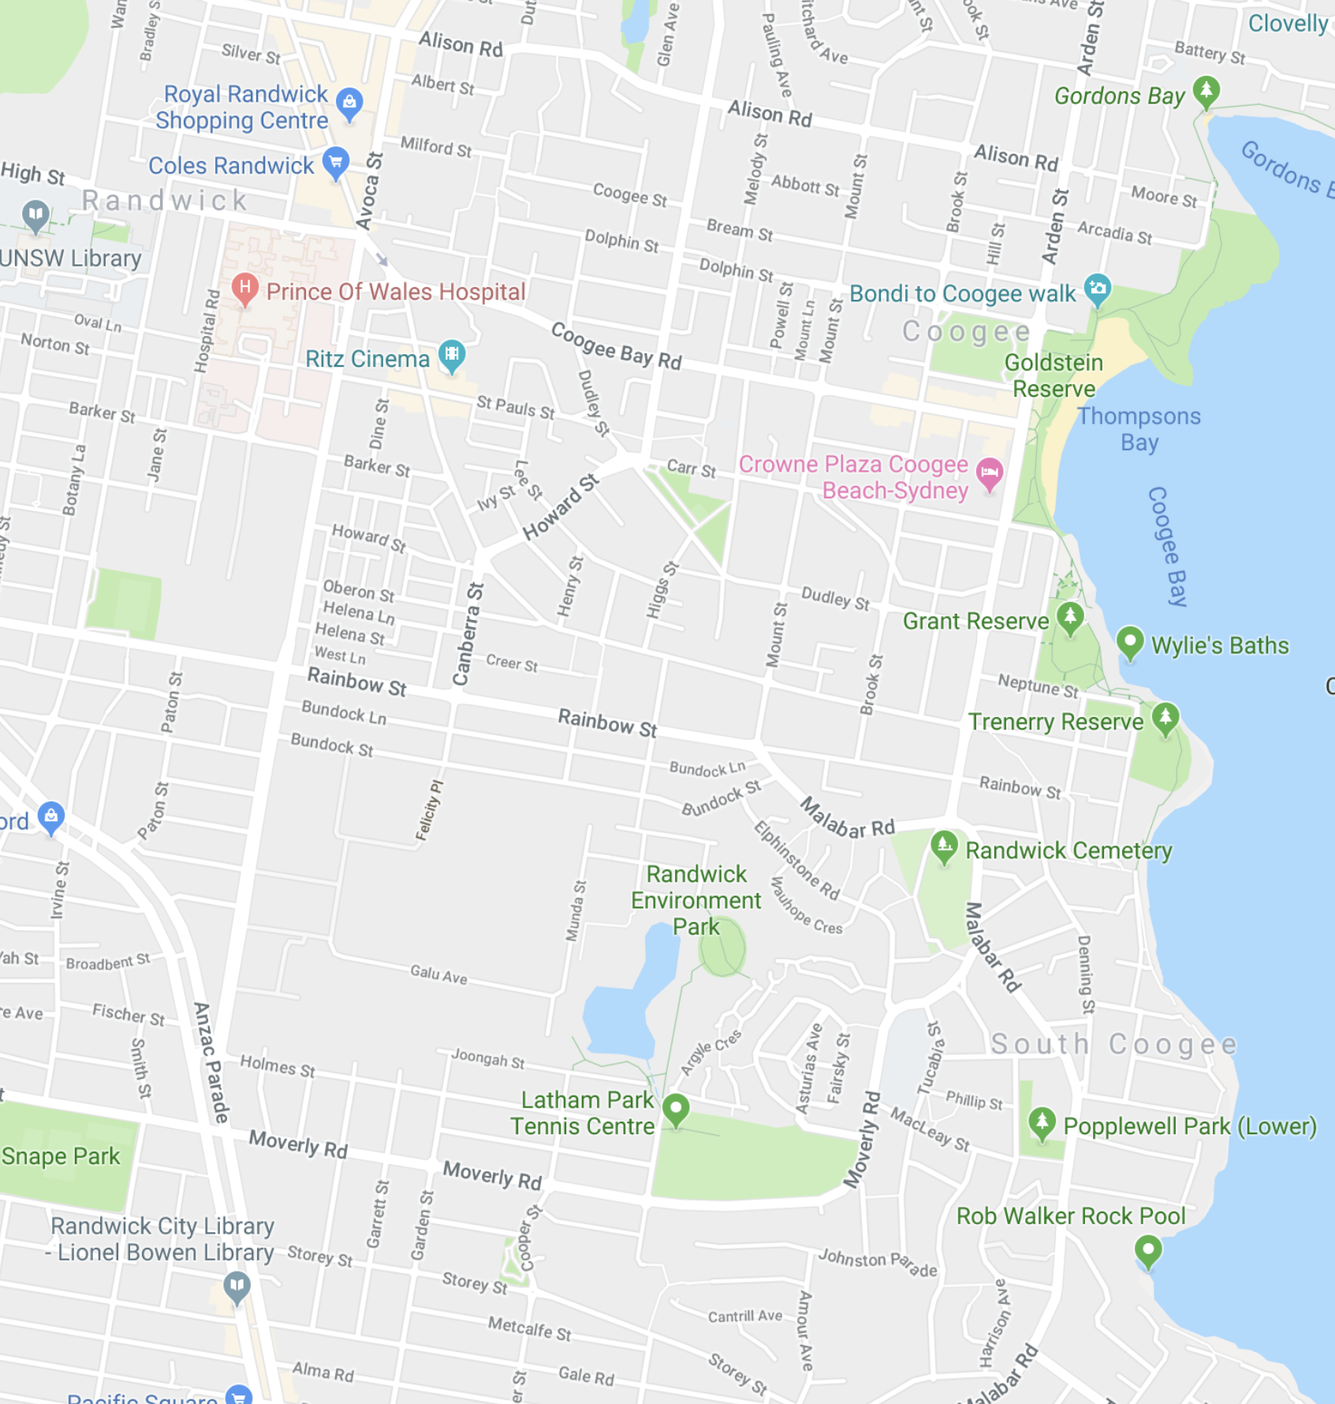

Decision Tree View
Map View
Reward
Exploration
Exploitation
Tradeoff-parameter
Backpropagate
Reward
Simulated Reward
Maximum Simulation Length

Slide 21
Decision Tree View
Map View
Backpropagate
Reward
Simulated Reward
Maximum Simulation Length

Slide 22
Decision Tree View
Map View
Backpropagate
Reward
Simulated Reward
Maximum Simulation Length

Slide 23
After MANY iterations

Slide 24
Decision Tree View
Map View
Pick the immediate decision with the highest accumulated reward.

Slide 25
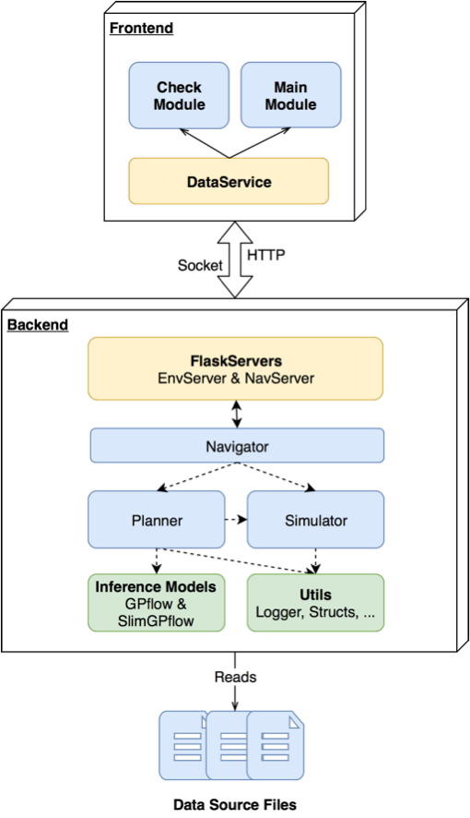
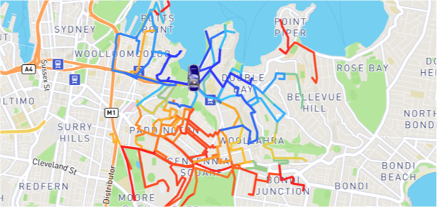
Implementation details
Schematic Diagram
Extract of COPS database 15 years worth of crime data.
One crime type: Domestic Violence Related Assaults
Grid Size: 400 [m]
Depth 5: 59,000 possible actions every timestep

Slide 26
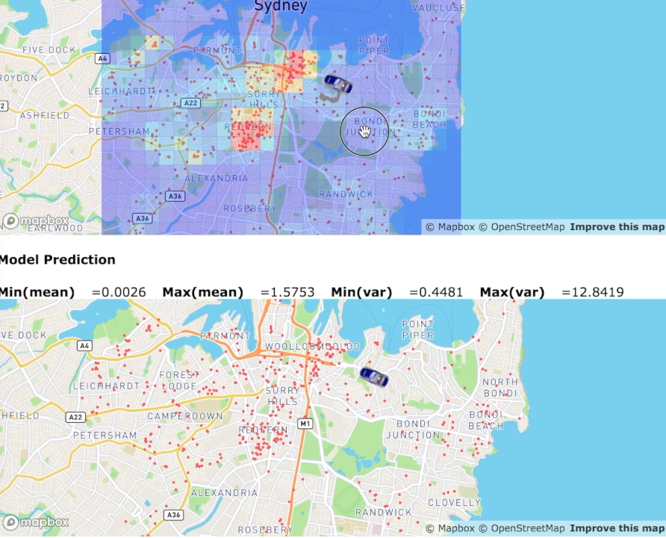
Example of Patrolling Path

Slide 27
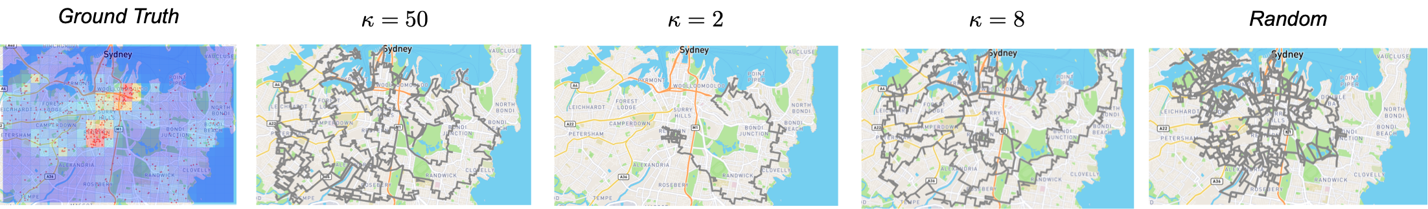
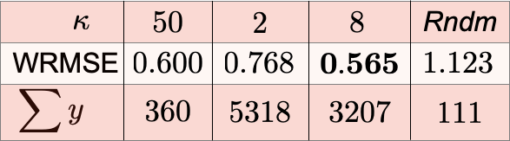
Evaluation

Slide 28
Strengths and Limitations
So, why haven’t we conducted randomised control trials yet?
Grid size dependence.
Evidence based decision making.
One model per crime type.
Uncertainty quantification.
Multiple and varied patrolling units.
Non-myopic sequential decisions.
No interaction between police presence and crime intensity.
Explicit trade off between exploration and exploitation.
Reported vs Discovered crime.
Uncover spatial temporal patterns.
Needs computer cluster.

Slide 29
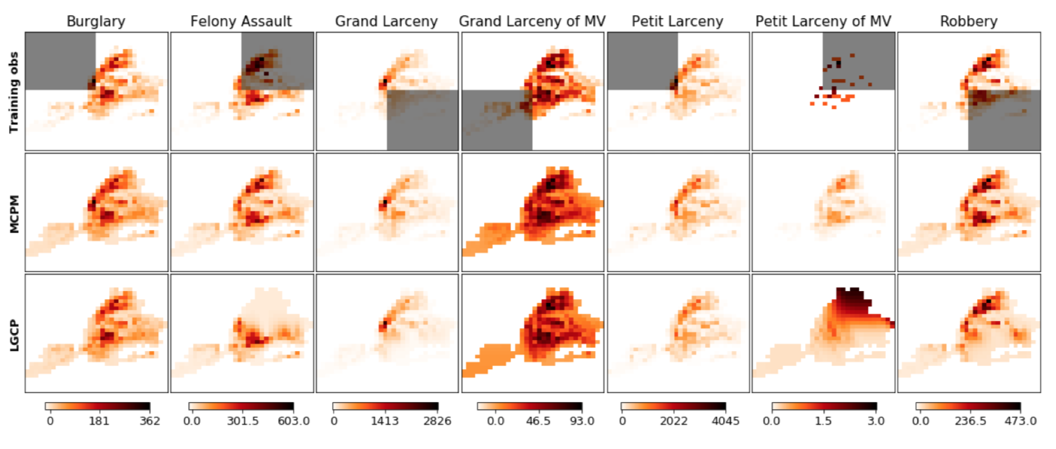


Multi-output Gaussian Process Model

Slide 30
Thanks!
Questions?
Roman Marchant
roman.marchant@sydney.edu.au
Centre for Translational Data Science
Sydney Institute of Criminology

