Slide 1
Does administrative data predict which
young people have justice contact?
A first look from a birth cohort study using
the NSW Human Services Dataset
Min-Taec Kim and Fan Cheng

Slide 2
Acknowledgement of Country

Slide 3
Context

Slide 4
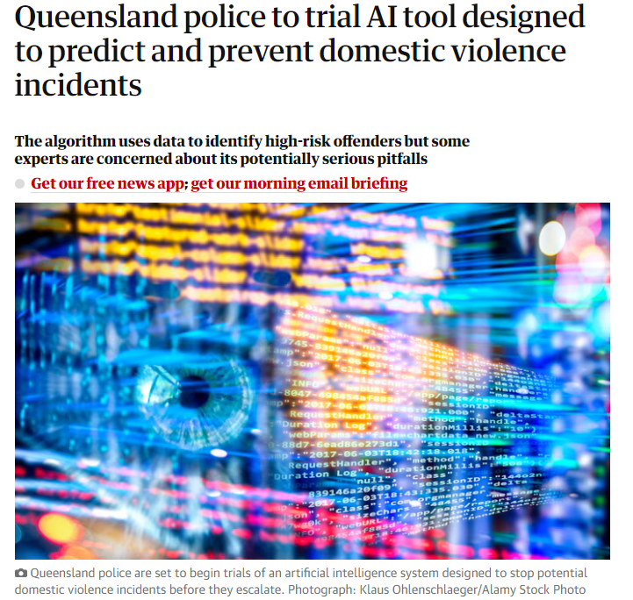
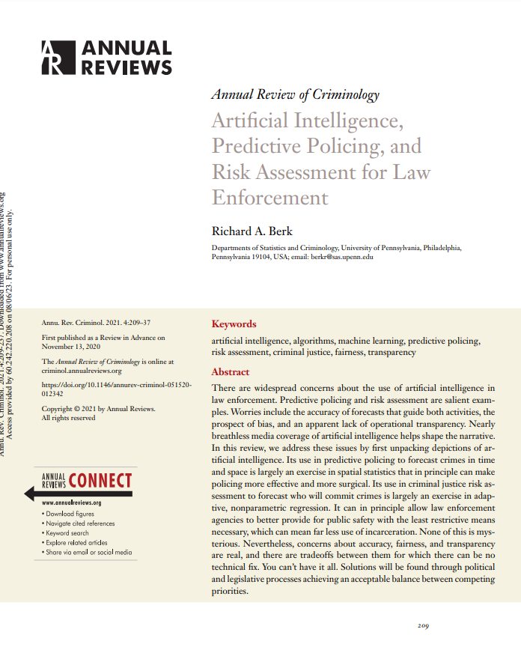
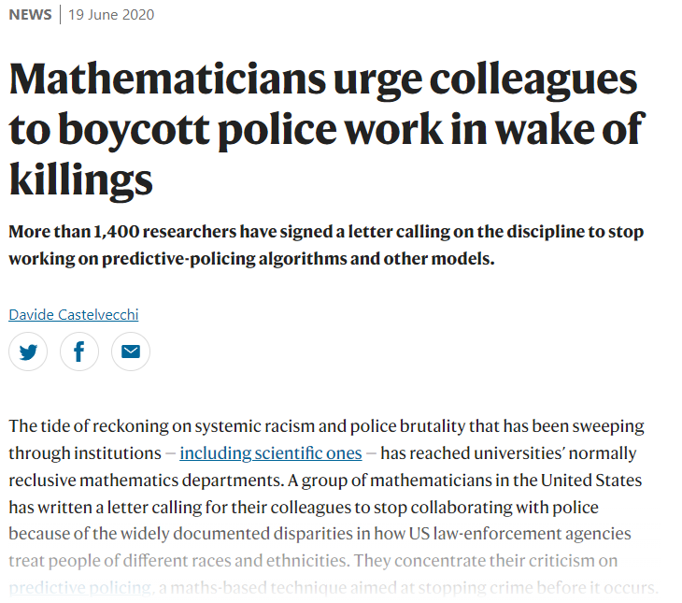
Policy makers are increasingly interested in using predictive models to target policies, in the belief that they can significantly overcome existing issues
Potential benefits
Potentially able to increase the impact and/or cost-efficiency of existing programs
Can make decisions quickly, consistently and with more confidence
Enable new types of interventions
Replace existing methods that are much less ‘data driven’
Potential issues
Concern about ‘algorithmic bias‘
Concern that these models are self-fulfilling and create unpredictable feedback loops
In justice, discussed largely in the context of predictive policing in the US
Boycott of working with police by US academics - 'It is simply too easy to create a "scientific" veneer for racism.'

Slide 5
Policy makers are increasingly interested in using predictive models to target policies, in the belief that they can significantly overcome existing issues

Slide 6
Policy makers are increasingly interested in using predictive models to target policies, in the belief that they can significantly overcome existing issues
With these perpetrators, we will not wait for a triple-zero phone call and for a domestic and family violence incident to reach the point of crisis,” acting Supt Ben Martain said.
“Rather, with this cohort of perpetrators, who our predictive analytical tools tell us are most likely to escalate into further DFV offending, we are proactively knocking on doors without any call for service.”
-Queensland police to trial AI tool designed to predict and prevent domestic violence incidents (2021)

Slide 7
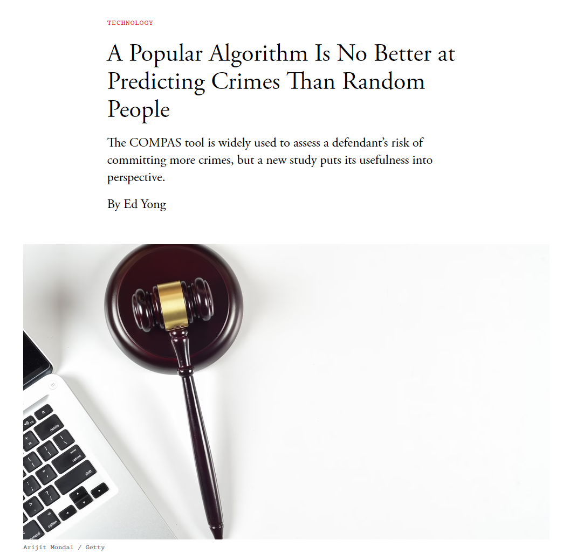
Understanding the properties of these models in practice may be of interest to policy makers, but these are often proprietary or otherwise kept private

Slide 8
Understanding the properties of these models in practice may be of interest to policy makers, but these are often proprietary or otherwise kept private
“If you are young and have a lot of prior convictions, you are high-risk,” says Farid. “It’s kind of obvious.”

Slide 9
Understanding the properties of these models in practice may be of interest to policy makers, but these are often proprietary or otherwise kept private
… instead of being a criticism of the COMPAS assessment, [this study] actually adds to a growing number of independent studies that have confirmed that COMPAS achieves good predictability and matches the increasingly accepted AUC standard of 0.70 for well-designed risk assessment tools used in criminal justice.
- Response from Equivant

Slide 10
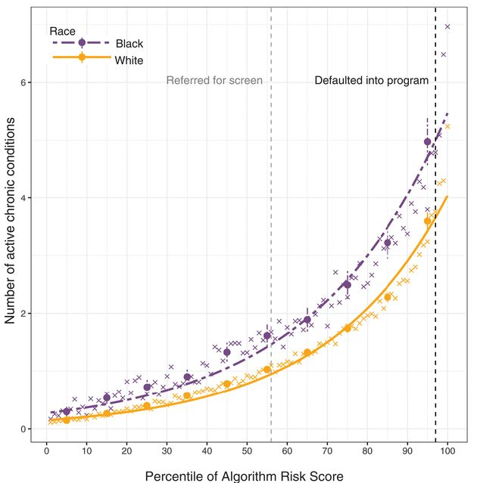
Understanding the properties of these models in practice may be of interest to policy makers, but these are often proprietary or otherwise kept private
Notes:
12.3-> 17.7 -> 46.5

Slide 11
Understanding the properties of these models in practice may be of interest to policy makers, but these are often proprietary or otherwise kept private
Empirical investigations of algorithmic bias, though, have been hindered by a key constraint: Algorithms deployed on large scales are typically proprietary, making it difficult for independent researchers to dissect them.
…
Without an algorithm’s training data, objective function, and prediction methodology, we can only guess as to the actual mechanisms for the important algorithmic disparities that arise.
- Obermeyer, Powers, Vogeli & Mullainathan (2019)
Notes:
12.3-> 17.7 -> 46.5

Slide 12
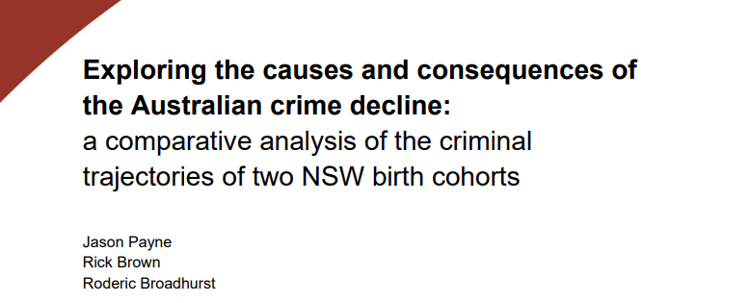
Understanding the properties of these models in practice may be of interest to policy makers, but these are often proprietary or otherwise kept private
Data on a limited cohort:
those who have already had contact with the justice system
those engaged with a specific service
a representative sample from a specific data collection
Data on a subset of predictors:
Often getting a large cohort comes at the cost of being able to get a rich set of predictors
Data at a point in time:
May be significant differences in the performance of the model at different ages for different cohorts

Slide 13
The purpose of this work is to build an accurate, transparent model using modern methods to predict first justice contact - in order to interrogate it
How accurate are the predictions of the model?
What variables drive the predictions of the model?
How does the performance of the model differ by group?
Does a model constructed using a significantly larger data-set and machine learning methods result in a giant leap in accuracy?
What information is available and useful for prediction?
How does this change as individuals get older?
Is the model more accurate for different groups?
Does the model create more ‘false alarms’

Slide 14
Our study

Slide 15
We build models to predict who will have contact with the CJS system by the age of 18, at every age from 0 to 18
Outcome: Do they have a caution, youth justice conference or court appearance before 18?
Model 1: Data at birth
Model 2: Data until 5
Model 3: Data until 10
Model 4: Data until 15
-10
Birth
5
10
15
18
Our predictors only include information that would have been available at each age
e.g., we do not use hospital admissions that happen at 8 years old if we are predicting from age 5, but we do at age 10
Once an individual has contact with the criminal justice system, they are dropped from the analysis
Age 10 is the first age where individuals have contact

Slide 16
We have built models using a machine learning algorithm to predict first justice contact - in order to interrogate it
Evaluate the performance of the model (accuracy, AUC, recall, sensitivity)
Clean and organise NSW HSDS, with correct cut-off date
Train gradient boosted tree model implemented using xgboost
Show which variables the model is using by calculating SHAP values
Evaluate the performance of the model by Aboriginality
Why a gradient boosted model (xgboost)?
Handles variable selection / functional form
Robust to a number of common data issues
Allows us to take a ‘data-driven’ approach e.g. reduce ‘researcher degrees of freedom’
Has been shown in a number of studies (e.g. Campedelli 2022) to be the most effective approach for similar prediction problems
Technical details you might be interested in:
We split our data-set 80:20 into a training set and a testing set, after sorting by birth month.
5-fold Monte Carlo cross-validation using an ANOVA grid-search to tune all hyperparameters of the model
The testing set is only used for calculating our model metrics and is a 'true' hold-out set.

Slide 17
We use the NSW HSDS - data from 60 services across 10 agencies for all 259,398 people born in NSW (and their parents) between 1998-2000
The NSW Human Services Data Set has linked information on:
27 years of data, with over 7 million records across NSW Government
60 services across 10 NSW government agencies
Due to the breadth of data sources used, there are serious gaps in data reliability and availability.
Births, Deaths, Marriages: Deaths, Demographic information, Jobs of parents
Family and Community Services: Out of Home Care, Child Protection, Homelessness, Public Housing
Health: Admitted Patient, Emergency, Mental Health Ambulatory, Perinatal, Alcohol and Drug
Justice: Legal Aid, Custody, Reoffending database
Education: NAPLAN, Suspensions, School attended (and attached information)
Police: Victimisation reports

Slide 18
We use the NSW HSDS - data from 60 services across 10 agencies for all 259,398 people born in NSW (and their parents) between 1998-2000
Our study uses:
259,398 people born in NSW between Jan 1998 and Dec 2000 (and their parents)
343 predictors (150ish ‘variables’)
Aboriginality constructed using information across datasets, using 2+ rule (Chan 2023, unpublished).
Births, Deaths, Marriages: Deaths, Demographic information, Jobs of parents
Family and Community Services: Out of Home Care, Child Protection, Homelessness, Public Housing
Health: Admitted Patient, Emergency, Mental Health Ambulatory, Perinatal, Alcohol and Drug
Justice: Legal Aid, Custody, Reoffending database
This dataset does not include:
Income / wealth / welfare payments
Pre-school / child care
MBS / PBS / Community Health
Education: NAPLAN, Suspensions, School attended (and attached information)
Police: Victimisation reports

Slide 19
Results

Slide 20
Our model to predict first contact with criminal justice performs well, but is less impressive than high level metrics might suggest

Slide 21
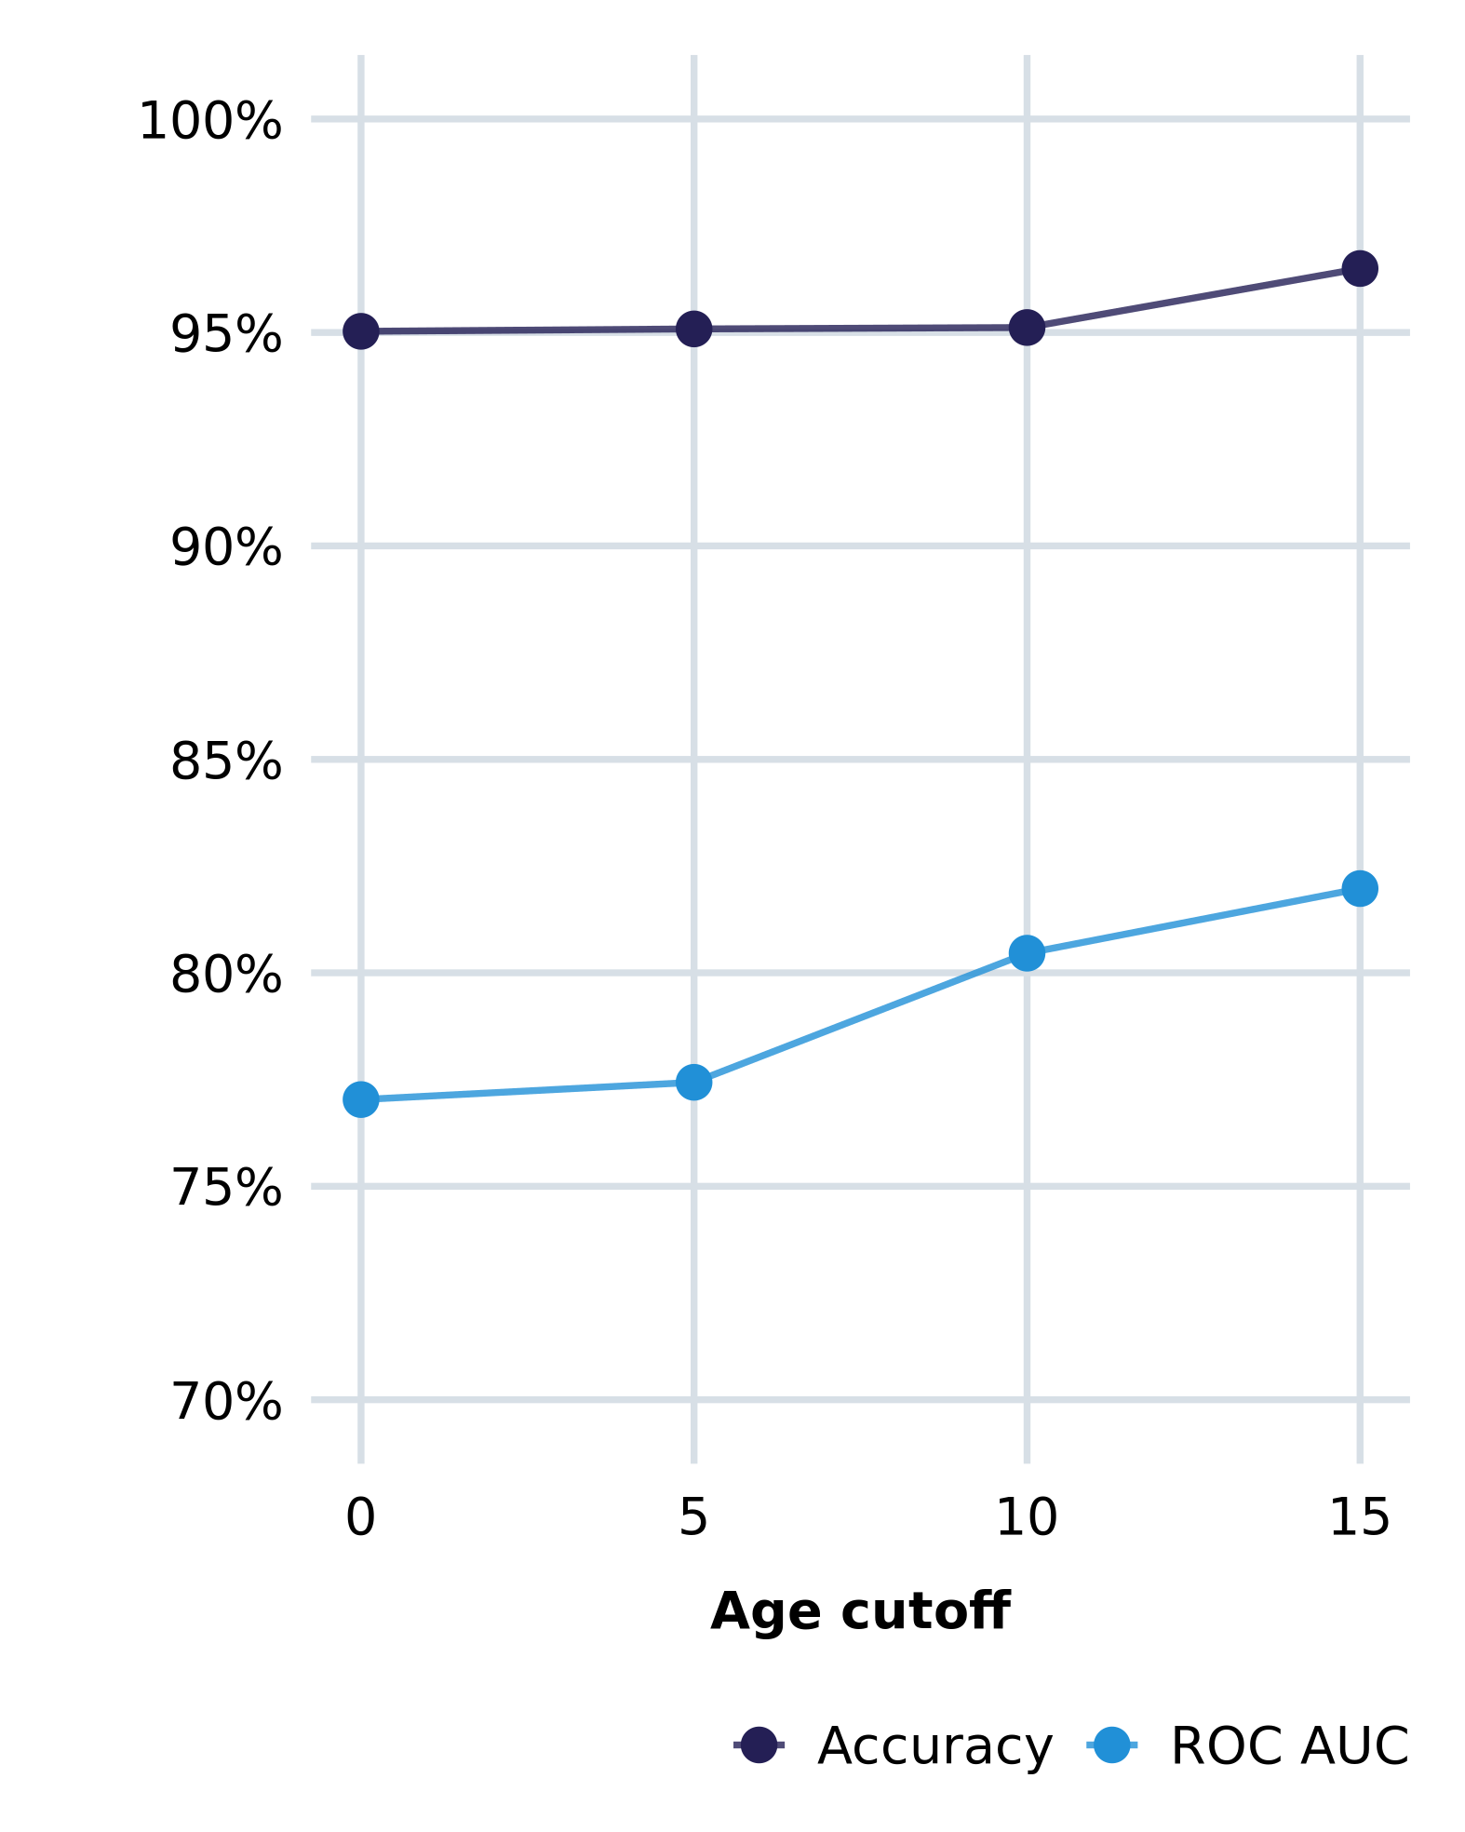
We can correctly predict whether an individual will have criminal justice contact by 18 for 95% of people, but this is less impressive than it seems
Reasons to believe the model performs well:
Our model performs well in an absolute sense
Approximately 95% accuracy
ROC AUC rises from 0.77 to 0.82
Our model performs as well (if not better) than others documented in the literature
Travaini et al (2022) find an average score of 81% accuracy and 0.74 AUC, but across very different recidivism prediction tasks
The model achieves this without the most predictive variables in the literature
By construction, the model does not predict using age or priors

Slide 22
We can correctly predict whether an individual will have criminal justice contact by 18 for 95% of people, but this is less impressive than it seems
Reasons to believe the model performs well:
Our model performs well in an absolute sense
Approximately 95% accuracy
ROC AUC rises from 0.77 to 0.82
Our model performs as well (if not better) than others documented in the literature
Travaini et al (2022) find an average score of 81% accuracy and 0.74 AUC, but across very different recidivism prediction tasks
The model achieves this without the most predictive variables in the literature
By construction, the model does not predict using age or priors
‘increasingly accepted standard’

Slide 23
We can correctly predict whether an individual will have criminal justice contact by 18 for 95% of people, but this is less impressive than it seems
Reasons to be skeptical:
Although 95% accuracy may seem high, our model barely outperforms a ‘naïve’ model that guesses that nobody will have criminal justice contact can achieve a 94.9% accuracy
‘increasingly accepted standard’

Slide 24
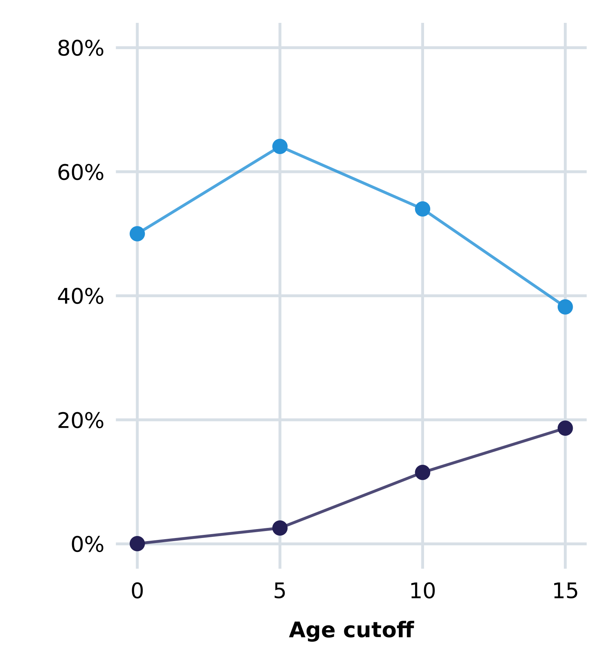
Our model is less accurate when considering those who eventually have contact with the criminal justice system, or the proportion we correctly ‘detect’
Reasons to be skeptical:
Model is much less effective when considering the group we care more about – those at high risk
38-64% of those predicted to have criminal justice contact go on to have criminal justice contact
The model is unable to meaningfully detect any individuals who will go on to have contact at birth, but improves as we accrue more information about the individual
Still only captures 20% at best
Can increase precision arbitrarily by reducing recall and vice versa, but this has flow-on impacts on accuracy and bias

Slide 25
The strongest predictors of first contact with criminal justice change as individuals get older, and more relevant data accrues

Slide 26
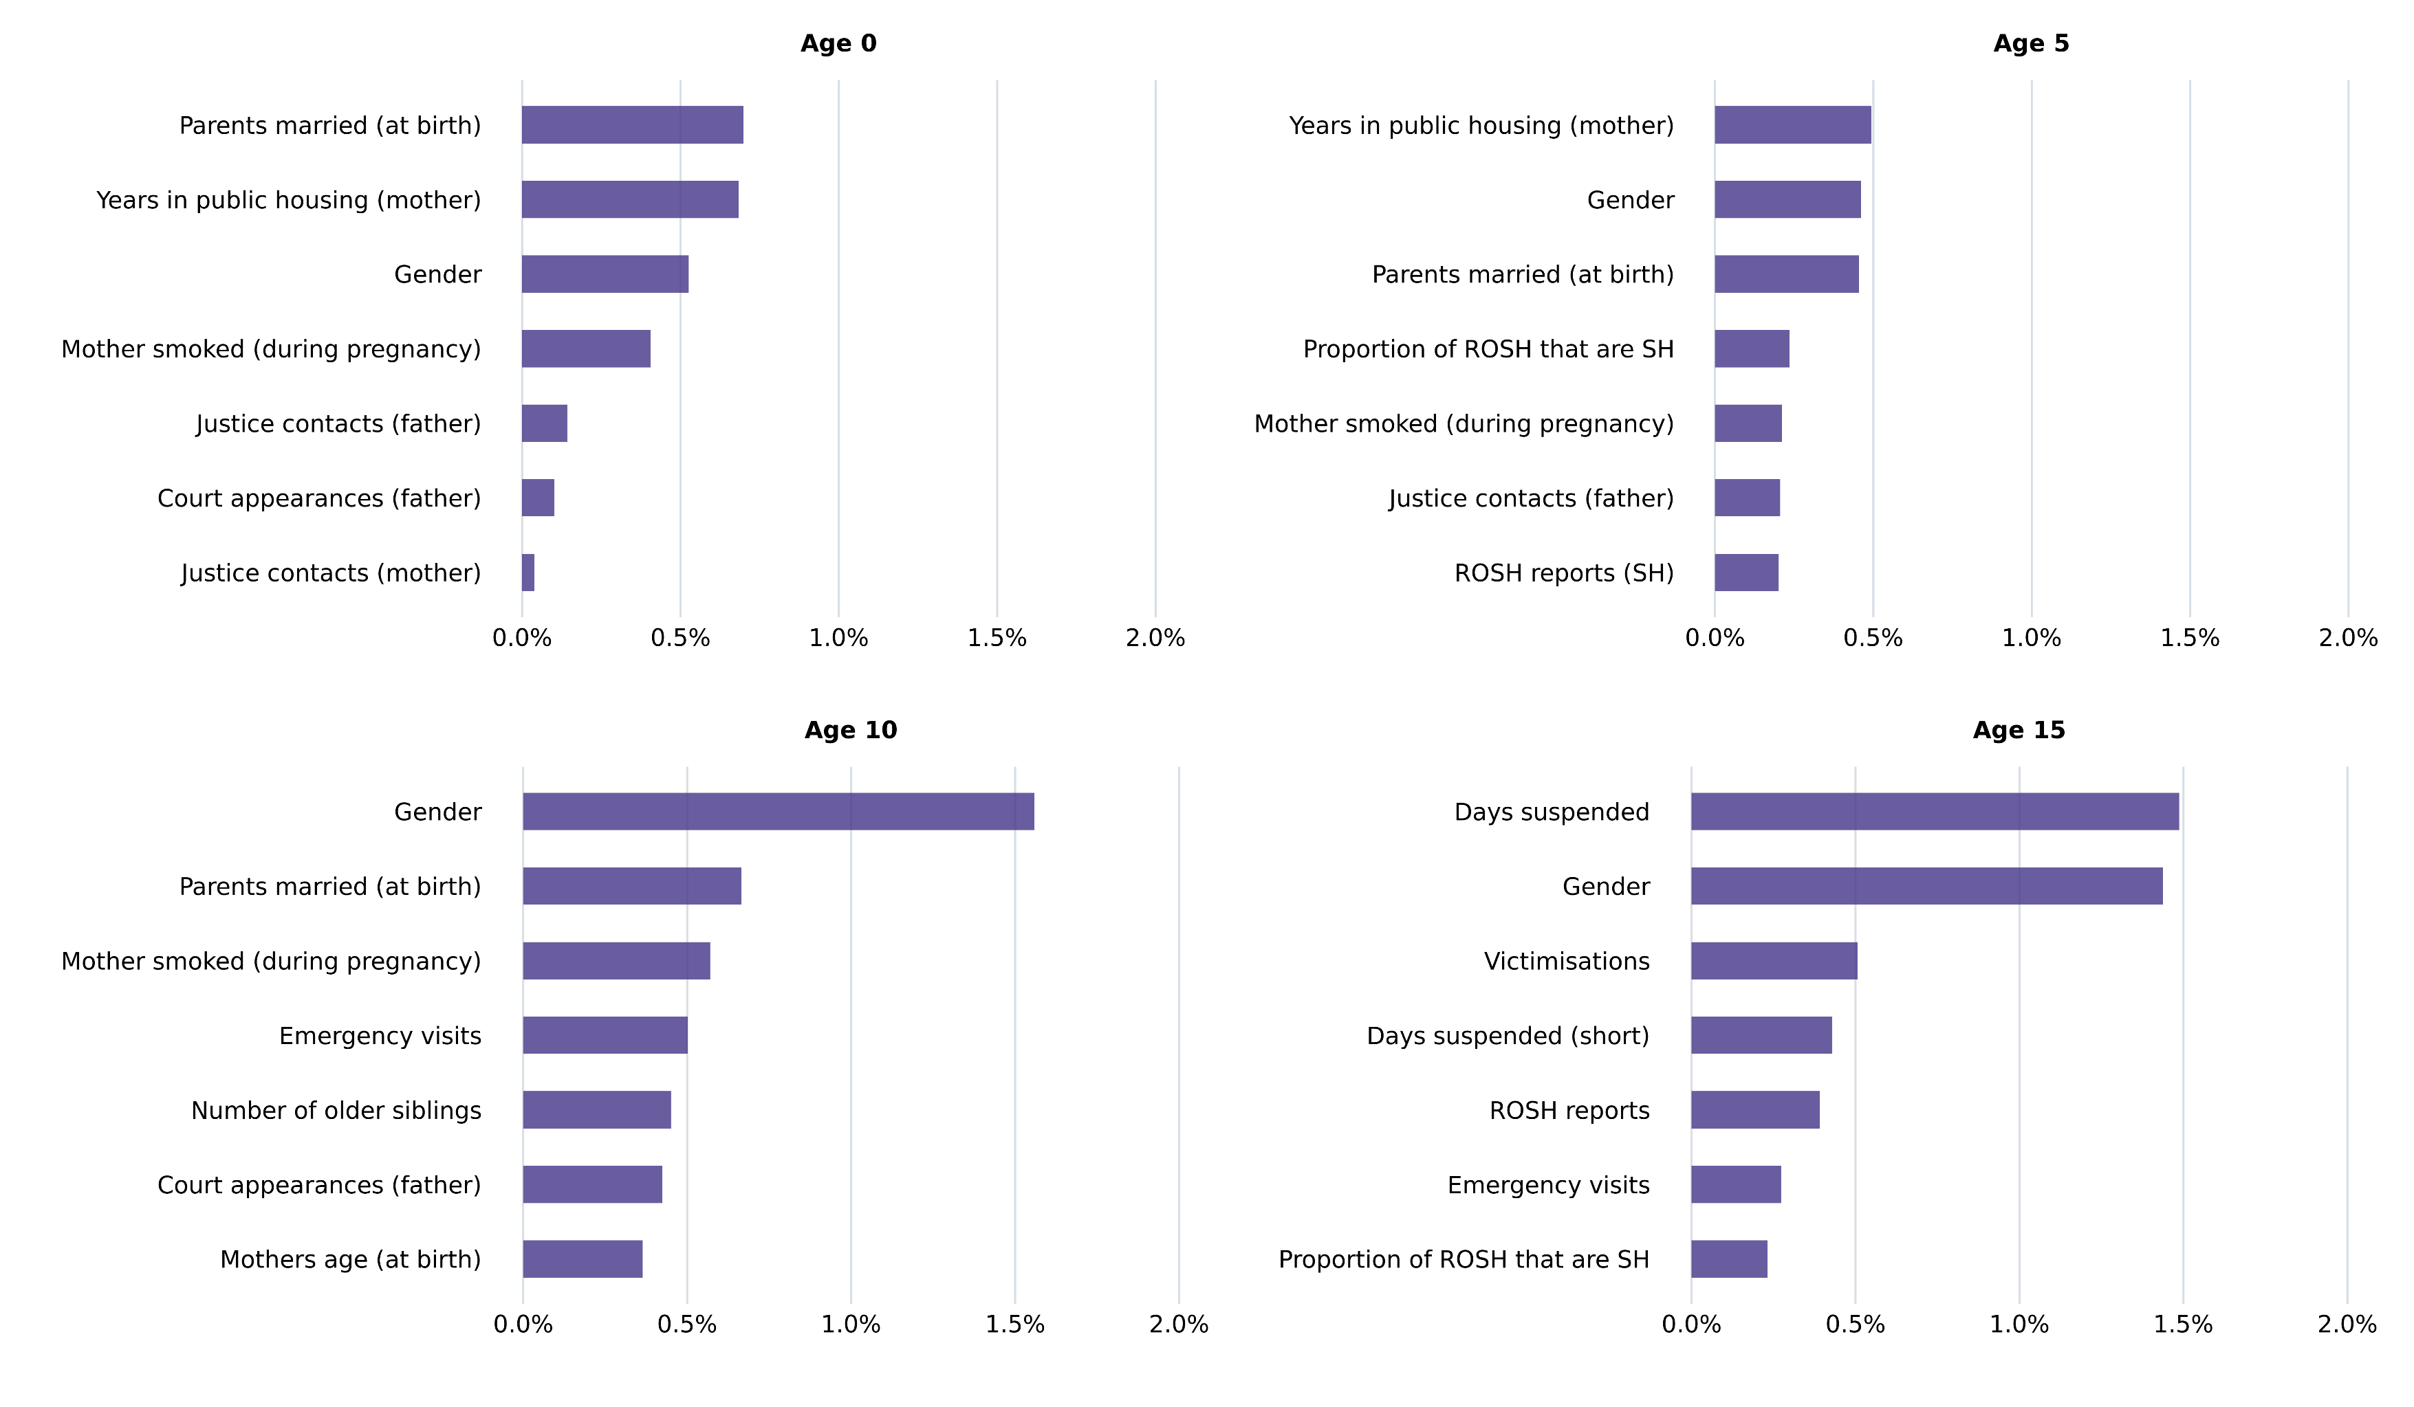
Predictions are driven by parents service usage at Age 0, ROSH reports at age 5, and suspensions at age 15 for Aboriginal and non-Aboriginal people
Non-Aboriginal people

Slide 27
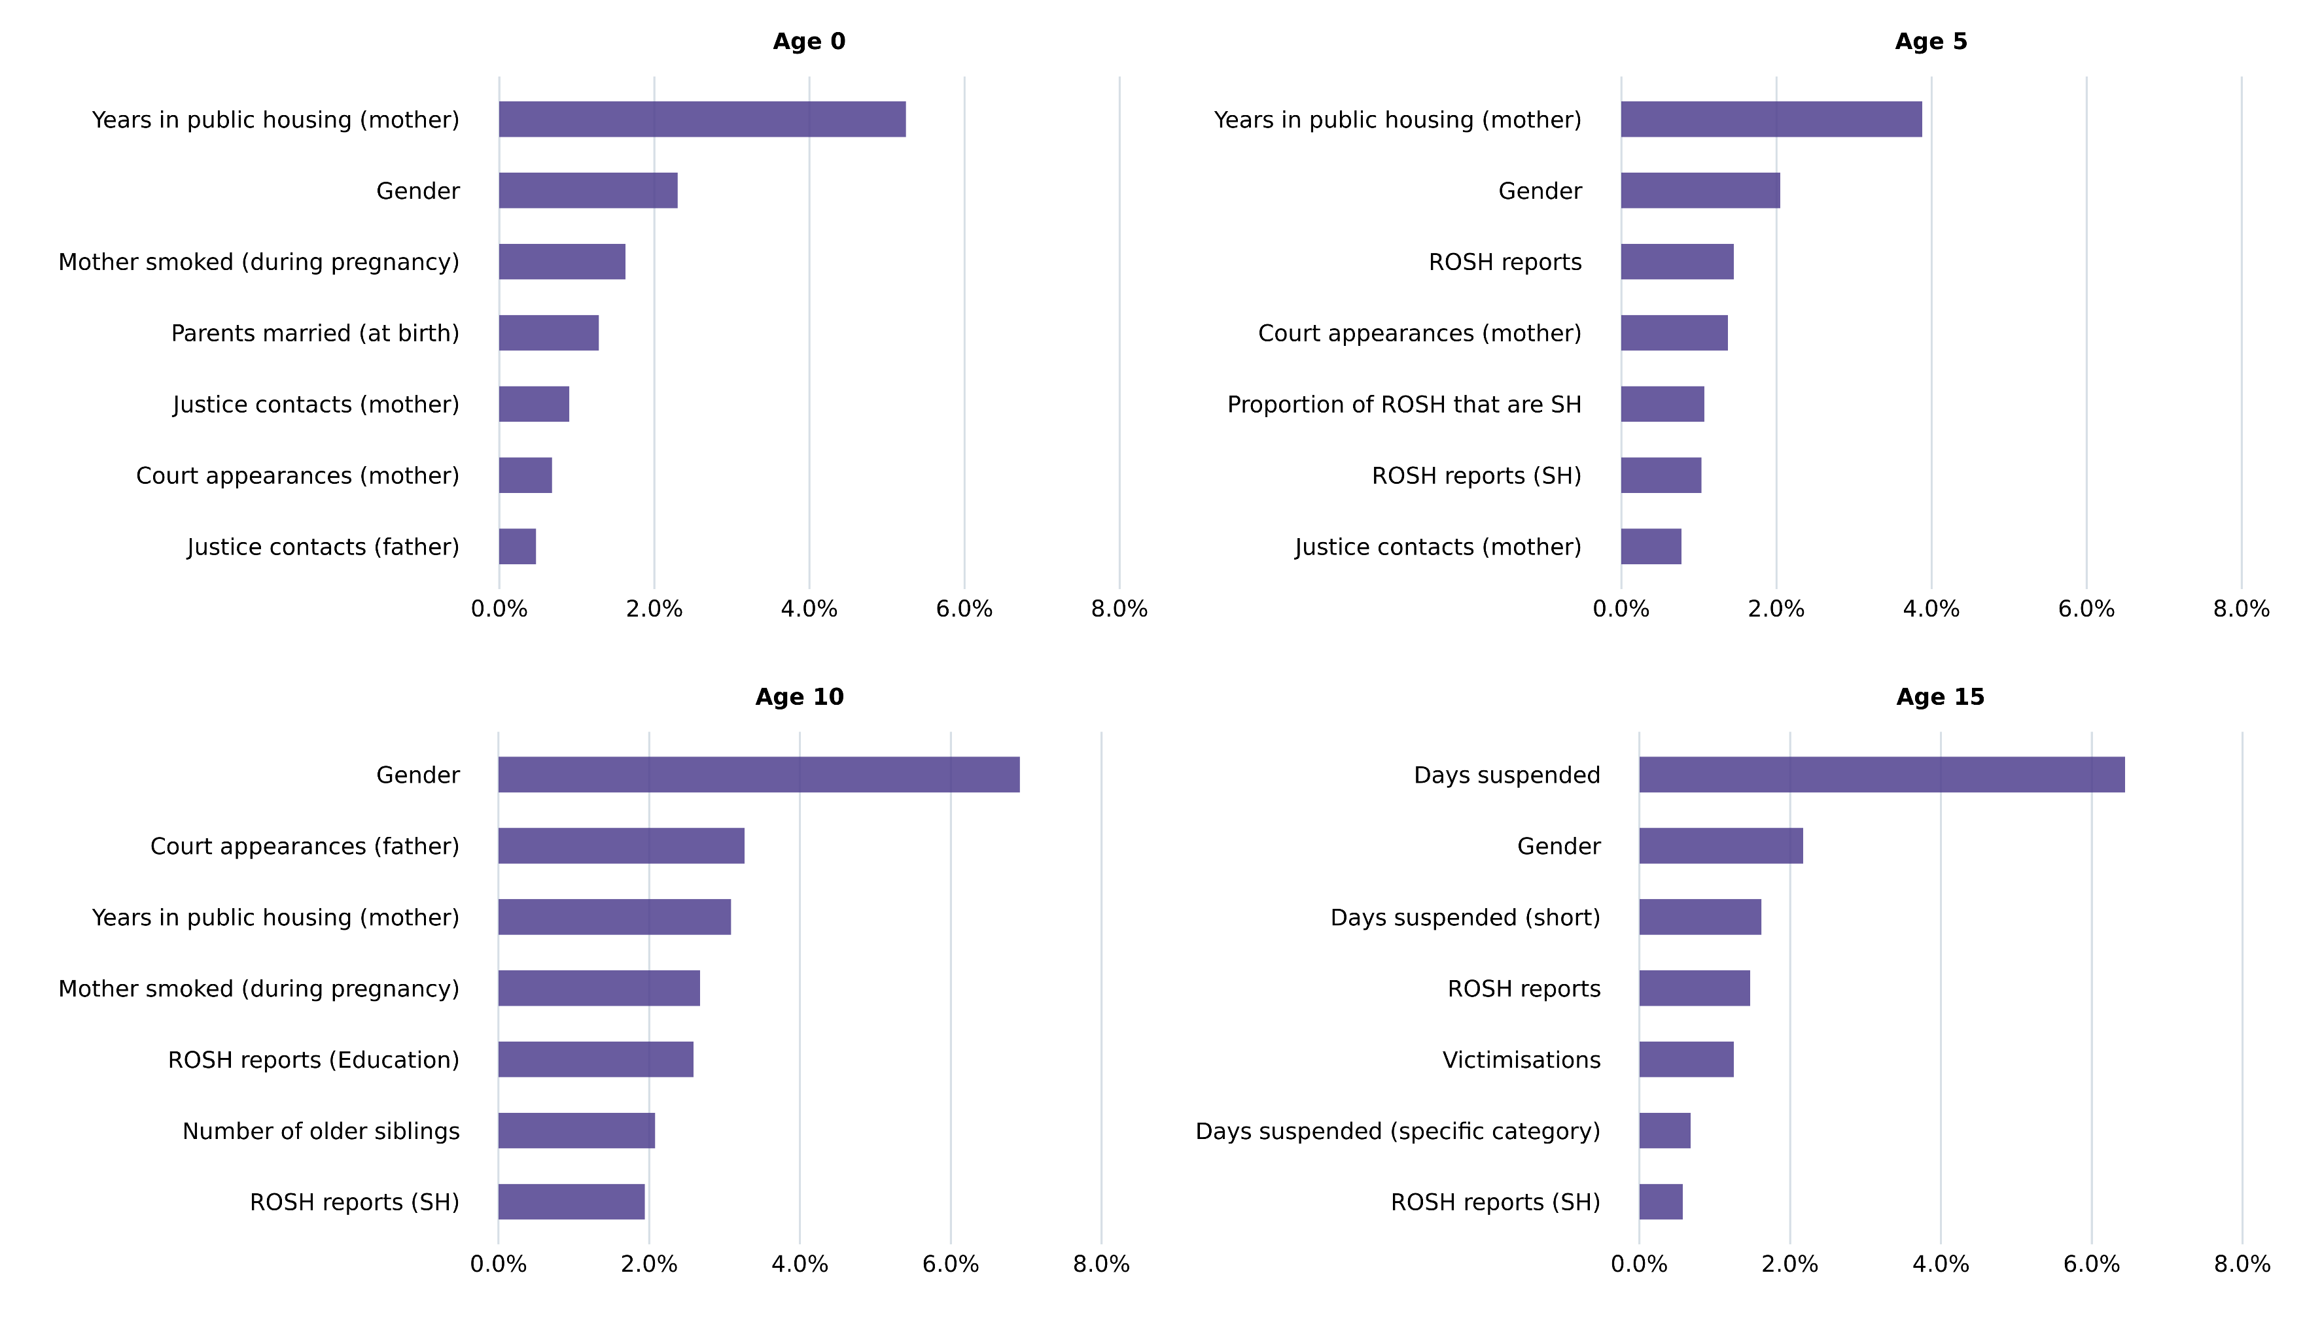
Predictions are driven by parents service usage at Age 0, ROSH reports at age 5, and suspensions at age 15 for Aboriginal and non-Aboriginal people
Aboriginal people

Slide 28
There are large differences in the accuracy and bias of the model for different demographic groups, making considering bias essential

Slide 29
We present the performance, predictors and bias of the model separately by Aboriginality, but we are unable attribute these differences to specific causes
Systemic bias
Data collection bias
Modelling bias
Outcome bias
Caused by differences in policing that lead to the same behaviour being more or less likely to become a contact with the criminal justice system
Criminal justice context
The historic and ongoing impacts of colonisation and systemic racism have led to differences in service usage, service effectiveness and criminal justice contact
Modelling bias
Caused by a large range of subtle (and not so subtle) modelling decisions that can exacerbate the existing bias in the data
Variable bias
Caused by differences in how services are targeted and accessibility, leading to differences in how predictive each variable is

Slide 30
We investigate bias using two notions of bias – predictive accuracy and relative false positive rates
Predictive accuracy: Does the model perform worse for different groups?
‘False alarms’: Does the model falsely predict contact at different rates for different groups?
Many of the benefits of using a predictive model may be contingent on the improved accuracy (for both Government and those receiving the service)
Difficult to argue that the model should be used for ‘everyone’ based on high-level accuracy metrics if this differs significantly by group
If the service / program delivered using this predictive model is undesirable (e.g. door knocking by police), then this gives a sense of the harm driven by the model
Conversely, if the service / program is desirable (e.g. unconditional cash transfer) then there is an equivalent notion of False Negatives (‘missed alarms’)

Slide 31
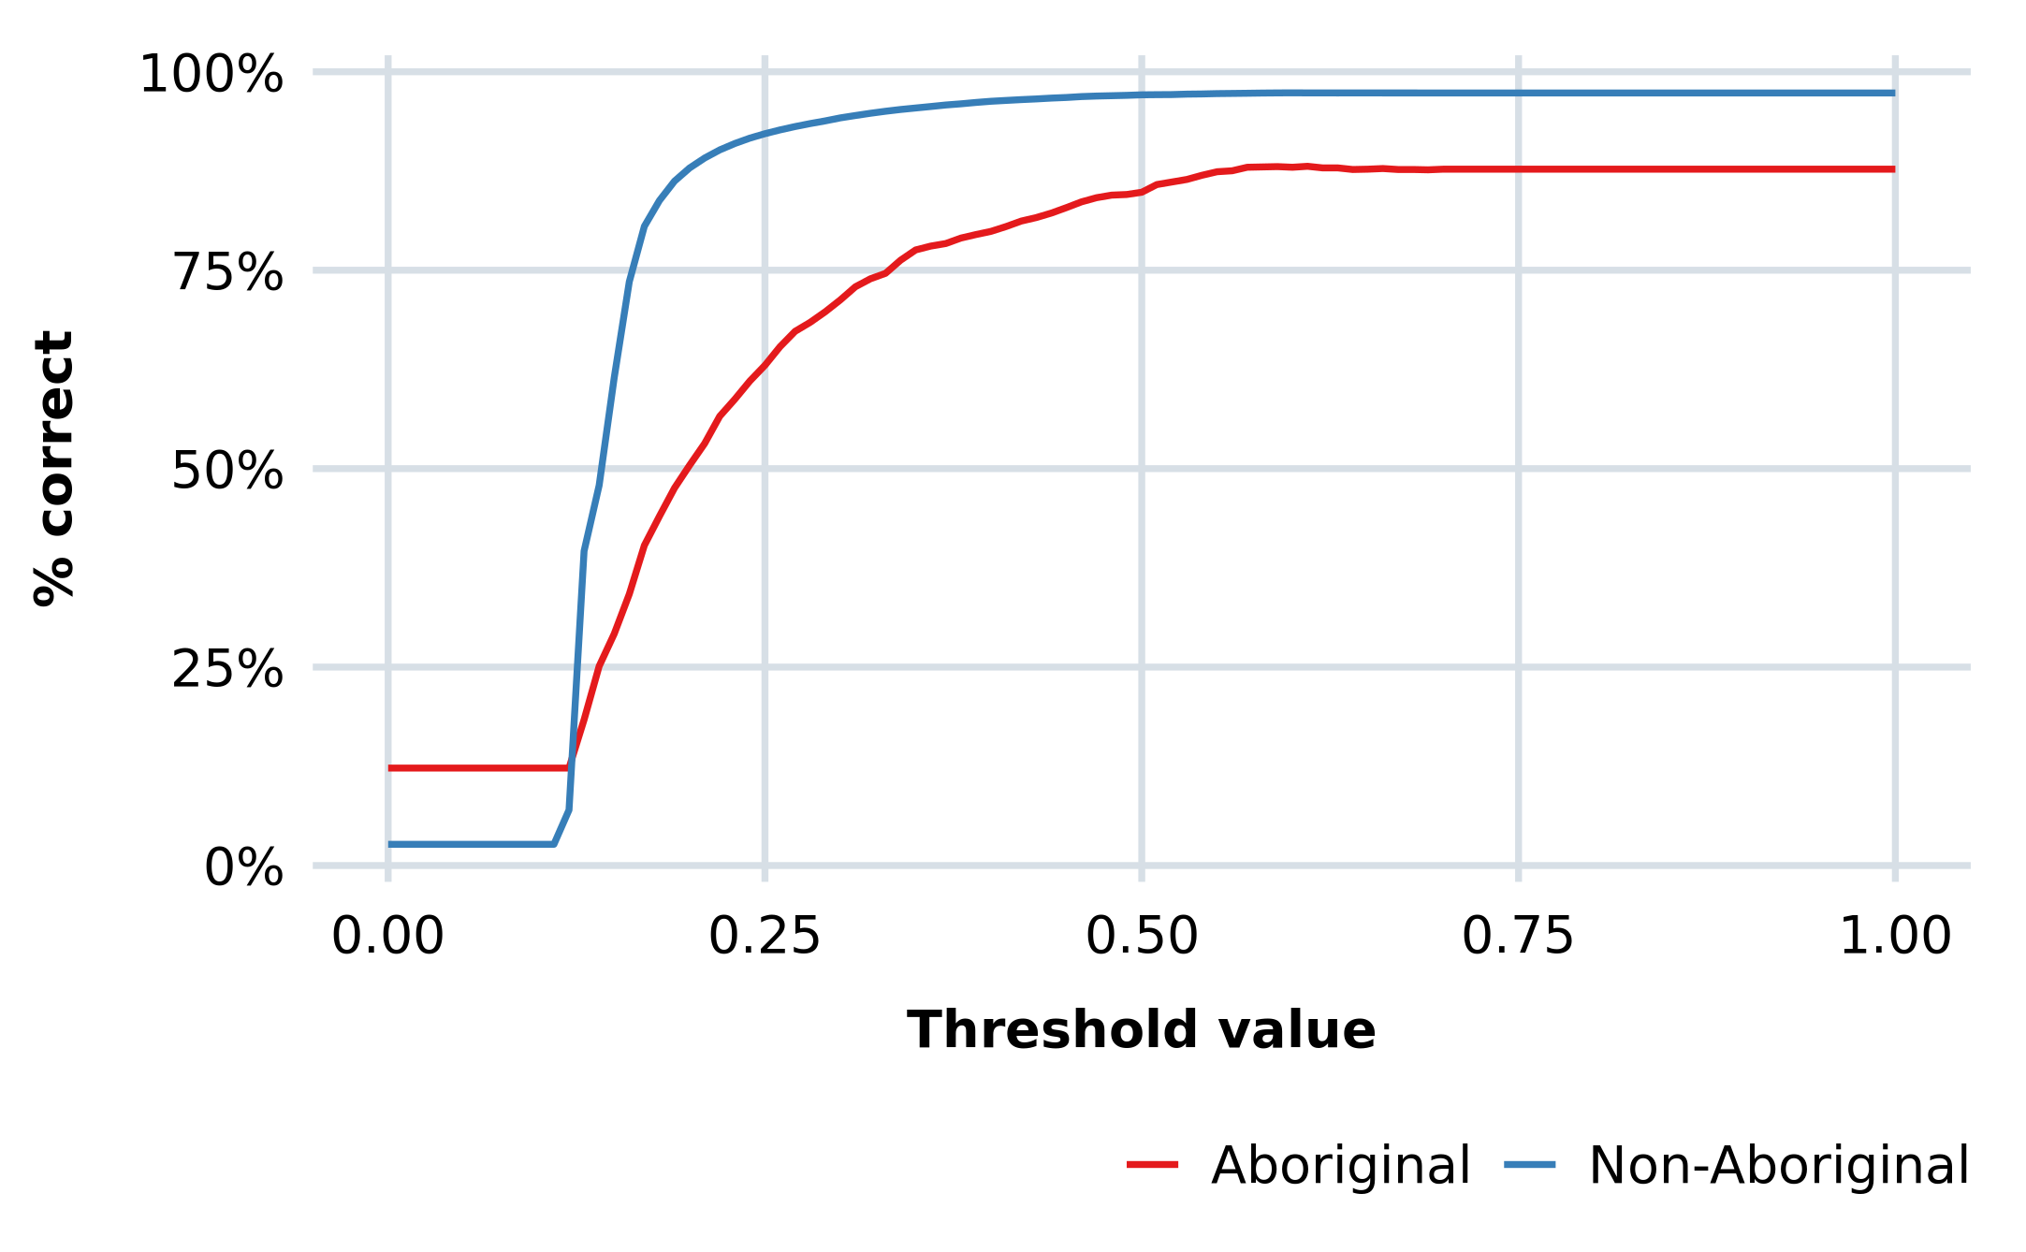
The model is substantially less accurate for Aboriginal people, with 10% fewer predicted correctly at age 10 for most reasonable thresholds
Accuracy for Age 10 model, by risk score required to predict contact

Slide 32
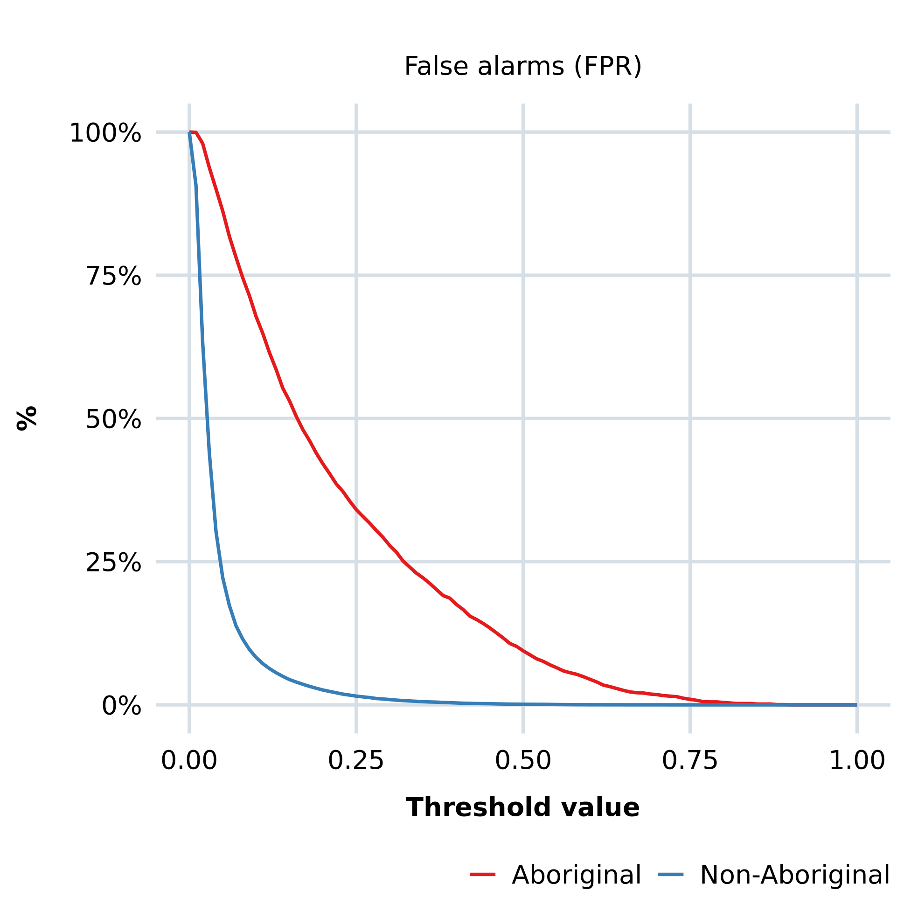
For the vast majority of threshold risk scores, we see significantly more false alarms (and fewer missed alarms) for Aboriginal people

Slide 33
For the vast majority of threshold risk scores, we see significantly more false alarms (and fewer missed alarms) for Aboriginal people
9.4% for Aboriginal people
0.01% for non-Aboriginal people

Slide 34
For the vast majority of threshold risk scores, we see significantly more false alarms (and fewer missed alarms) for Aboriginal people
Can generally find a point where FPR rates are ‘acceptable’

Slide 35
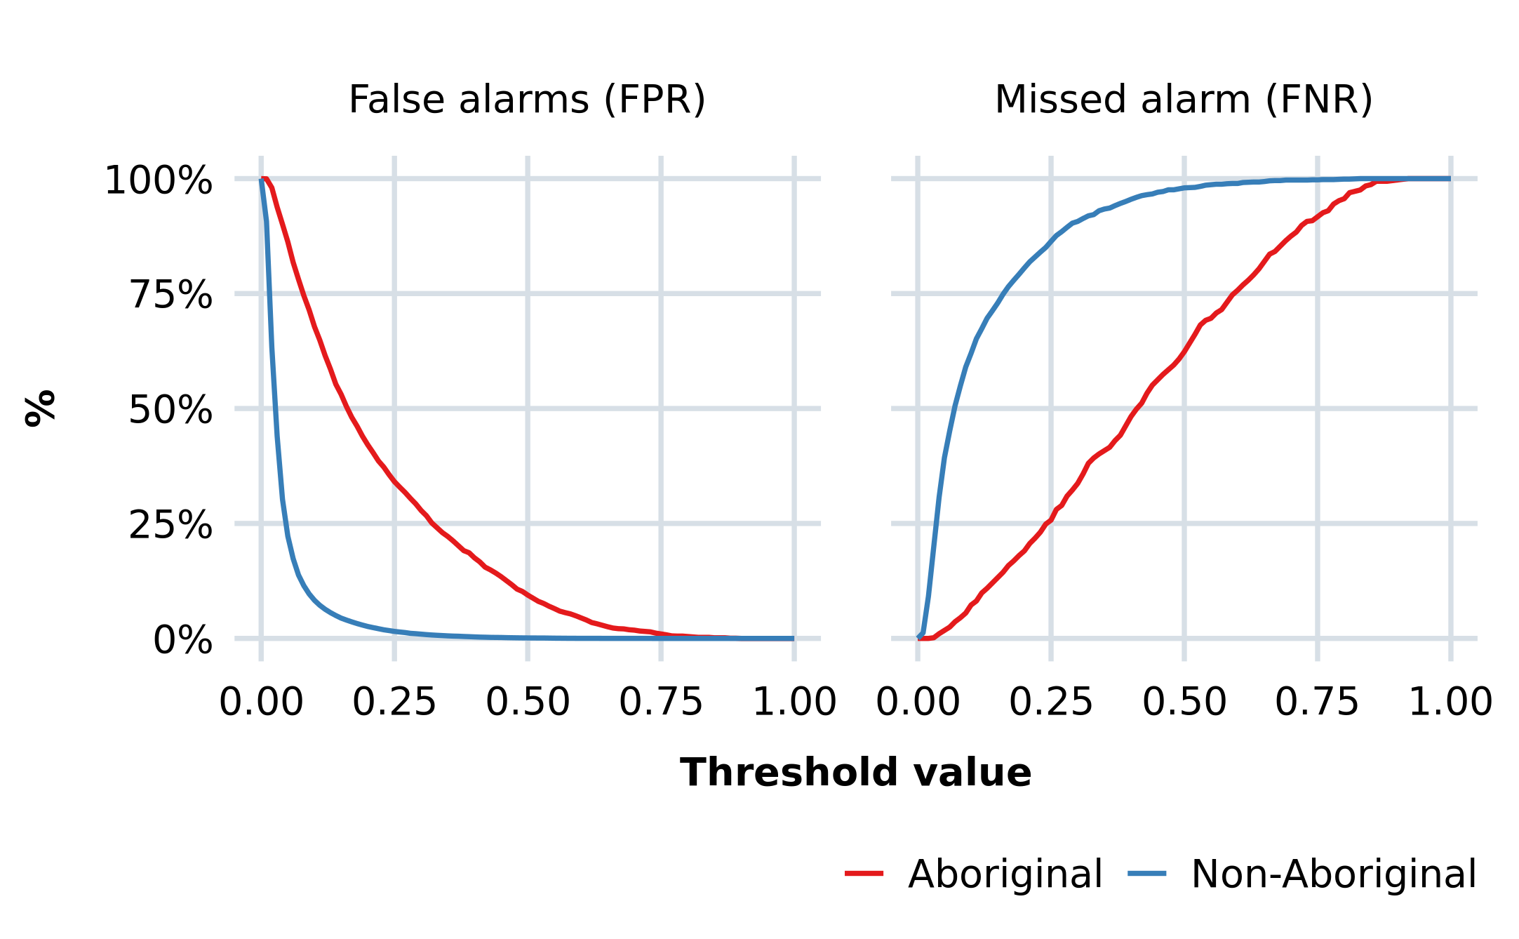
Increasing the threshold may generate new concerns, such as how many individuals are missed and much higher rate of Aboriginal people flagged

Slide 36
Increasing the threshold may generate new concerns, such as how many individuals are missed and much higher rate of Aboriginal people flagged
Nevertheless, concerns about accuracy, fairness, and transparency are real, and there are trade-offs between them for which there can be no technical fix. You can’t have it all.
Solutions will be found through political and legislative processes achieving an acceptable balance between competing priorities.
- Berk 2021, Artificial Intelligence, Predictive Policing and Risk Assessment for Law Enforcement

Slide 37
Discussion

Slide 38
We use a large, novel, data-set to construct a plausibly policy relevant predictive model, which performs as well as others in the literature…
We cleaned a large, policy relevant data-set and constructed a dataset with a large number of potentially useful predictors
We built a predictive model which can correctly predict whether an individual will have criminal justice contact 95% of the time, and achieves an AUC of 0.8ish
We are able to decompose our predictions to show that ROSH reports and suspensions become more useful for prediction as the cohort ages, and the model is more effective as the individual gets older

Slide 39
… but the accuracy of the model differs significantly by Aboriginality, the bias of the model is significant, and these results are sensitive to modelling
The model is unable to predict justice contact successfully for the majority of those who go on to have contact (predicts 20% at Age 15)
There are significant differences in both accuracy, false positives and false negatives by Aboriginality that are likely to have significant implications for any implementation
The magnitudes of these results are sensitive to small decisions, and suggest that a single general ‘risk score’ is unlikely to be usable without introducing serious issues

Slide 40
THANK YOU

Slide 41
We have aimed to use as transparent and 'reasonable' an approach as possible so they give a sense of the properties of a 'production' version
Different modelling decisions will produce radically different results
We tried to be data-driven wherever possible
Aim to take ‘middle of the road’ decisions so our results reflect general properties
Aimed to minimize ‘researcher degrees of freedom’ – all decisions we were forced to make we believe are relatively inconsequential to the results
There are significant data issues, but they do reflect real challenges
Reflects what data would be available for NSW Government
Data quality issues are something that all models of this type have to overcome
Actively looking to improve and expand the number of predictors
Has severely limited our ability to make inferences about variables other than predictive accuracy
Possible that better methods / implementation will change results
Reflects, for better or worse, a model developed internally by a NSW public servant
No evidence that there are significant gains from using more sophisticated approaches
Always possible that the ‘magic’ variable or technique awaits discovery – but as far as we can tell the HSDS is not it.

Slide 42
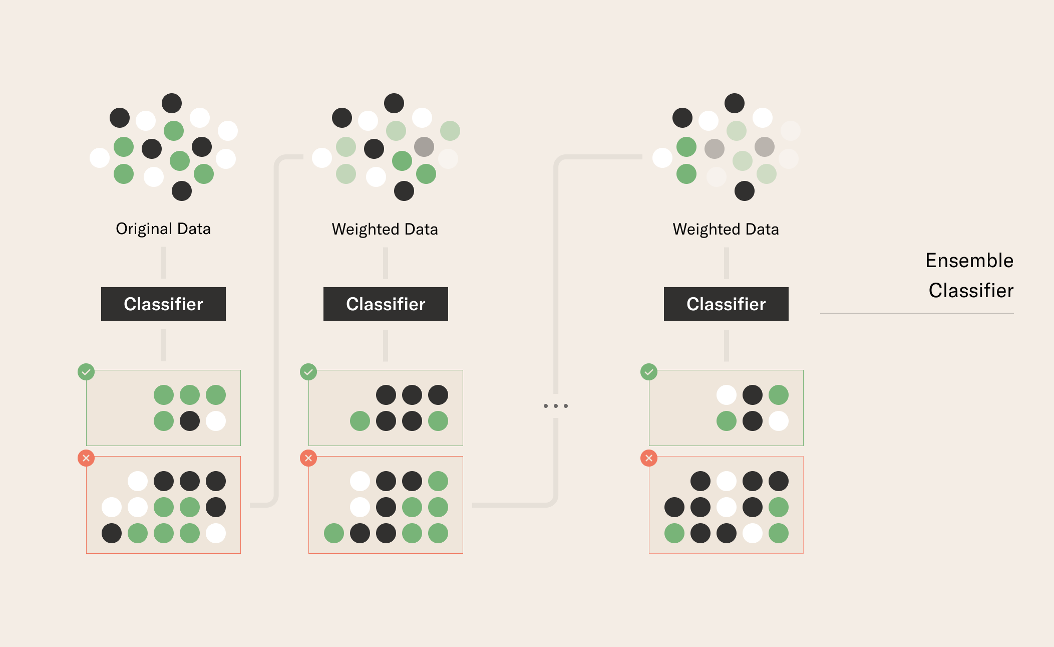
We use a gradient boosted tree model approach to flexibly utilise the large range of variables and reduce ‘researcher degrees of freedom’
Main reasons for selecting this approach:
Handles variable selection / functional form
Allows us to worry less about whether the variable is ‘good enough’
Robust to a number of common data issues
Completeness
Multi-collinearity
Allows us to take a ‘data-driven’ approach, so decisions made by the researcher is not driving the results
Has been shown in a number of studies (e.g. Campedelli 2022) to be the most effective approach for similar prediction problems

Slide 43
We use a gradient boosted tree model approach to flexibly utilise the large range of variables, and SHAP values to explain the resulting model
We split our data-set 80:20 into a training set and a testing set, after sorting by birth month.
This means that we use the younger 80% to predict the older 20%
We then tune all hyper-parameters on just our training set, selecting the hyper-parameters that give us the best accuracy score (e.g. % guessed correctly).
The testing set is only used for calculating our model metrics and is a 'true' hold-out set.
All results shown are based on performance on the testing set
All 259,398 individuals, sorted by age
207,518 in training set
50% selected
50% selected
50% selected
5-fold Monte-Carlo Cross-Validation
50% selected
50% selected
Final model trained on all training data

Slide 44
We use SHAP values decompose our prediction for each individual by the variables used for prediction, allowing us to show what variables drive results
Calculated by averaging the difference in prediction with the feature taken out, for all possible combinations of variables
Can be interpreted as the marginal contribution of the variable to the prediction
We have presented the average absolute SHAP value as a measure of how important the variable is for prediction
the actual contribution of the variable could be positive or negative, and differs between individuals and the level of the variable
= 0.95
+0.05
= 0.90
= 0.75
-0.10
= 0.85
SHAP of
= 0.50
±0.10
+0.10
= 0.40
= 0.85
+0.35
= 0.50

Slide 45
For the vast majority of threshold risk scores, we see significantly more false alarms (and fewer missed alarms) for Aboriginal people
In practice, won't be free to choose the threshold (e.g., if you have a set number of people you want to enrol in a program)
Will need to construct the model explicitly for each policy application to minimise bias issues while maintaining accuracy
Can’t just use the model to construct a 'global' risk score without accepting some pretty severe implications for bias that will need to be mitigated elsewhere
We see similar levels of bias for essentially any number of variables in our data-set where base rates of contact differ

Slide 46
Predictions are driven by parents service usage at Age 0, ROSH reports at age 5, and suspensions at age 15 for Aboriginal and non-Aboriginal people
Non-Aboriginal people

Slide 47
Predictions are driven by parents service usage at Age 0, ROSH reports at age 5, and suspensions at age 15 for Aboriginal and non-Aboriginal people
Aboriginal people

