Slide 1
Applied Research in Crime and Justice Conference 2023
The impact of changes to liquor licensing policy on violence in NSW 2000-2019
Professor Scott A. Sisson, UNSW Data Science Hub
Dr Suzanne Poynton, NSW Bureau of Crime Statistics & Research
Dr Ziyang Lyu, UNSW Data Science Hub
14th August 2023

Slide 2
Liquor licensing in NSW
Between 2008 and 2018, the NSW Government implemented a series of reforms to reduce violence related to licensed premises, both state-wide and local area.
Menendez et al (2015) found:
the 2008 reforms reduced police-recorded serious assaults
subsequent policy changes in 2011 and 2012 enhanced these effects.
the 2014 “Sydney Lockout Laws” led to a significant decrease in assaults in the CBD and Kings Cross (KCP) entertainment precincts.
However the reforms were criticised for negatively affecting Sydney’s night-time economy and city vibrancy.
In response:
NSW Govt commissioned a 2016 review, leading to several easing changes.
A 2019 joint select parliamentary committee also made further easing changes
One committee recommendation: “further analysis … be undertaken to ascertain which of the suite of public safety measures introduced in the last decade have contributed most to the decline in non-domestic assaults both in Sydney and across the state”.
NSW BOCSAR was nominated to lead this work and identify a methodology to quantify the effects of individual liquor licensing policies on rates of violent crime in NSW.

Slide 3
The data
749,576 non domestic violence-related assaults in NSW from 1st Jan 2000 – 31st Dec 2019
Due to the varying geographical scope of liquor licensing policies, the assault data were partitioned into those occurring
in the CBD (a)
the KCP (b)
the rest of NSW (RNSW) defined as all of NSW excluding the Sydney LGA (local govt area)
Numbers of assaults were aggregated into weekly count series

Slide 4
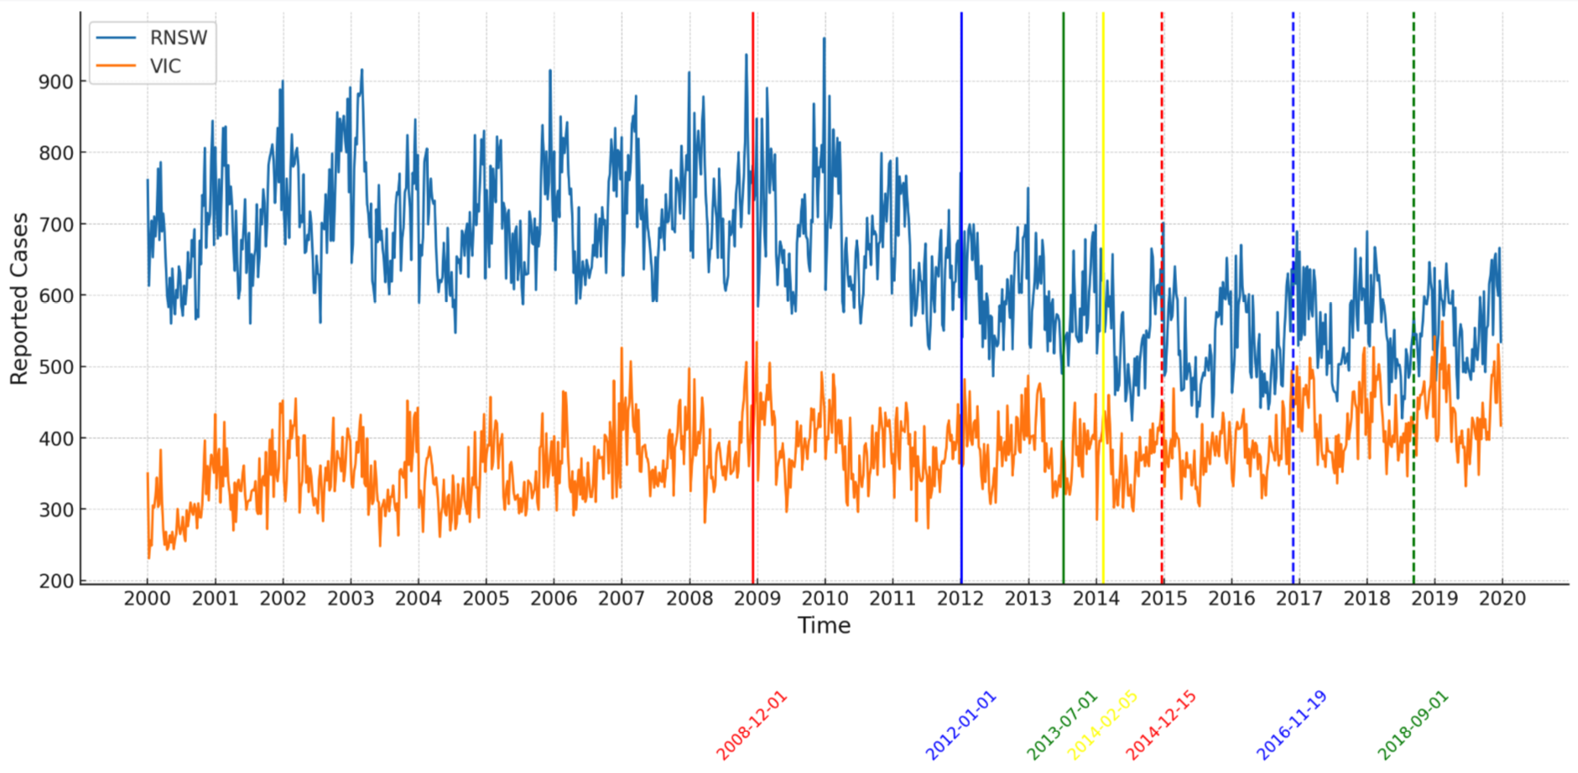
Weekly counts of reported non-domestic assaults in RNSW
Vertical lines indicate the promulgation times of the 7 statewide Policy interventions
Some trend and seasonality before first Policy
Apparent decrease 2008-2015
Possible stability post 2015

Slide 5
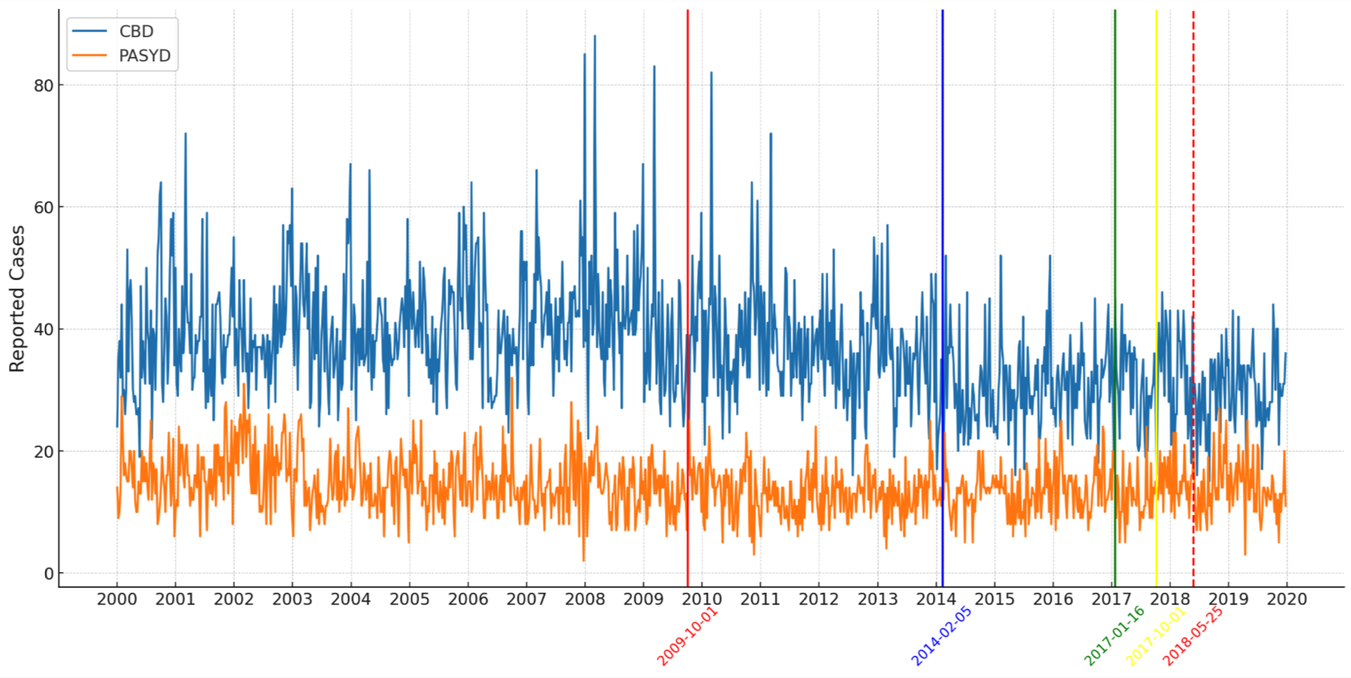
Weekly counts of reported non-domestic assaults in the CBD
Vertical lines indicate the promulgation times of the 5 Policies impacting the CBD
Some trend, weak seasonality before first Policy
Apparent decrease between Policies 1 & 2
Possible stability Policy 2+

Slide 6
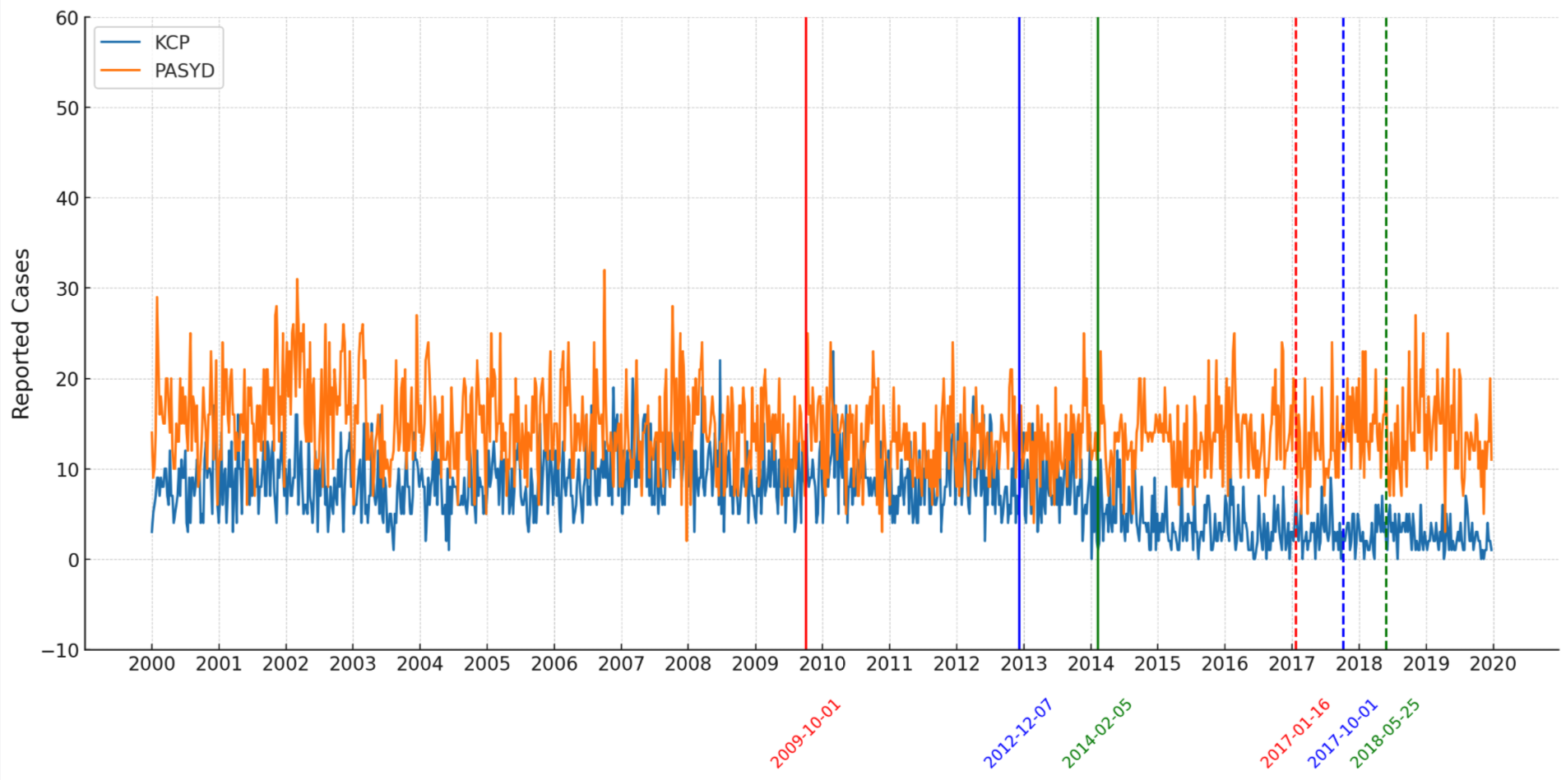
Weekly counts of reported non-domestic assaults in the KCP
Vertical lines indicate the promulgation times of the 6 Policies impacting the KCP
Some trend before first Policy
Apparent decrease between Policies 2 & 4
Possible stability Policy 4+

Slide 7
Liquor licensing policy timeline: Statewide and CBD/KCP
The promulgation time between many consecutive policies is short (order ~ months)
Challenge to estimate policy effects on a few (weekly aggregate) data points
Accordingly we group these into composite Policies (capital P)

Slide 8
Modelling Approach
Brief: Wish to evaluate the effect of individual liquor policies.
Challenges:
Policy effects overlap (the impact of one policy still being felt when another policy is introduced).
We don’t know what would have happened if no laws were introduced.
Approach:
Can’t just fit time series model to data (RNSW), as unclear if observed changes are due to laws.
Identify independent proxy dataset (Vic) with same influences and trends, but without any laws.
Specify a joint model for both (RNSW, Vic), and forecast how RNSW would behave without any laws.
Calculated difference between counterfactual and observed datasets = the effect of the laws.

Slide 9
Modelling Approach
For each region (RNSW, CBD, KCP):
yt = observed counts
yt* = counterfactual data for t=1,…,T
If τk = promulgation time of k-th Policy then
yt* = yt for t=1,…,τ1-1
yt* = unobserved for t= τ1,…,T
If yt* was observed:
then (with additivity assumptions)
Dt = yt - yt*
would contain Policy effects only.
So we build a model to predict the unobserved part of yt*
Model for yt*:
First identify proxy dataset pt:
available for the full study period
strongly related to yt (yt*) before Policy 1
not affected by Policies
Then:
build joint model for (yt*,pt) over t=1,…,τ1-1
use (yt* | pt) to forecast over t= τ1,…,T

Slide 10
Proxy data for RNSW
Orange line is equivalent data from Victoria (VIC):
VIC is similar in population and urbanisation to NSW ✓
Clear relationship prior to Policy 1 ✓
did not enact liquor licensing Policies ✓
(useful) differences afterwards

Slide 11
Proxy data for CBD and KCP
CBD & KCP subject to both statewide and local Policies
Same proxy for both areas
PASYD = Sydney LGA - CBD - KCP
- DDA (Distal Displacement Area)
- PDA (Proximal Displ. Area)
PASYD should
contain information about CBD & KCP ✓
but not be influenced by local Policies ✓
while accounting for statewide Policies ✓
Weaker relationship
but useful differences Policy 1+
DDA includes Bondi Beach, Coogee, Double Bay and Newtown. PDA includes: Surry Hills, Chippendale, Ultimo, Pyrmont and Elizabeth Bay (including The Star casino).

Slide 12
A model for (yt*,pt)
Vector Autoregression: VAR(p)
T = trend (linear)
S = seasonality (annual cycle)
e = normal errors (assumption reasonable)
p = process degree
fit via MLE/AIC etc.
Conditional predictive distribution is then
fit VAR model for (yt*,pt) over t=1,…,τ1-1
use (yt* | pt) to forecast over t= τ1,…,T

Slide 13
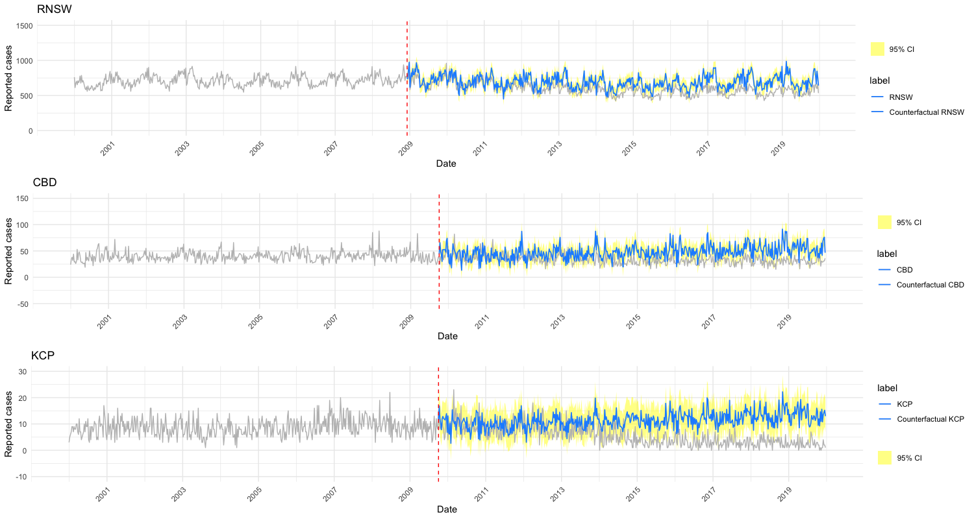
Counterfactual forecasts
1,000 replicate counterfactual datasets
Fitted VAR R² values:
(0.68, 0.60)
(0.29, 0.27)
(0.18, 0.28)
Diagnostic tests suggest model is reasonable.

Slide 14
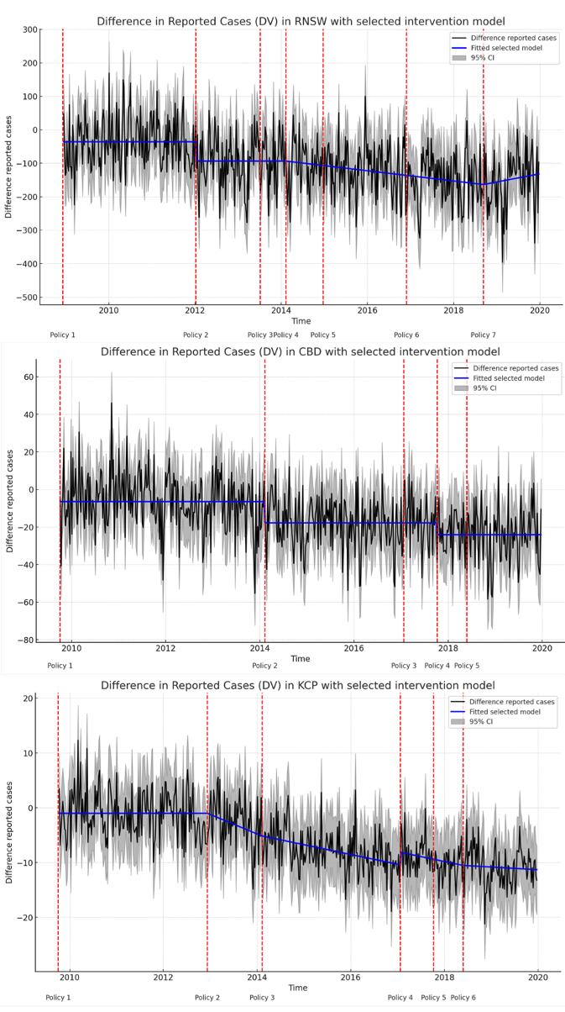
Difference datasets {D_t}
1,000 replicate datasets
Ideally contains Policies effects only.
Now specify intervention model for these data.

Slide 15
An intervention model
Define
Piecewise linear spline with knot points at Policy promulgation times τk
Possible step changes (c) at knot points
Errors modelled as ARMA(p,q)
Interpretation of (ck, βk):
ck = instantaneous effect of Policy k
βk = over time effect of Policy k
… conditional on the effects of all other Policies up to Policy k
… and compared to a scenario where no Policies are implemented
Other intervention models are possible (see later discussion)

Slide 16
Model fitting and reduction
Fit intervention model to each difference dataset (of 1,000)
Histograms of p-values
Which correspond to important predictors?
Can perform backwards selection, removing least important at each step.

Slide 17
The reduced model
Only important effects remaining.

Slide 18
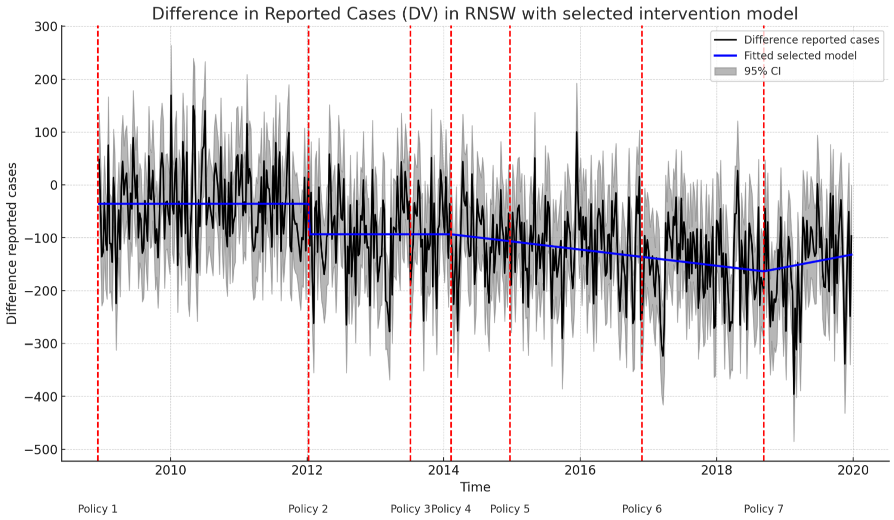
Results for statewide policies in RNSW
Table 3: Summary of estimated policy intervention effects for statewide policies in RNSW.
 | Policy 1 Violent venues/six hour closures | Policy 2 Three strikes scheme | Policy 4 Fee scheme /take-away restrictions | Policy 7 Industry training
Constant | -35.72 | -57.72 | --- | ---
95% CI | ( -53.87, -17.57) | ( -82.99, -32.45) | --- | ---
Change in slope | --- | --- | -0.29 | 0.76
95% CI | --- | --- | (-0.43, -0.15) | (-0.21,1.73)
Cumulative change | -5.05% | -14.22% | -23.53% | -18.73%
Individual change | -5.05% | -9.66% | -10.85% | 6.28%
Instantaneous effect of Policy 1 (not linear).
Due to:
VIC proxy being below-trend Policy 1+
Leading to expectation of RNSW doing the same
“Possible stability post 2015” for yt:
becomes a decrease
relative to increasing proxy

Slide 19
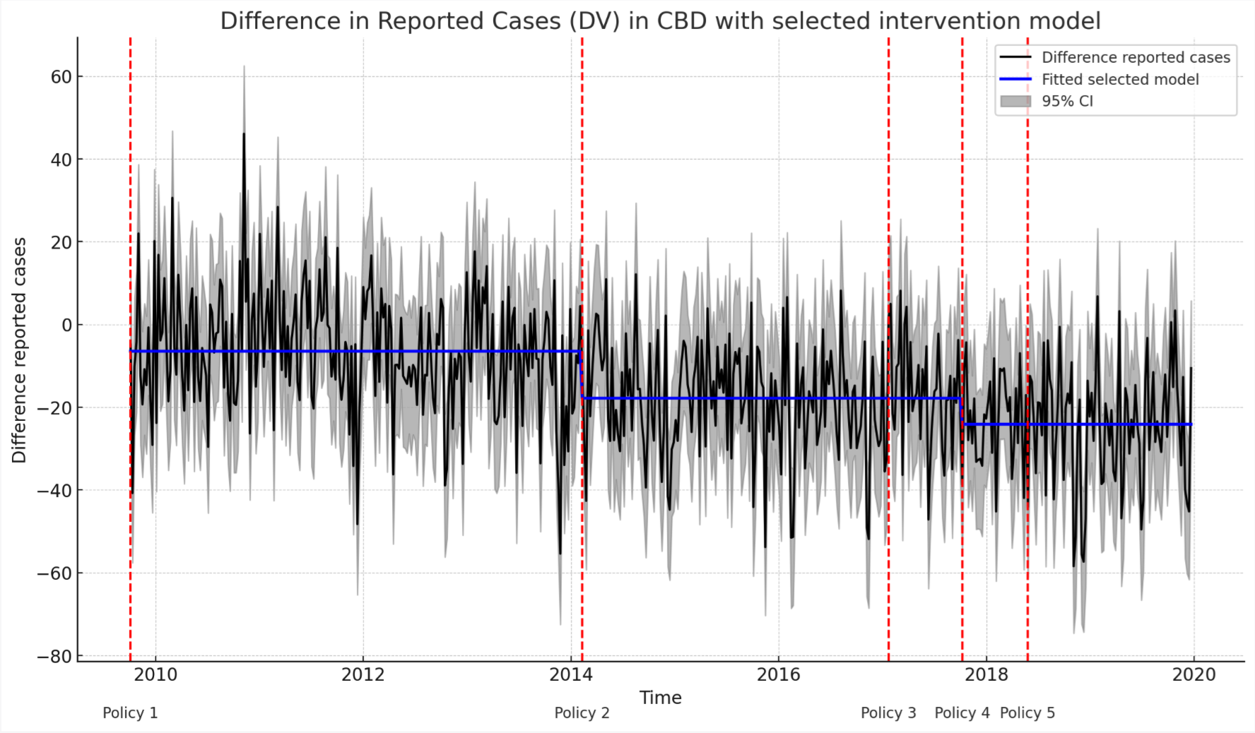
Results for policies in CBD
Table 4: Summary of estimated policy intervention effects for CBD centric policies in the CBD.
 | Policy 1 Licence freeze | Policy 2 Lockouts | Policy 4 Lockout relaxation for entertainment venues
Constant | -6.48 | -11.37 | -6.28
95% CI | (-9.176, -3.784) | (-15.35, -7.39) | (-11.06, -1.51)
Change in slope | --- | --- | ---
95% CI | --- | --- | ---
Cumulative change | -15.48% | -37.45% | -44.78%
Individual change | -15.48% | -25.99% | -11.72%
Effect of Policies best described by
constant effects of Policies 1, 2 & 4.

Slide 20
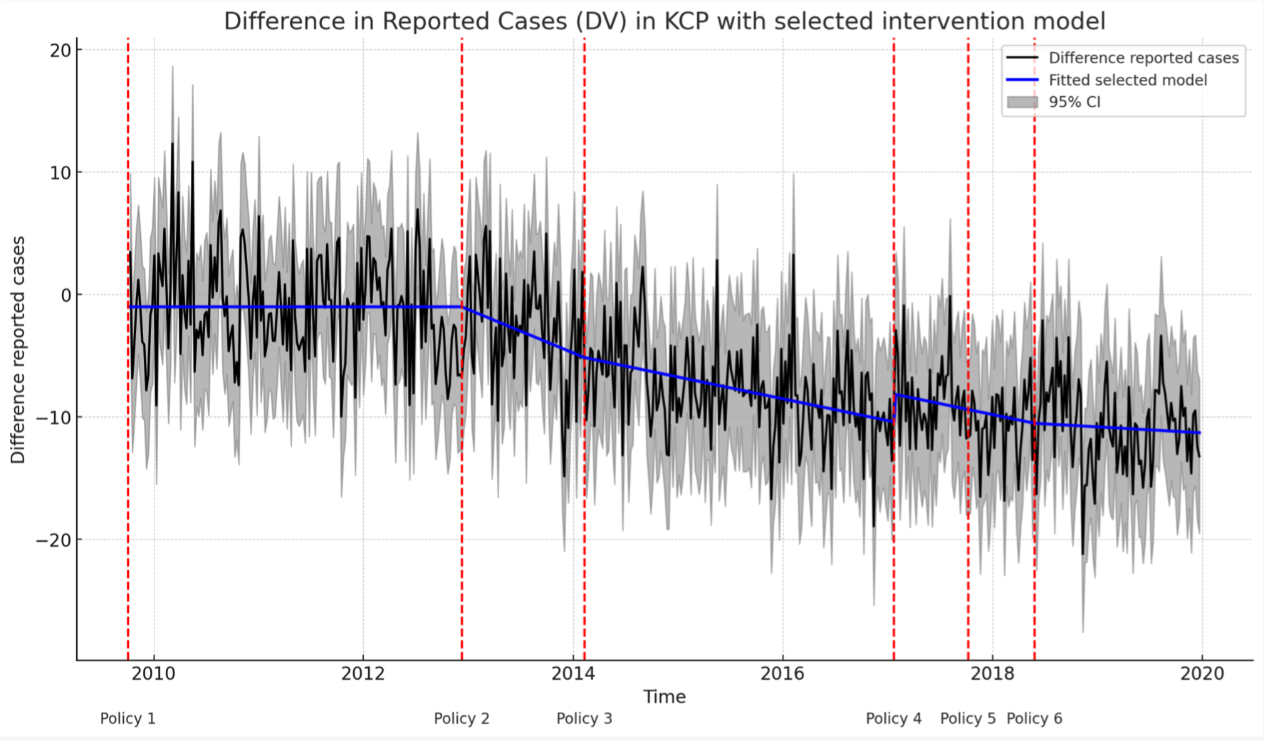
Results for policies in the KCP
Table 5: Summary of estimated policy intervention effects for KCP centric policies in the KCP.
 | Policy 1 Licence freeze | Policy 2 KCP Liquor accord | Policy 3 Lockouts | Policy 4 Lockout relaxation for entertainment venues | Policy 6 Licence freeze lifted for entertainment venues
Constant | -1.01 | --- | --- | 2.28 | ---
95% CI | (-1.9,-0.12) | --- | --- | (-0.61,5.17) | ---
Change in slope | --- | -0.07 | 0.03 | --- | 0.02
95% CI | --- | (-0.10, -0.04) | (-0.02,0.08) | --- | (-0.03,0.07)
Cumulative change | -11.21% | -53.41% | -82.23% | -75.83% | -84.04%
Individual change | -11.21% | -47.53% | -61.86% | 36.02% | -33.97%
Linear decrease Policy 2-4 identified
with change of slope (-0.04)
attributed to Policy 3

Slide 21
Discussion
Study aimed to quantify effects of individual liquor license laws on violent crime
Overall the laws contributed to a decline of
19% in RNSW
45% in the CBD
84% in the KCP (low numbers make this % large)
from levels that would have been achieved had no alcohol control policies been introduced.
Results broadly consistent with previous studies
The proxy dataset for CBD and KCP (PASYD) was less informative than that for RNSW (VIC), despite being sensibly derived as a reasonable choice given the data available. Better proxies will of course, improve inference.
Some policies were close together in time, making it challenging to accurately estimate their individual effects
The falls in violent crime are larger than those reported in previous work.
Possible reasons:
use of a counterfactual allowed us to isolate the impact of the lockout laws from the effect of other statewide policies (or other effects).
measured from estimated levels had no policies been introduced

Slide 22
Discussion
Model discussion:
Intervention model was a piecewise linear spline (with possible intercept changes at each knot).
Reason:
a Policy effect is likely still taking place when the next Policy is enacted, confounding effect estimates
βk coefficients directly interpretable as the change observed compared to what was already happening — helpful.
Downside: difficult to represent, e.g., a Policy effect that is an initial weekly reduction in assaults before levelling-off to a new constant value. Rather, the levelling-off will tend to be attributed to an increase in the weekly assault rate of a subsequent Policy.
(This could account for the apparent slowing of the weekly decline in assaults following Policy 2 but attributed to Policy 3 in the KCP.)

Slide 23
Discussion
Alternatives:
Introduce new parameter that determines when the transitional effects of a Policy expire
And/or adopt exponential decay form for Policy “impulse” effect
Cons: such parameters are difficult/impossible to estimate. Especially if the levelling-off occurs after the introduction of the next Policy and so parameters are conflated with later Policy effects.)
Can specify parameters/form more strongly, but then this becomes a model choice, and we’re back to analyst model specification decisions of the kind we have already made.

Slide 24
THANK YOU

Slide 25
Contact us
UNSW Data Science Hub (uDASH)
Room 1050, Level 1, East Wing
Lawrence Centre (H13)
UNSW Sydney
uDASH@unsw.edu.au
Michelle Cartwright
Centre Manager
mcartwright@unsw.edu.au
Emily Zeng
Business Development Mgr
Scott.Sisson@unsw.edu.au
Prof. Scott Sisson
Director
Scott.Sisson@unsw.edu.au

