Slide 1
Can Parole Reduce Both Time Served and Crime?
William Arbour
Department of Economics
University of Montreal
Steeve Marchand
Melbourne Institute: Applied Economic and Social Research
University of Melbourne
Applied Research in Crime and Justice Conference
International convention Centre, Sydney
14-15 August 2023

Slide 2
The opinions expressed in this presentation are those of the authors only and do not necessarily reflect those of the ministère de la Sécurité publique of Québec or of the Commission québécoise des libérations conditionnelles.

Slide 3
Motivation
Parole : the conditional early release of prisoners
Can decrease incarcerated population and costs
Reduced incapacitation period ⇒ ↑ recidivism ?
Reduced deterrence ⇒ ↑ recidivism ?
Allows parole officers to exert influence on parolees’ transition
Rehabilitation assistance for transitioning back into community ⇒ ↓ recidivism ?

Slide 4
Motivation
The net effect of parole on recidivism is unclear
Cannot simply compare parolees to non-parolees
Empirical evidence of the causal effect of parole is limited
Decreases recidivism (Meier et al., 2020)
No effect (Zapryanova, 2020)
Increases rearrests (Laforest, 2021)
In NSW, decreases recidivism (Ooi & Wang, 2022)

Slide 5
Motivation
Which specific practices make parole successful ?
In which context is parole appropriate and for whom ?
How to measure recidivism ?

Slide 6
Our study
We study the context of provincial prisons in Quebec, Canada
Short sentences : between 6 months and 2 years
Selective process : selection of low-risk prisoners
Significant rehabilitation assistance for parolees through halfway houses

Slide 7
Our study
Estimate the causal effect of parole on recidivism and incarceration We exploit the propensities of parole board members (PBMs) to grant parole We find:
Likelihood of reincarceration ↑
Likelihood of reconviction ↓
Total time spent in prison ↓
We decompose the effect of parole on incarceration time into different channels

Slide 8
Context

Slide 9
Parole in Quebec’s provincial prisons
Inmates with sentences ≥ 6 months are eligible
Hearing happens at 1/3 of sentence
Parole applies immediately if granted
52% of eligible prisoners renounce to their parole hearing
Low chances to obtain it / unpleasant process
Longer time under supervision

Slide 10
Parole in Quebec’s provincial prisons
Inmates renouncing to parole hearing ⇒ self-selection
PBMs methodically select parolees ⇒ PBM’s selection
Extensive case review and interview
Recommendation letters
Risk scores
Program participation
Credible rehabilitation plan
PBMs decide on parole conditions (60 possible conditions)
A major condition : residing in a halfway house

Slide 11
Pictures of halfway houses in Quebec

Slide 12
Halfway houses in Quebec
A compromise between incarceration and release
Covers basic needs (shelter, food)
Parolees can leave freely, but they must
Report to employees regularly
Spend night at the halfway house
Participate in programs/therapy
Seek job/go to work
Costs per offender lower than incarceration
Prison : $220 /day
Halfway house : $100 /day

Slide 13
Data and summary statistics

Slide 14
Data
Administrative data on all prisoners in Quebec’s provincial prisons
Sentences to provincial and federal prisons
Recidivism
Type of crime + demographics
Risk scores from the sentence’s onset (8 components)
2007-2020
Combined with data on parole hearings
Parole board member (PBM) identifiers
Around 30 PBMs
Decisions: granted or not, required conditions
2007-2015

Slide 15
Definitions of recidivism
We consider two definitions of recidivism :
Reincarceration (technical violation of conditions, new conviction)
New conviction
within a certain time window after 1/3 of the sentence

Slide 16
Reincarceration rates

Slide 17
Reconviction rates

Slide 18
Estimating the causal effect of parole

Slide 19
Empirical strategy
Challenge
Parolees and non-parolees are not comparable
Self-selection into hearings
Selection from parole board members during hearings
Parolees are likely to commit less crimes for reasons other than parole
Solution
We use the propensities of parole board members to grant parole
Well established method to isolate the causal effect of sentencing decisions on offenders
Often called “judge leniency design”

Slide 20
The idea
Most lenient
Least lenient
Randomly allocated to a parole board member

Slide 21
The idea
Granted
Granted
Granted
Granted
Denied
Denied
Denied
Most lenient
Least lenient

Slide 22
The idea
Granted
Most lenient
Least lenient

Slide 23
The idea
Denied
Most lenient
Least lenient

Slide 24
Empirical strategy
The random allocation of parole board members to hearings allows to use an instrumental variable approach:
Estimate the propensity of each parole board member to grant parole
Estimate the effects of parole decisions that are explained by these propensities
This method isolates the causal effect of parole for offender at the margin of being granted parole
In our context, these individuals are very likely to be required to stay at a halfway house

Slide 25
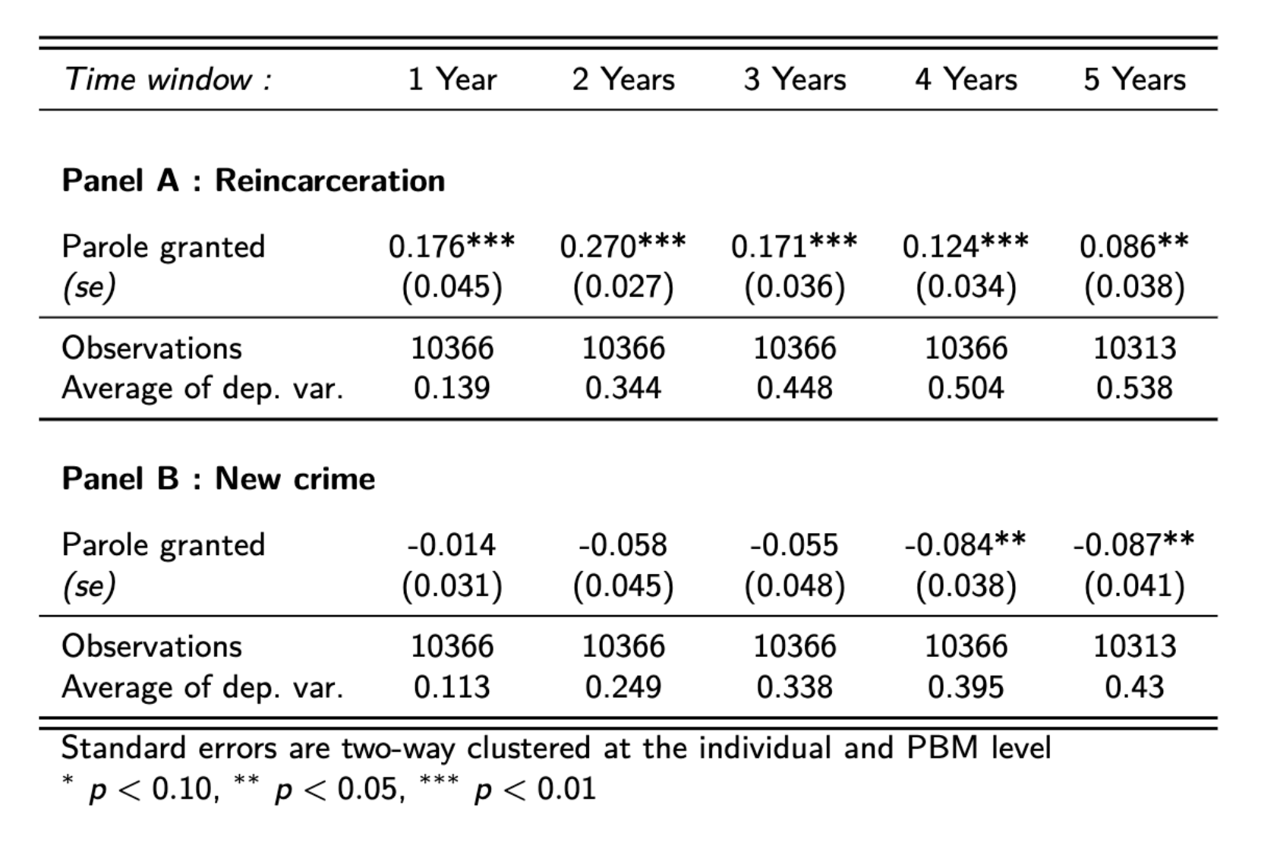
IV regressions

Slide 26
IV regressions
Parole increases the probability of reincarceration by 8.6 percentage points within 5 years …

Slide 27
IV regressions
Parole increases the probability of reincarceration by 8.6 percentage points within 5 years …
but decreases the probability of reconviction by 8.7 percentage points

Slide 28
Contradictory results ?
Asks for another framework to understand the overall effect
What is the effect on incarceration time?
Breaking a parole condition ⇒ reincarceration
This may partly counterbalance the decrease in incarceration caused by parole

Slide 29
Effect of parole on time incarcerated

Slide 30
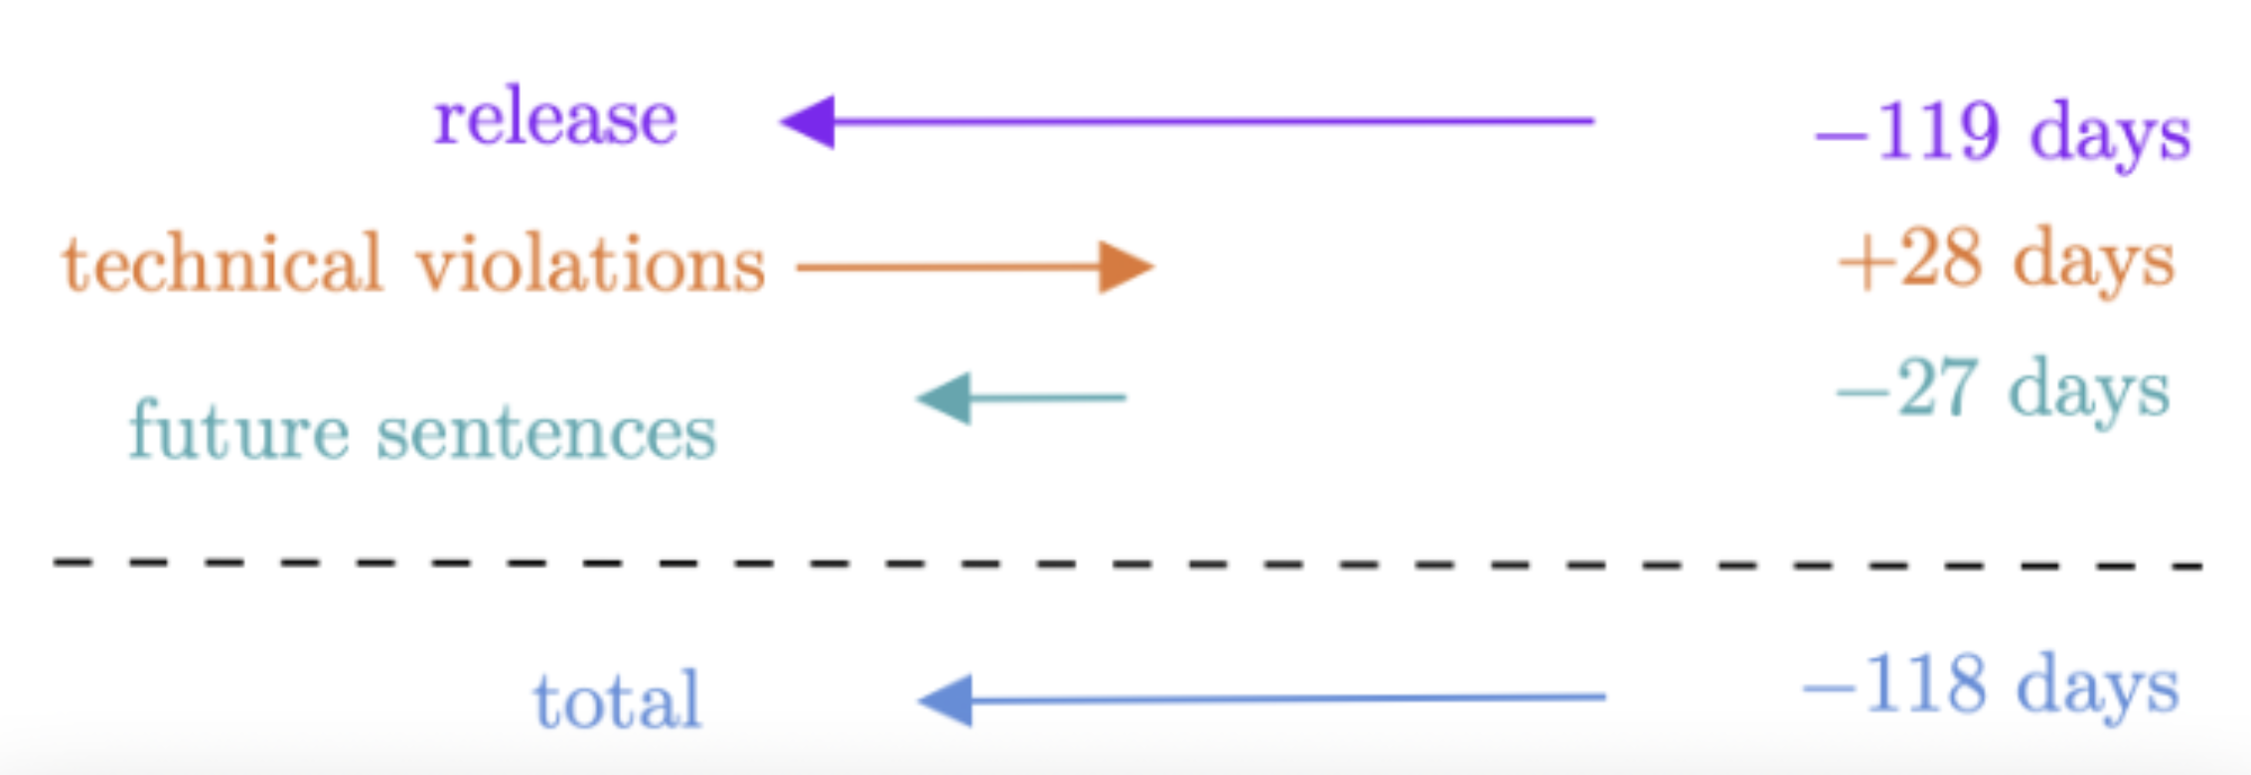
Effect of parole on time incarcerated
Results from IV estimation:

Slide 31
Concluding remarks
Parole decreases total time served (↓ incarceration days) while reducing new crimes
In a context with
substantive rehabilitation assistance (e.g., halfway houses)
a selection of relatively low risk offenders

Slide 32
Thank you steeve.marchand@unimelb.edu.au

