Slide 1
Supporting incarcerated mothers and their children with a model for individual and systems change
Susan Dennison, Janet Ransley, Tara McGee and TCTL team
Applied Research in Crime and Justice Conference, 14th September 2023

Slide 2
Female imprisonment in Queensland
Number of women in prison has doubled in past decade
  Increase in remand
  Increase in First Nations women in custody
  Increase in violent, non-sexual offences
  Parole breaches/suspension
Third highest rate in Australia (making up approximately 9% of prison population in Qld)
Average age 34-35 years
A third of women return to custody within 2 years (half return to Corrective Services for a new sanction)
Majority of women are mothers

Slide 3
Intergenerational cycle of risk, offending and incarceration

Slide 4

TCTL Phase1
Co-create a new model of service provision for imprisoned mothers and their children, during custody and after release, that:
  Creates conditions for families to thrive through a holistic system of practice that supports wellbeing and social inclusion; and
  Demonstrates more effective, sustainable service provision that can be scaled up by governments.

Slide 5
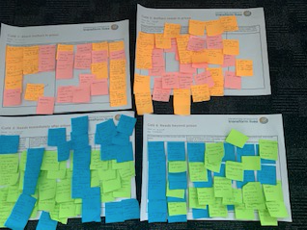
TCTL Co-creation workshops (2020 – 2021)
Workshop Series 1 – Mothers needs (mothers in prison; service providers/agencies)
Workshop Series 2 – Children and young people’s needs (service providers/agencies)
Workshop Series 3 – Model development (TCTL team)
Workshop Series 4 – Model validation (mothers in prison)

Slide 6
Transforming Corrections to Transform Lives Centre
Our Vision
To support mothers and their children to have safe, dignified, and fulfilling lives, breaking down intergenerational cycles of disadvantage and incarceration, by transforming systems and generating new knowledge for evidence-based programs.

Slide 7
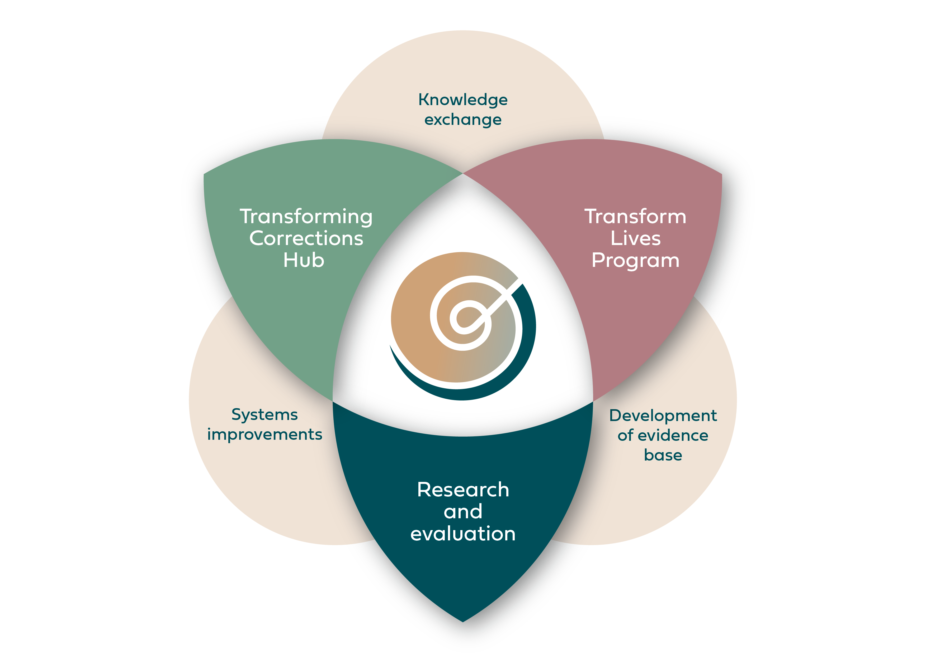

Slide 8
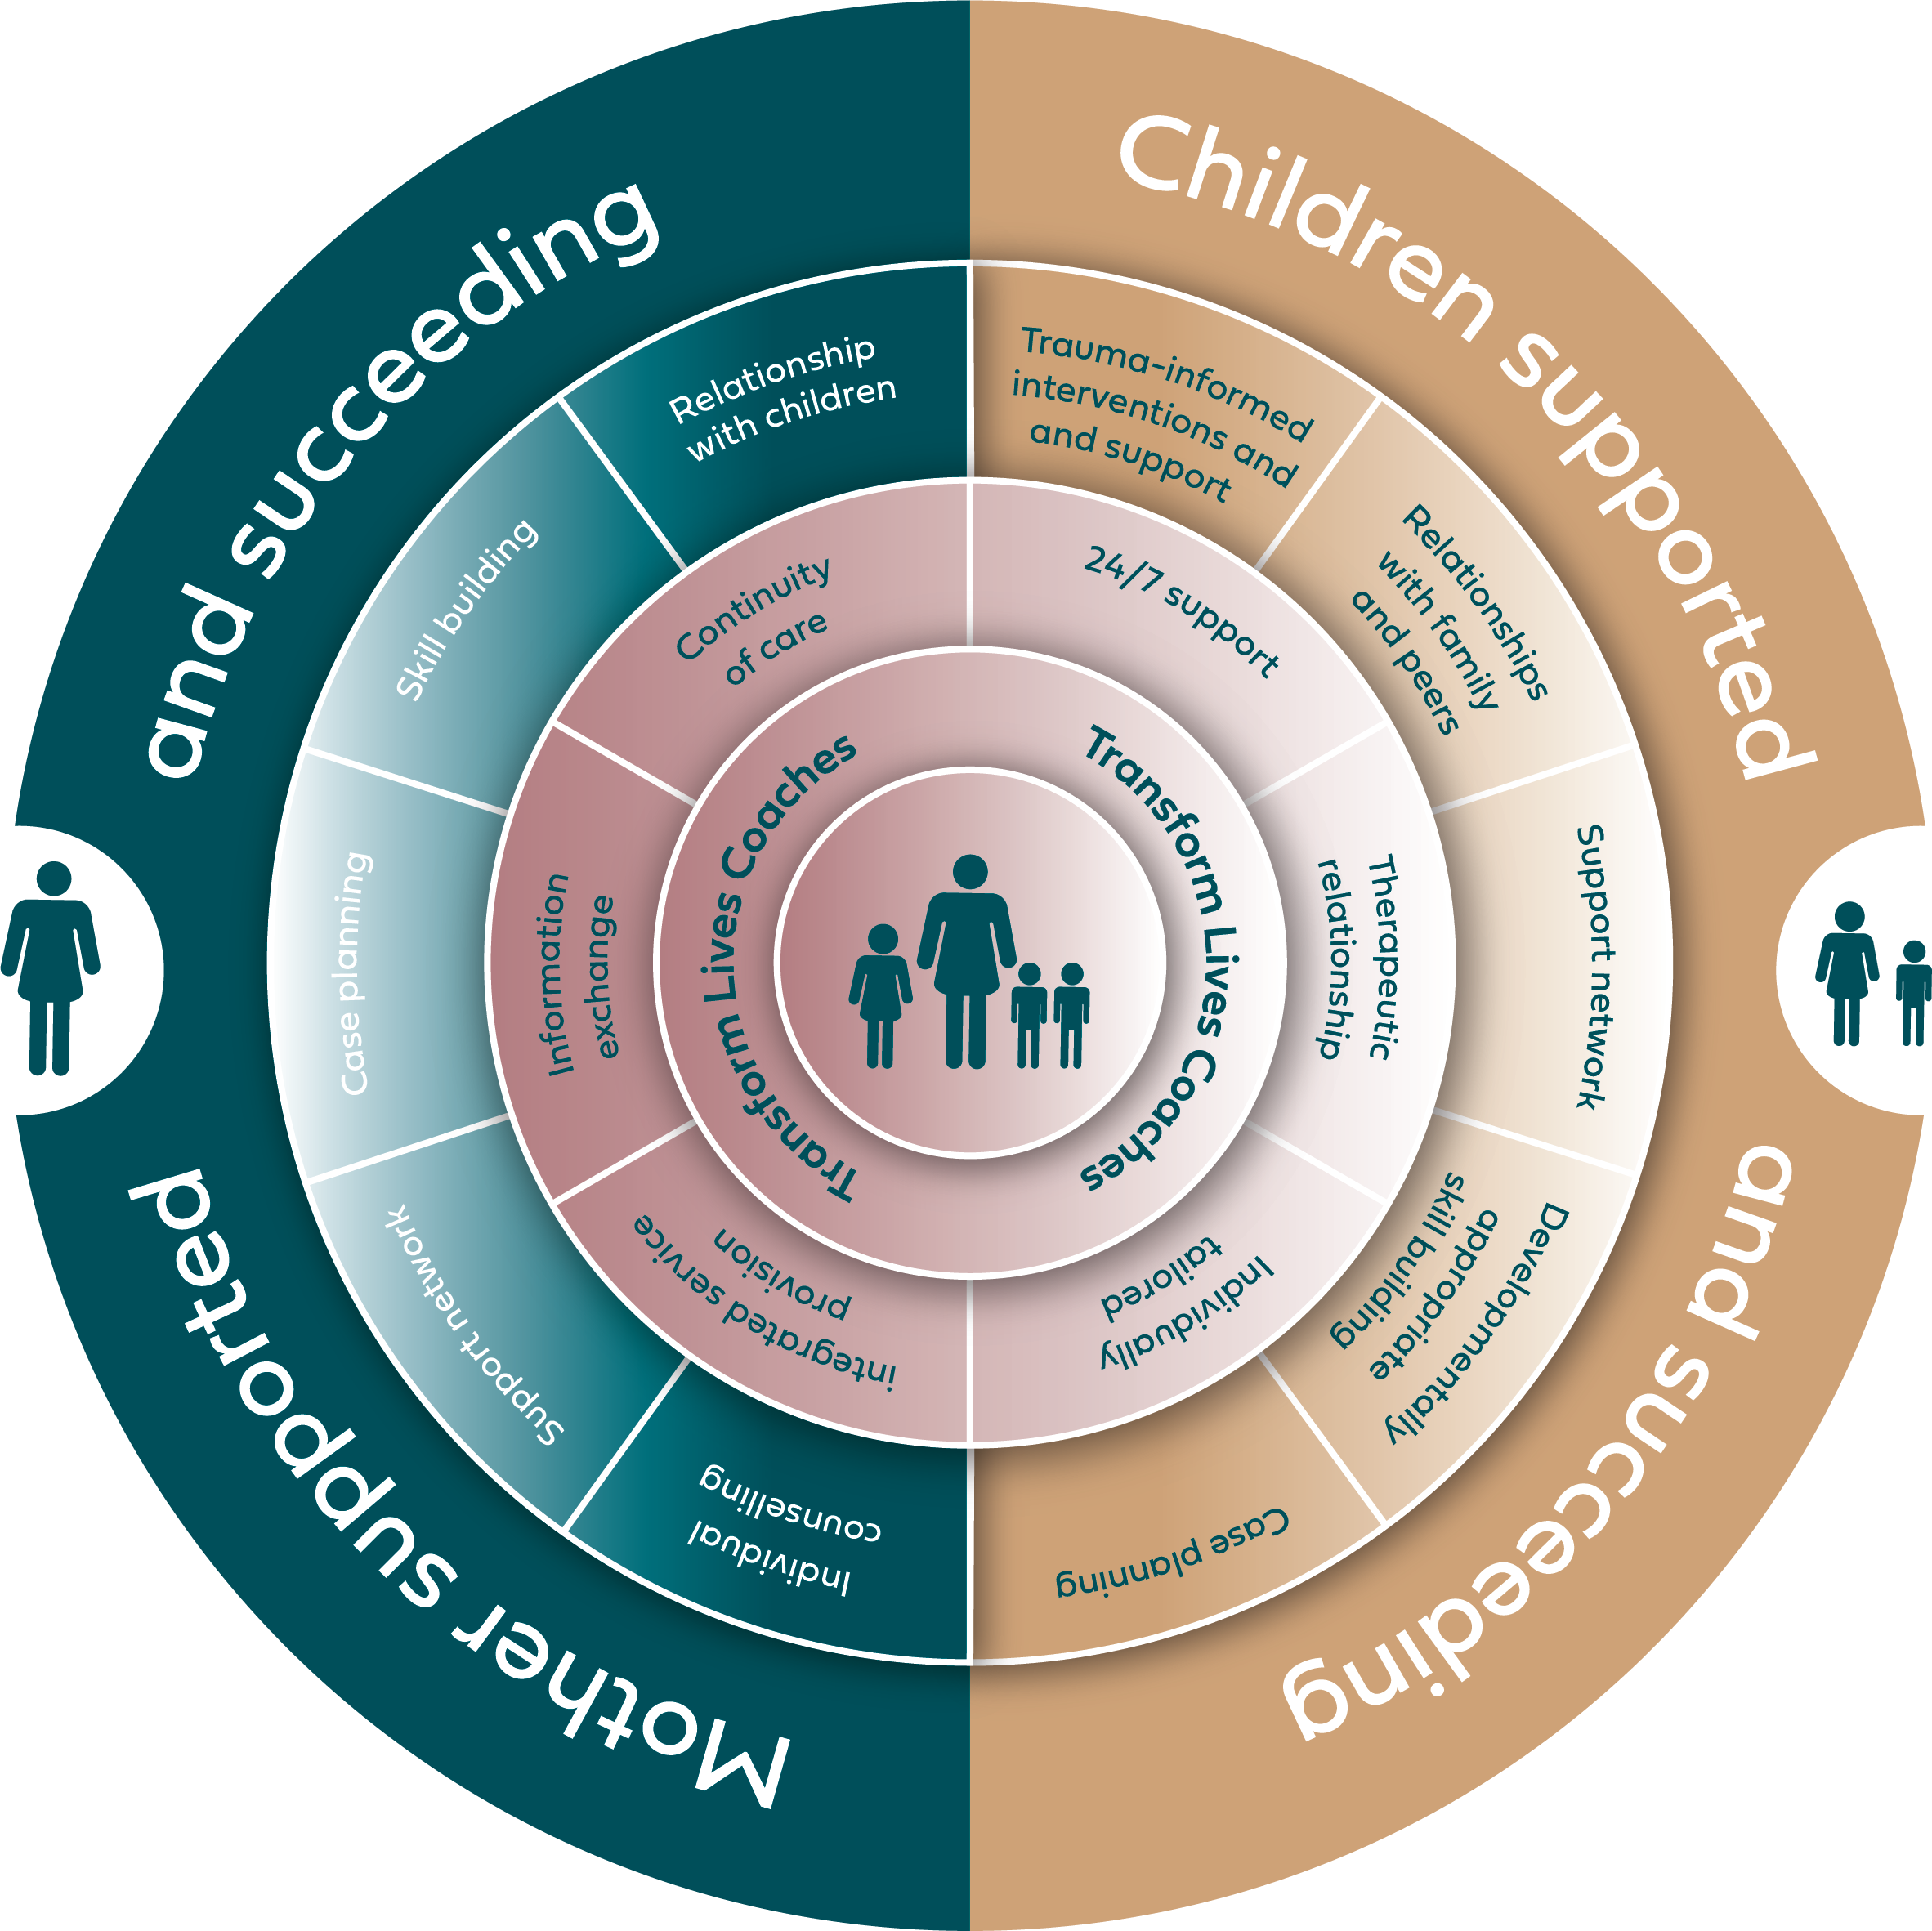

Slide 9
Intended outcomes of Transform Lives Program
Mothers:
  Improvement in key areas that are preconditions for change (knowledge/skills, attitudes, practice/behaviours)
  Improved relationships with their children and capacity to engage in mothering
  Stability and wellbeing (i.e., housing, relationships, employment, health)
  Increased time to re-offend/reduced recidivism
Children:
  Needs assessed (neurodevelopmental, learning, behaviour, health) and support accessed
  Healthy
  Enrolled in, and attending, school (or other educational setting)
  Strong support network and improved relationship with their mother
  Reduced contact with the child protection system and reduced time in out of home care
  Reduced risks for youth offending

Slide 10
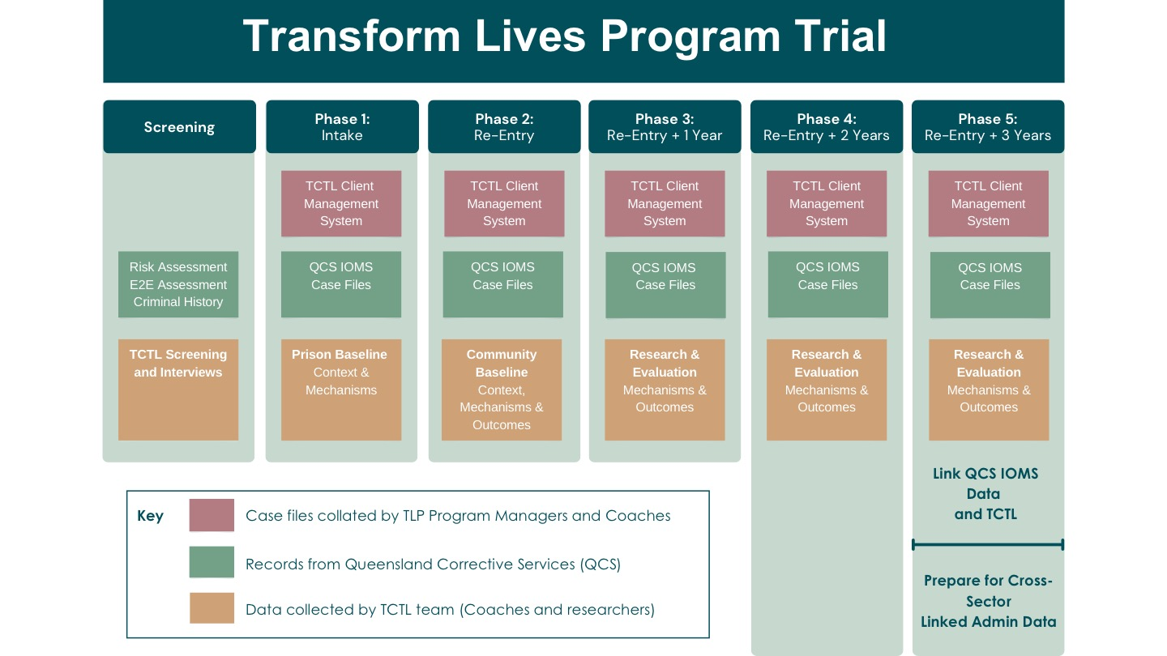


Slide 11
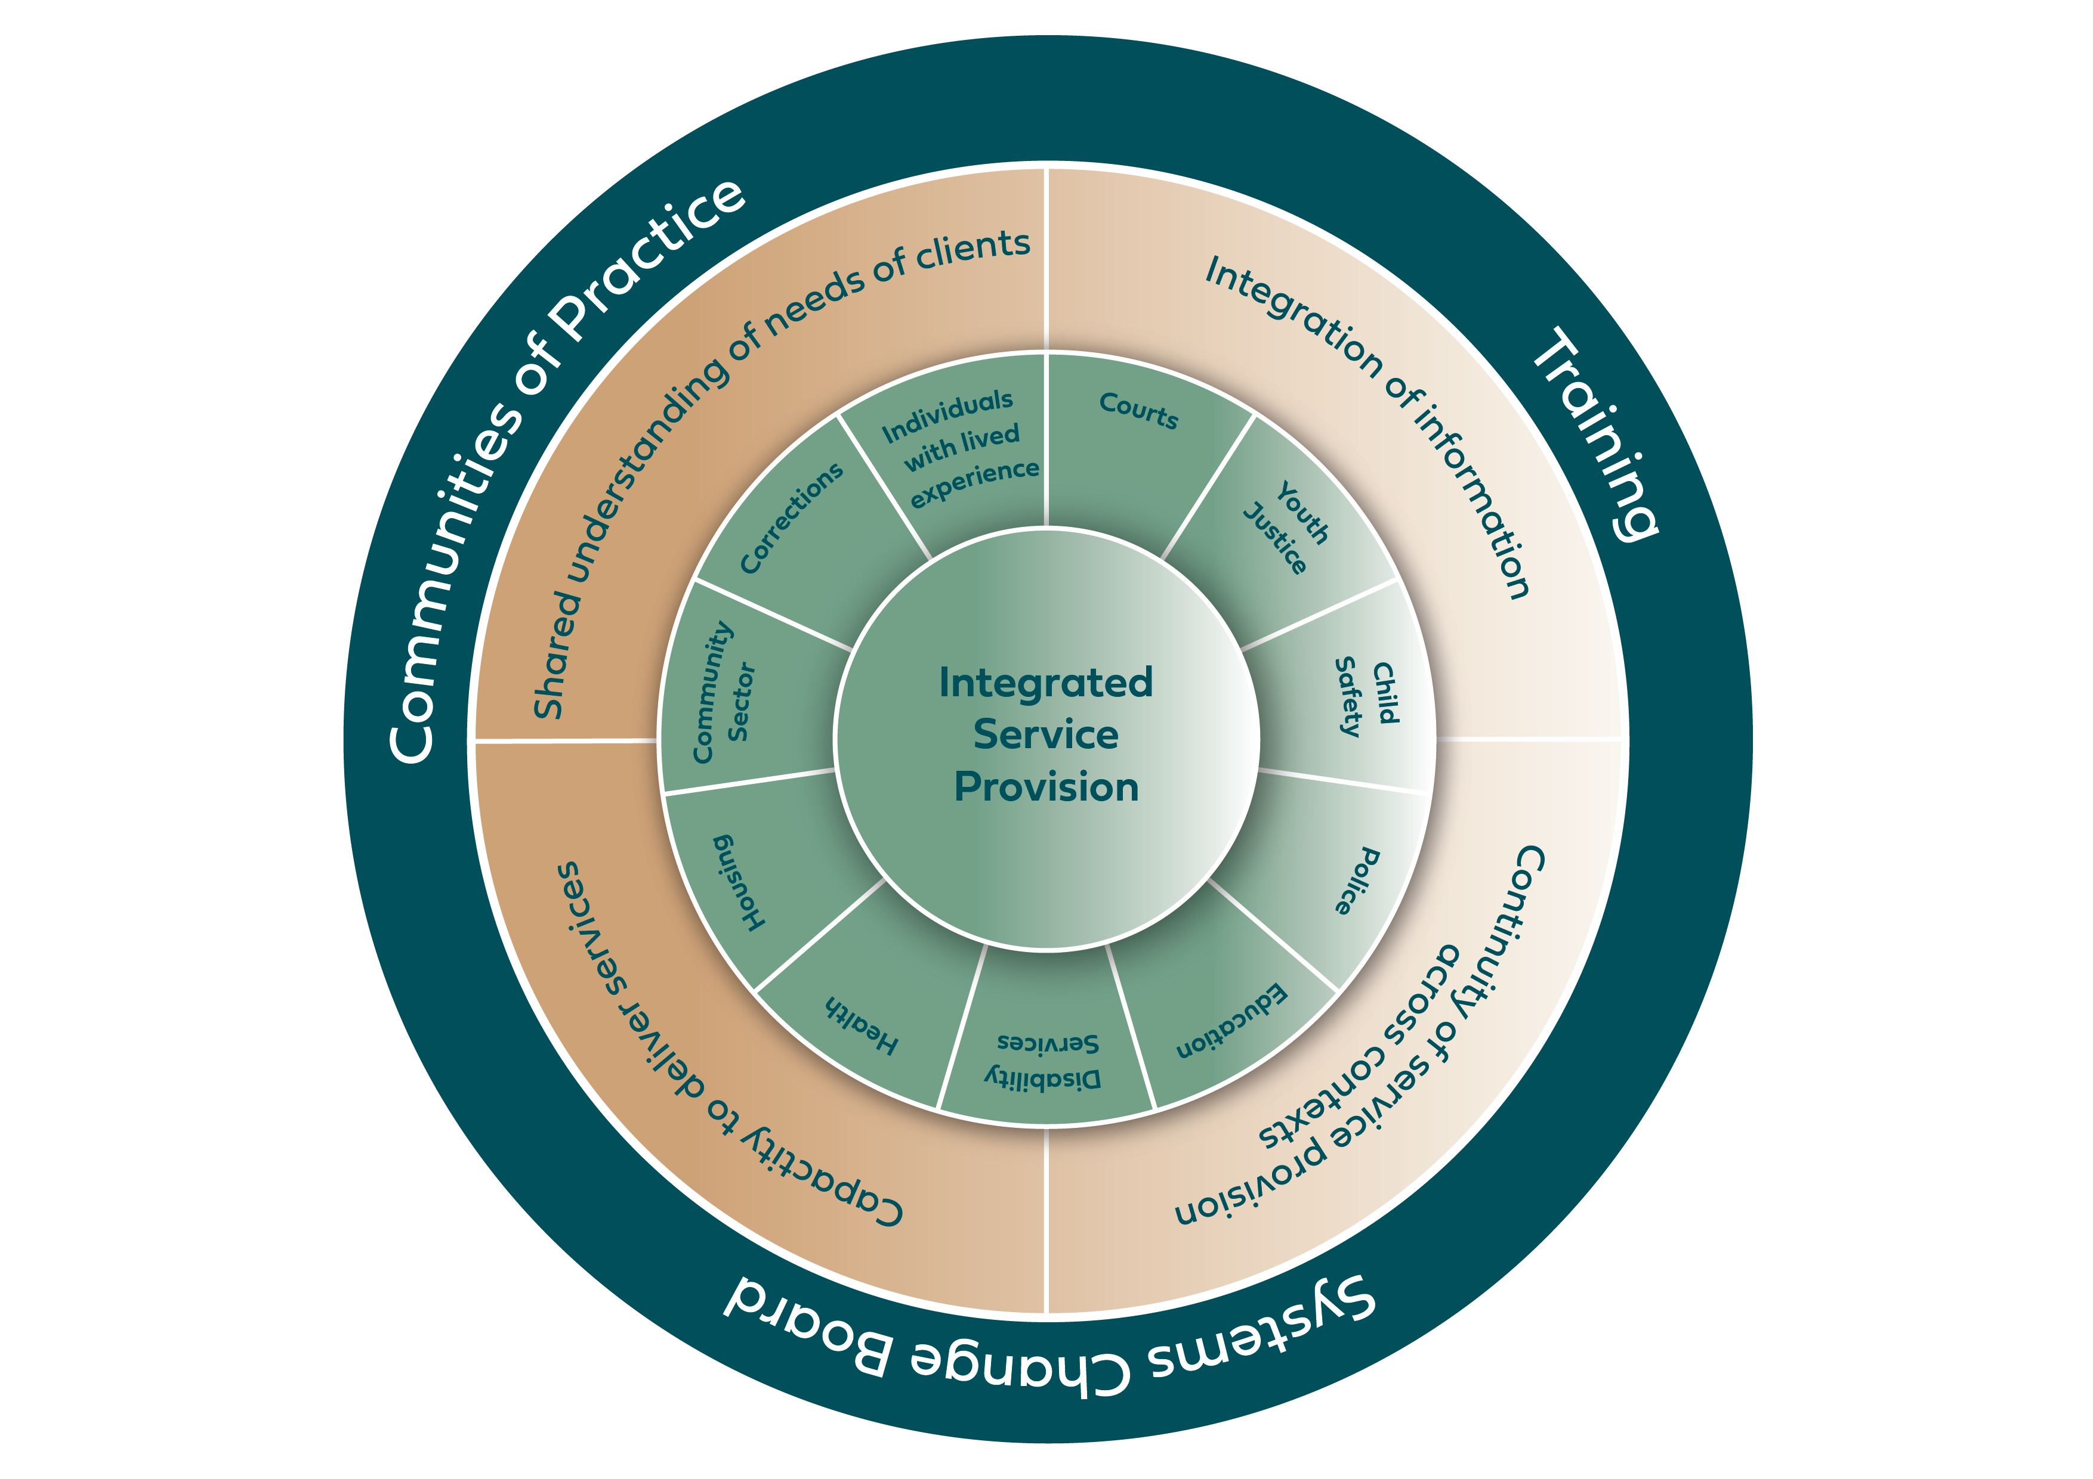

Slide 12
Systems Change Board
The Honourable Margaret McMurdo AC, Chair
Queensland Corrective Services
Department of Youth Justice, Employment, Small Business and Training
Department of Youth Justice, Employment, Small Business and Training
Department of Treaty, Aboriginal and Torres Strait Islander Partnerships, Communities and the Arts
Department of Treaty, Aboriginal and Torres Strait Islander Partnerships, Communities and the Arts
Queensland Health
Department of Education
Department of Housing
Department of Child Safety, Seniors and Disability Services
Office for Women and Violence Prevention, Department of Justice and Attorney General
First Nations Justice Office, Department of Justice and Attorney General
Justice Innovation Office, Department of Justice and Attorney General
Transforming Corrections to Transform Lives Centre, Griffith University

Slide 13

System Mapping
Why map the system?
  To understand how mothers and their children flow through multiple systems
  To identify complexity, overlaps and gaps and how they shape the experiences of mothers and their children
  To identify key decision points where policy or practices change could lead to better outcomes
  To engage system leaders (via the Systems Change Board) in evidence-based and enduring reform
  To provide a baseline for measurement of impact over time
How are we mapping the system?
  Based on Meadows and Wright (2009) - Stock and flow modelling
  Drawing on relevant legislation, policies, procedures, and practices of multiple agencies impacting mothers and their children
  Supplemented by key stakeholder interviews and phase 1 workshops including with imprisoned mothers

Slide 14
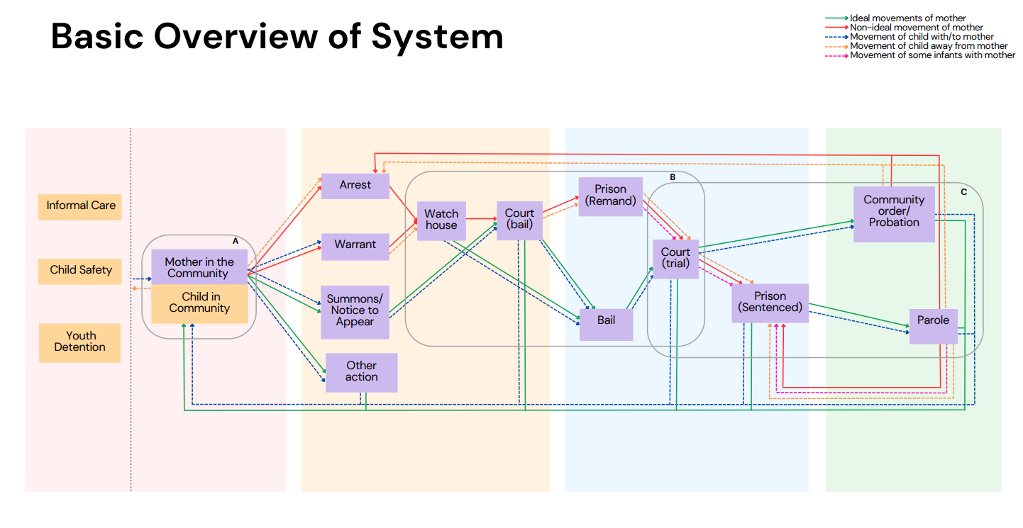
Basic Overview of System

Slide 15
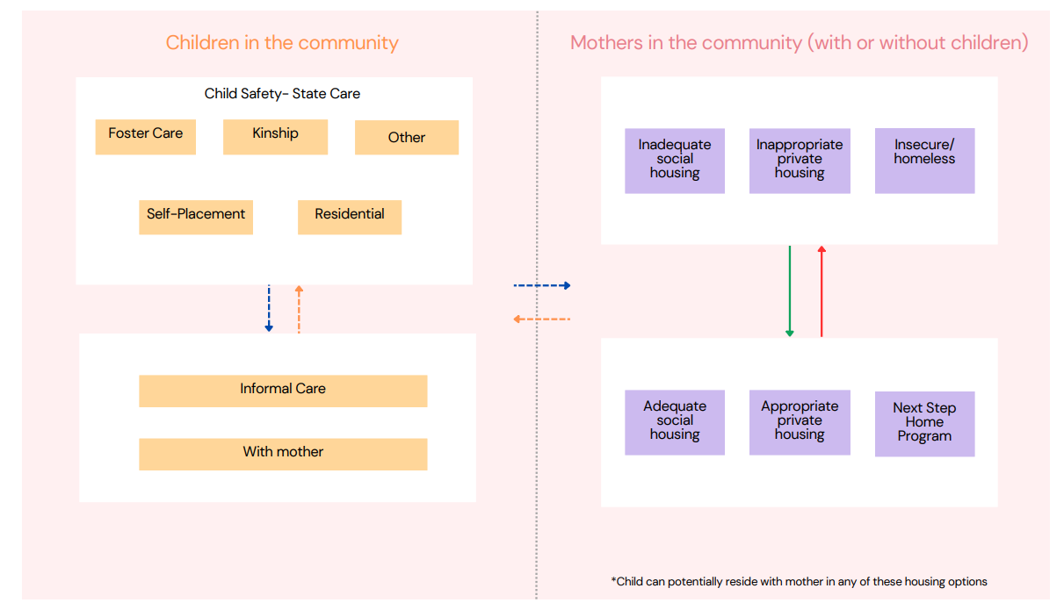

Expansion of Community Sub-System

Slide 16
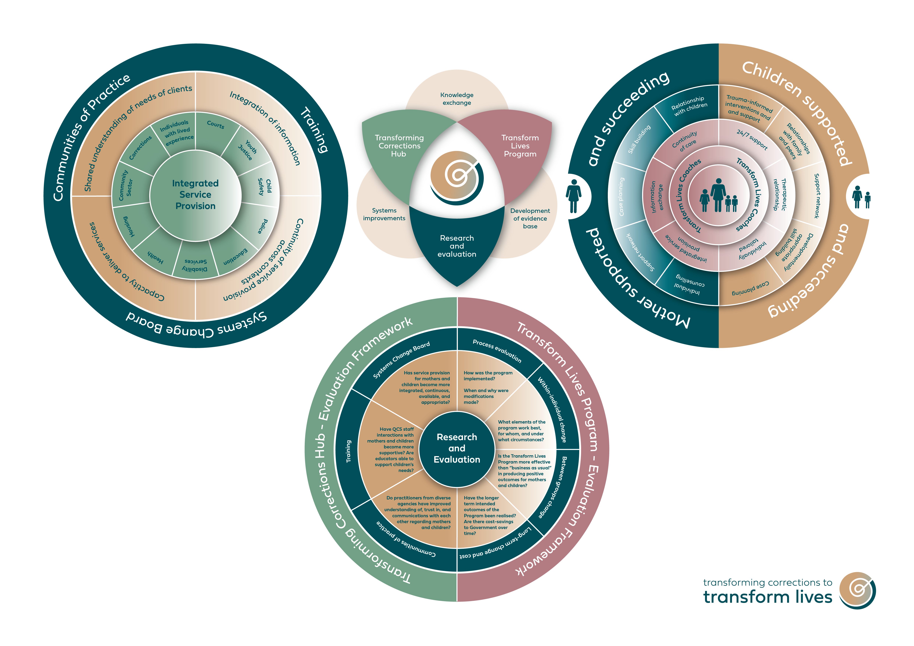

Slide 18

Partnerships
PRF – investment, risk, facilitation, evidence
TCTL – independence, evidence, knowledge brokers
QCS – clients, expertise, systems reform, sustainability
Whole of government – information sharing, strategic advice, systems change
Shared vision - Women and children at core; breaking cycles of disadvantage and offending
Relationships – openness, trust, collaboration

Slide 19
Thank you
For more information:
Director, TCTL Centre
Professor Susan Dennison
susan.dennison@griffith.edu.au
Transforming Corrections to Transform Lives website:
www.transformingcorrections.com.au

