Slide 1
YOUTH CRIME IN NSW
A TIME OF CRISIS OR A CRISIS IN CONFIDENCE?
Prof. Jason Payne
GRIFFITH CRIMINOLOGY INSTITUTE

Slide 3
YOUTH CRIME IN NSW
A TIME OF CRISIS OR A CRISIS IN CONFIDENCE?
Was Don Weatherburn right all along?
Prof. Jason Payne
GRIFFITH CRIMINOLOGY INSTITUTE

Slide 4
ACKNOWLEDGEMENT
Australian Institute of Criminology (AIC) and Criminology Research Council (CRC)
NSW Bureau of Crime Statistics and Research (BOCSAR)
NSW Registry of Births Deaths and Marriages
Cameron Langfield (UOW, PhD Candidate) and Dr Delia Rambaldini-Gooding (UOW)
But, the errors are all mine!
griffith.edu.au/criminology-institute

Slide 5
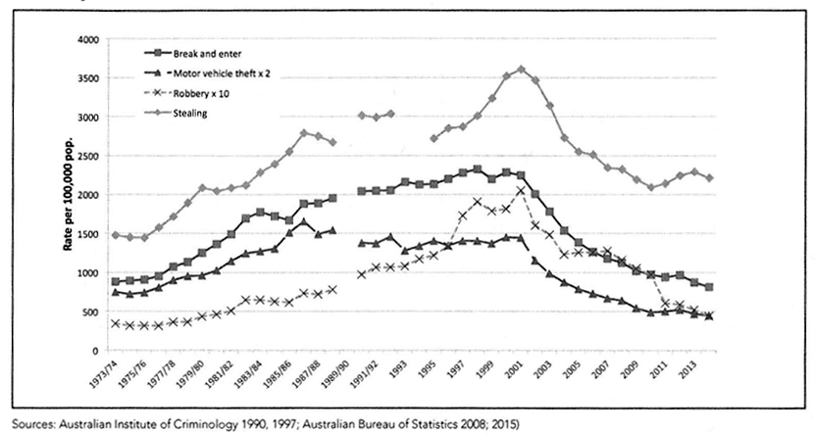
FIRST: A little bit of history
Heroin Shortage
Employment
Improving economy
Incarceration
Source: Weatherburn, Halstead and Holmes (2016)
griffith.edu.au/criminology-institute

Slide 6
SECOND: Another different hypothesis
1984 cohort
10-18 years
1994 cohort
Generation Y study - Hua et al., (2006)
Source: Weatherburn, Halstead and Holmes (2016)
griffith.edu.au/criminology-institute

Slide 7
STAGE 2: A repeat methodological plan
Re-extract births data for
1984 & 1994
BOCSAR ROD
Replicate Hua et al., (2006) for the 1984 cohort
Hua et al., (2006)
methodology
Repeat and compare for the 1994 cohort
griffith.edu.au/criminology-institute

Slide 8
RESULTS: Three key findings
Down -30%
Difference emerges at 15
No difference in early years
griffith.edu.au/criminology-institute

Slide 9
RESULTS
Cumulative population prevalence of offending (proven offences) was 30% lower
(6.2% vs. 9.3%)
Total quantum of offending (proven offence counts) was 7% lower
(34,463 vs. 36,996)
Largest declines were for property offences (-33%) and drink driving offences (-48%).
HOWEVER, offending rates (i.e. the average number of offences per offender) were higher.
(6.4 offences, vs. 4.7 offences)
AND, there was NO CHANGE in the prevalence of offending up to age 14 (1%, respectively).
griffith.edu.au/criminology-institute

Slide 10
BUT: Two unanswered questions
Are the 1994 kids just more ‘cocooned’ in adolescence and will they emerge later as adults?
Noting that the 1994 cohort was already 21 by the time we extracted the data, what about today’s kids?
griffith.edu.au/criminology-institute

Slide 11
STAGE 2: A repeat methodological plan
Re-extract birth data for 1984, 1994 & 2004
BOCSAR ROD
Replicate 1984 and 1994 results
Name & DOB
Exact match
Repeat for 2004 cohort
griffith.edu.au/criminology-institute

Slide 12
RESULTS
Down -87%
griffith.edu.au/criminology-institute

Slide 13
RESULTS
Cumulative population prevalence of offending (proven offences) was 87% lower
(0.3% vs. 2%).
Total quantum of offending (proven offence counts) was 60% lower
(1,357 vs. 3,701).
Largest declines were for property offences (-77%), but everything declined.
That’s extraordinary – perhaps unbelievable, even!
griffith.edu.au/criminology-institute

Slide 14
STAGE 2: A repeat methodological plan
Re-extract Births
1984 & 1994
& 2004
BOCSAR ROD
Replicate 1984 and 1994 results
Name & DOB
Probability Match
Repeat for 2004 cohort
griffith.edu.au/criminology-institute

Slide 15
RESULTS
Down -34% on 1994
Down -18% on 1984
griffith.edu.au/criminology-institute

Slide 16
Difference between the 1994 and 2004 cohorts
 | Exact match |  |  | Probability Match
Metric | 1994 | 2004 | Diff | 1994 | 2004 | Diff
Cumulative prevalence to age 15 (%) | 1.8 | 0.3 | -84% | 3.3 | 2.2 | -34%
N per 100,000 | 1754 | 284 | -1469 | 3289 | 2166 | -1123
Proportion violent to age 15 (%) | 39% | 71% | +32% | 34% | 49% | +15%
Proportion property to age 15 (%) | 60% | 54% | -6% | 57% | 45% | -13%
griffith.edu.au/criminology-institute

Slide 17
Difference between the 1994 and 2004 cohorts
 | Exact match |  |  | Probability Match
Metric | 1994 | 2004 | Diff | 1994 | 2004 | Diff
Cumulative prevalence to age 15 (%) | 1.8 | 0.3 | -84% | 3.3 | 2.2 | -34%
N per 100,000 | 1754 | 284 | -1469 | 3289 | 2166 | -1123
Whichever measure – the number of young people with a proven criminal offence has declined between 1994 and 2004.
griffith.edu.au/criminology-institute

Slide 18
Difference between the 1994 and 2004 cohorts
 | Exact match |  |  | Probability Match
Metric | 1994 | 2004 | Diff | 1994 | 2004 | Diff
Cumulative prevalence to age 15 (%) | 1.8 | 0.3 | -84% | 3.3 | 2.2 | -34%
N per 100,000 | 1754 | 284 | -1469 | 3289 | 2166 | -1123
Proportion violent to age 15 (%) | 39% | 71% | +32% | 34% | 49% | +15%
Proportion property to age 15 (%) | 60% | 54% | -6% | 57% | 45% | -13%
Whichever measure – those 2004-born young offenders who were proceeded against (and proven) are disproportionally more violent.
griffith.edu.au/criminology-institute

Slide 19
Difference between the 1994 and 2004 cohorts
 | Exact match |  |  | Probability Match
Metric | 1994 | 2004 | Diff | 1994 | 2004 | Diff
Cumulative prevalence to age 15 (%) | 1.8 | 0.3 | -84% | 3.3 | 2.2 | -34%
N per 100,000 | 1754 | 284 | -1469 | 3289 | 2166 | -1123
Proportion violent to age 15 (%) | 39% | 71% | +32% | 34% | 49% | +15%
Proportion property to age 15 (%) | 60% | 54% | -6% | 57% | 45% | -13%
Whichever measure – those 2004-born young offenders who are proceeded against (and proven) are disproportionally less likely proceeded against for property offences.
griffith.edu.au/criminology-institute

Slide 20
Difference between the 1994 and 2004 cohorts
 | Exact match |  |  | Probability Match
Metric | 1994 | 2004 | Diff | 1994 | 2004 | Diff
Cumulative prevalence to age 15 (%) | 1.8 | 0.3 | -84% | 3.3 | 2.2 | -34%
N per 100,000 | 1754 | 284 | -1469 | 3289 | 2166 | -1123
Proportion violent to age 15 (%) | 39% | 71% | +32% | 34% | 49% | +15%
Proportion property to age 15 (%) | 60% | 54% | -6% | 57% | 45% | -13%
Average number of offences per offender at age 15 | 5.2 | 9.7 | +4.5 | 4.0 | 4.5 | +0.5
The exact match measure produces higher estimates of both property and violent offences – this signals that offenders ‘found’ are more chronic.
griffith.edu.au/criminology-institute

Slide 21
MACR DEBATE –Thoughts on youth offending (10-13 years)
Proposition 1: Things are getting worse
No. In fact, youth offending (under 14) has declined by about 30% in the past 10 years.
Proposition 2: Youth offenders are more violent
The number of young people processed for violence has declined.
However, violence is more common for an increasingly larger share of the (smaller) group who are charged, arrested and proceeded against by the police.
Proposition 3: Youth offenders are more prolific
Not really. In raw terms there are fewer high-volume/chronic offenders. Its just that they represent a larger proportion of those who are processed.
griffith.edu.au/criminology-institute

Slide 22
STAGE 2: A repeat methodological plan
Re-extract Births
1984 & 1994
& 2004
BOCSAR ROD
Replicate 1984 and 1994 results
Name & DOB
Probability Match
Parents of the 2004 birth cohort
Repeat for 2004 cohort
griffith.edu.au/criminology-institute

Slide 23
BUT… a fly in the ointment!
griffith.edu.au/criminology-institute

Slide 24
BUT… a fly in the ointment!
griffith.edu.au/criminology-institute

Slide 25
BUT… a fly in the ointment!
Prior to Birth: N=1,091, (1.2%)
griffith.edu.au/criminology-institute

Slide 26
BUT… a fly in the ointment!
Prior to Birth: N=1,091, (1.2%)
After Birth: N=1,916, (2.3%)
griffith.edu.au/criminology-institute

Slide 27
Parental involvement in crime (youth offenders)
griffith.edu.au/criminology-institute

Slide 28
BUT… a fly in the ointment!
Down -11%
Difference emerges at 18
griffith.edu.au/criminology-institute

Slide 29
FINAL THOUGHTS
Replication matters.
Understanding and trust between researchers and data providers is crucial.
Researchers need to know what’s happening inside the ‘black box’ of data matching.
Research results must be carefully considered alongside a clear understanding of the processes through which the research data has been generated – applied researchers, especially those using ‘BIG’ administrative datasets, must always interrogate.
griffith.edu.au/criminology-institute

Slide 30
FINAL THOUGHTS
For the apparent crime-decline to disappear, especially at younger ages, this means that the probability-matching method has yielded disproportionally more “new records” people in 1994 cohort.
It likely means that there is a disproportionally higher rate of ‘error at time of input’ for one or more elements of the name and DOB matrix.
It likely also means that exact-match methodologies become more accurate with time – as each new contact with the CJS creates a new opportunity correct/connect erroneous historical records.
Can we exploit that difference to reflect on policy/practice? What social or procedural mechanisms would cause disproportionally higher rates of data-entry error?
On-the-street processing for minor offences?
griffith.edu.au/criminology-institute

Slide 31
YOUTH CRIME IN NSW
A TIME OF CRISIS OR A CRISIS IN CONFIDENCE?
Was Don Weatherburn right all along?
Prof. Jason Payne
GRIFFITH CRIMINOLOGY INSTITUTE

