Slide 1




Findings from the evaluation study of home detention in South Australia: 2016-2022
BoCSAR Conference 14-15 August 2023 - Sydney
Associate Professor Jesse Cale, Griffith Criminology Institute, School of Criminology and Criminal Justice, Griffith University
Fredrick Zmudzki, Époque Consulting and Social Policy Research Centre (SPRC), UNSW
Dr. Tyson Whitten, Charles Sturt University
Dr. Fiona Hilferty, Social Policy and Research Centre, UNSW
Dr. Lise Lafferty, Centre for Social Research in Health, UNSW
Dr. Michael Doyle, Kirby Institute, UNSW
Prof. kylie valentine, Social Policy and Research Centre, UNSW
with
Jane Farrin, Director Sentence Management Unit, Department for Correctional Services, South Australia
Final Report: https://www.corrections.sa.gov.au/__data/assets/pdf_file/0005/901508/Evaluation-of-HD-in-SA-Final-Report-20230216-CLEAN.pdf
Previous reports: https://www.corrections.sa.gov.au/about/our-research/hd-research-evaluation

Slide 2
Overview of the presentation
Policy Context
Outcomes evaluation
Economic evaluation

Slide 3
Policy Context
Growth in South Australia’s imprisonment rate was increasing at twice the national rate over the past decade.
Expanding community-based supervision and rehabilitation
Statutes Amendment (Home Detention) Bill 2015
    Release Ordered Home Detention (ROHD) – 14 June 2016
    Court Ordered Home Detention (COHD) – 1 September 2016
  Expansion in numbers post proclamation in 2016
  Home Detention Integrated Support Services Program (HISSP)
Notes:
Growth in South Australia’s imprisonment rate was increasing at twice the national rate over the past decade.
Faster growth of sentenced prisoner numbers in South Australia (67%) compared to Australia (33%) over the past 10 years;
A 13% decline in the number of South Australians on community-based corrections orders over the past 10 years compared to an 1% increase nationwide;
Significant public safety and community protection policy and legislative settings;
• Increased scrutiny on parole board decisions;
• Increasing police numbers, growth in the rate of police arrest and changing police practices.
Projected prisoner demand identified a shortfall of
181 beds by 1 July 2020 and
606 beds by 1 July 2024.
Risks associated with overcrowding and reduced ability to deliver effective rehabilitation were identified
Expanding community-based supervision and rehabilitation
Evidence showed that early identification and assessment of offenders to confirm their risk and needs and match them to relevant responses including rehabilitation and treatment programs will likely reduce reoffending
If crime and recidivism can be reduced by using non custodial evidence based programs there may be reduced demand for prison beds
Non custodial solutions included
Expansion of current Release Ordered Home Detention Program (back end home detention)
Enabling the courts to sentence an offender to a period of home detention (front end home detention)
Additional community rehabilitation measures
The legislation allows suitable prisoners to be released to Home Detention earlier in their prison sentence and to spend longer periods on Home Detention. Increased use of Home Detention is supported by evidence based practice which shows that improved outcomes can be reached when suitable offenders engage in rehabilitation services in a community setting.
The impact of the proposal on the community is likely to be viewed as positive as it will:
enable families to stay together (if desired);
minimise harm and economic loss associated with imprisonment through loss or employment and housing;
allow prisoners to retain community and family ties and family units to remain intact;
allow prisoners to continue with rehabilitative efforts and make restitution;
provide prisoners with access to counselling and education programs that are not available in custody; and
reduce the risk of recidivism by promoting rehabilitation and preventing exposure to the environment of a correctional institution,
thereby better supporting the offender and contributing to the Government’s ‘safe communities and healthier neighbourhoods’ strategic priority.
Statutes Amendment (Home Detention) Bill 2015
The Statues Amendment (Home Detention) Bill 2015 (the Bill) was introduced to Parliament on 10 September 2015. The Bill set out a number of proposed changes to legislation to expand the use of home detention. The Bill sought to:
amend the Correctional Services Act 1982 (the Act) to expand the Department’s current Home Detention Program for Sentenced Prisoners; and
amend the Criminal Law (Sentencing) Act 1988 (the CLSA) to allow a court to sentence an offender to a period of imprisonment to be served on home detention. Recent amendments expand current eligibility criteria to remove the requirement that offenders complete 50% of their non parole period and have less than 12 months to serve to their parole eligibility date.
Release ordered home detention
DCS SA has operated a Home Detention for offenders exiting custody since 1986
Prior to the legislative changes prisoners were only eligible for back end home detention if offenders
have served at least 50% of their non-parole period; and
have less than 12 months to serve to their parole eligibility date.
Prisoners approved for HD are subject to Electronic Monitoring (EM) and strict supervision by corrective services officers
The legislative changes removed these restrictions and allow eligible prisoners to be released to home detention earlier in their sentence and to spend longer periods on home detention.
Since proclamation:
On 9 June 2016, there were 115 offenders on Home Detention, this number increased to 149 on 22 June 2016, a 29.6% increase. The number of males on Home Detention in this period increased from 99 to 127 (a 28.3% increase) and the women increased from 16 to 22 (37.5%).
Court ordered home detention
On 1 September 2016 Court Ordered Home Detention commenced under the Criminal Law (Sentencing) Act 1988.
This Act allows for magistrates and judges to use Court Ordered Home Detention as a sentencing option for a period of imprisonment
The Sentencing Act delineates the hierarchy of sentencing options available to a sentencing court, with Court Ordered Home Detention sitting between a suspended sentence and a custodial sentence of imprisonment.
It does not exclude particular classes of offences or lengths of terms of imprisonment in its application. A sentencing court will retain discretion to be exercised upon consideration of all the relevant factors in the legislation and any other matter the court thinks relevant.
Home Detention Integrated Support Services Program (HISSP), delivered by OARS Community Transitions.
Following intake, OARS will provide support tailored to the needs of the participant. OARS will proactively deliver participant support; they will not simply refer participants to other services. Case Workers will also support participants to access mainstream services by assisting them to navigate these systems.
Services and support will be offered against the following areas:
· Housing (assistance to access housing and support to maintain a tenancy);
· Mental health;
· Alcohol and drug counselling;
· Employment (support to source and sustain);
· Education and training;
· Independent Living skills;
· Financial counselling;
· Gambling support; and
· Family and Community Connectedness (including issues relating to domestic and family violence).

Slide 4
Release Ordered Home Detention
Eligibility and Suitability
Assessment process – Sentence Plan and Case Review
  Home Detention Check List and Home Detention Committee
Assessment considerations
    Risk of Reoffending
    Community Compliance
    Prison Behaviour
    Program Participation
    Intel, Victim and SAPOL information
    Community Safety
    Structured day/residence
Notes:
Not Eligible – sexual, homicide, terrorism offences
Suitability – assess – previous compliance, cut and run, breaches on HD, breaches on COHD, number and recency, victim information, risk of reoffending (VPP), length of time on HD, sentencing remarks, community expectations/safety
Assess at time of sentence plan and at time of case review
Review prison incidents – behaviour urine tests, Intel, SAPOL information, victims views of release (mainly DV)
Program participation – engagement
Residence – if IO/victim resides, other residents, police attendance/activity at the residence, if resident does not wish to accommodate offender
Structured day – employment/study – protective – Road to Redemption
Focus on increasing female and Aboriginal participation – Lemongrass Place
Add in recent data of HD numbers
Homicide offenders, sex offenders and terrorist offenders and those serving a sentence of indeterminate duration remain ineligible
Release to Home Detention is not automatic and a robust process is undertaken before an offender is approved to Home Detention, including home suitability and risk assessment. The Chief Executive has absolute discretion under Section 37A of the Correctional Services Act 1982 to release a prisoner and various criteria must be met. Other criteria considered pursuant to Section 37A(3)(d) includes community safety, the behaviour of the prisoner whilst serving their sentence and any remarks of the Court at the time of sentencing.
For any prisoners with a head sentence greater than five years, the Parole Board is invited to provide input.
For any prisoners with Registered Victims, the Department’s Victim’s Services Unit will seek to make contact and provide input on behalf of victims.
For any prisoner deemed a Serious Offender the Serious Offender Committee must review and approve prior to release onto the Home Detention Program. This committee also includes representation from SAPOL and Victim Support Service.
When considering release of a prisoner onto Home Detention the Home Detention Committee gives consideration to the following:
Risk posed to the community
eligibility/suitability for release onto the program;
prisoner comments, as set out in any accompanying prisoner submission/s;
information contained within the Home Detention Evaluation Reports prepared during the process;
any information provided by SAPOL or DCS Intelligence;
any criminogenic risk/need assessments undertaken;
Institutional behaviour that would inform suitability for release, including urinalysis history, engagement in rehabilitation programs and progression through the prison system.
any additional information provided to HDC members for consideration.

Slide 5
Outcomes evaluation
ROHD outcomes
COHD outcomes
Does HD reduce the likelihood of returning to custody compared to a prison sentence?

Slide 6
Average age at release to ROHD: Males= 39.3 v. Females 39.2 (ns)
Average no. of priors: Males= 1.9 v. Females 1.5 (**)
Average RoR score: Males= 10.9 v. Females 10.9 (ns)

Slide 9
Average age at release to COHD: Males= 38.5 v. Females 38.1 (ns)
Average RoR score: Males= 10.6 v. Females 10.3 (ns)

Slide 12
Does HD reduce the likelihood of returning to custody compared to a prison sentence?

Slide 13
Notes:
Matching Procedure Step 1

Slide 14
Average age at sentence: PD= 35.2 v. ROHD= 40.0 (***)
Average RoR score: PD= 14.8 v. ROHD= 11.0 (***)
Notes:
Matched variables:
Age
Male
Aboriginal
Completed high school
Employed
Prior sentences
INDEX offence
ROR score
Program participation
Non-parole period

Slide 15
Days to return to custody by matched Prisoner Discharge (n=308) and ROHD (n=308) groups
On average the PD group returned to custody 407 days sooner than the ROHD group
By 730 days post discharge, around 40% of the PD group, and 23% of the ROHD group, had returned to custody.
Rate of return to custody was 1.85 times lower for the ROHD than PD group

Slide 17
Average age at sentence: PD= 35.2 v. COHD= 38.4 (***)
Average RoR score: PD= 14.8 v. ROHD= 10.5 (***)
Notes:
Matched variables:
Age
Male
Aboriginal
Prior sentence
Violent offence
RoR Score

Slide 18
Days to return to custody by matched Prisoner Discharge (n=352) and COHD (n=352) groups
On average the PD group returned to custody 196 days sooner than the COHD group
By 730 days post discharge, around 45% of the PD group, and 33% of the COHD group, had returned to custody.
Rate of return to custody was 1.53 times lower for the COHD than PD group

Slide 19
Summary of outcomes
The majority of individuals serving HD orders were males (approximately 80%) with an average age in the late 30s, and less than one in ten were Aboriginal.
Most common index offences for ROHD were drug related (34%) compared to driving/administrative offences for COHD (79.9%)
13.9% of prisoners breached the conditions of ROHD compared to 14.0% of individuals serving COHD who breached the conditions of an order.
21.0% of those serving ROHD returned to custody within the approximately six-year follow-up period, and 24.4% of those serving COHD returned in the same time frame.

Slide 20
Factors associated with ROHD outcomes
Increased likelihood of breaches
  Risk assessment score
  Multiple prior sentences
  Fraud related index offences
Decreased likelihood of breaches
  Violent index offence
  # of NPP days and ROHD sentence days
  # of HISSP support days
Increased likelihood of RTC
  Younger age at release
  Number of prior sentences (Risk)
  Breaches of ROHD
Decreased likelihood of RTC
  Employed prior to prison
  Length of ROHD

Slide 21
Factors associated with COHD outcomes
Increased likelihood of breaches
  Risk assessment score
  Public order/property related index offence
Decreased likelihood of breaches
  Longer COHD sentence
  # of HISSP support days
Increased likelihood of RTC
  Male
  Theft index offence
  Risk assessment score
Decreased likelihood of RTC
  Longer COHD sentence

Slide 22
HD vs. Prison release outcomes
The results provide empirical evidence to suggest that all else being equal, if a prisoner is released to ROHD or sentenced COHD they will be less likely to return to custody than if they remain in, or were sentenced to, prison for the duration of their sentence.
The impact of the COVID-19 pandemic as measured in the current analyses was not associated with breaches of COHD or returns to custody post COHD net of other factors measured.

Slide 23
Economic evaluation (agenda for 7 minutes)
  HD Economic evaluation methods
  HD program establishment and growth
  Program funding and costs
  Average cost per HD detainee
  Custodial cost offsets
    Direct custodial time avoided by HD sentencing option (during study period)
    Additional cost offsets from reduced returns to custody (post study period)
  Program outcomes and benefits
  Program cost effectiveness modelling – Markov framework

Slide 24
Economic evaluation - methods
Program evaluation – government guidelines – ‘cost effectiveness’
    Cost benefit analysis (CBA): costs and benefits in monetary terms
    Cost Effectiveness Analysis (CEA): this evaluation: cost per prison year avoided (PYA)
    Cost utility analysis (CUA): Quality Adjusted Life Years (QALYs): mental / physical heath
  Health economic methods
    Similarities with custodial pathways and outcomes – multiple sources of uncertainty
    Need to assess joint uncertainty in all parameters – Markov modelling
    Well established methods – new application in custodial evaluation setting

Slide 25
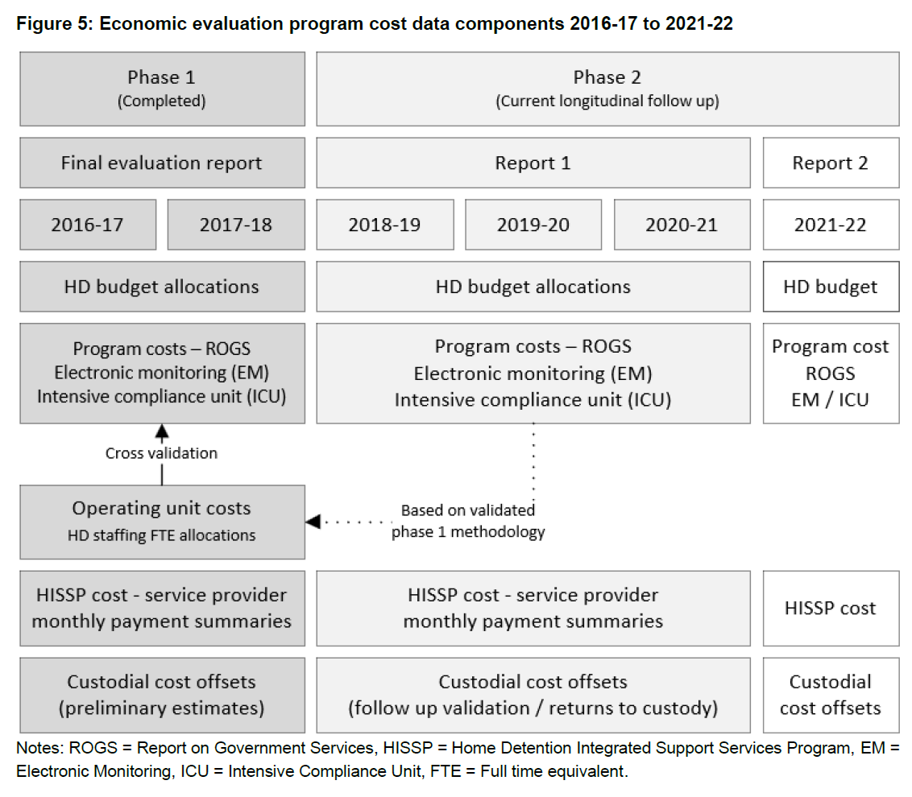
Program cost approach & validation
Phase 1
  Bottom-up costing approach based on staffing FTE allocations
  Development and cross validation with published RoGS expenditure across ROHD and COHD populations
Phase 2
  RoGS calculation method based on phase 1 validation
Integration with HISSP support services
Custodial cost offsets

Slide 26
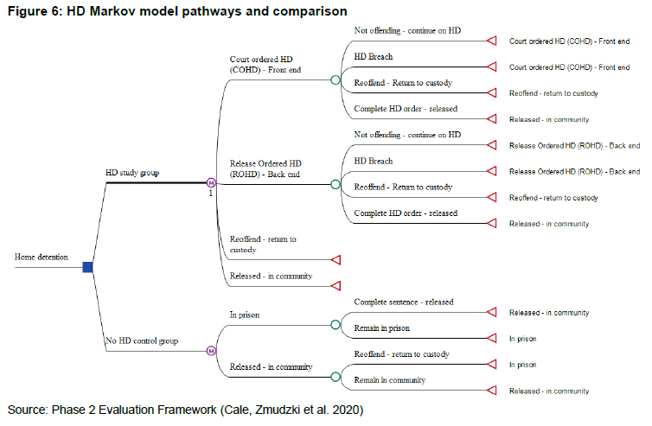
Economic cost effectiveness model
HD study group arm
  Compared to HD control group
Transition probabilities developed from outcomes analysis
Costs, variation and distributions at each pathway branch
Cost offsets
    HD prison years avoided vs propensity score matched control group
Model results, scenarios and assessing uncertainty, bootstrapping, probabilistic sensitivity analysis (PSA)

Slide 27
HD program outcomes and benefits
Custodial cost offsets represent a subset of quantifiable outcomes for HD
    the program is also potentially producing a range of implicit positive outcomes that are difficult to measure, particularly in monetary terms
    These benefits may include:
      Increased ability to obtain and sustain appropriate housing and reduced risk of homelessness, management of drug and alcohol abuse, improved community and workforce participation, improved education and job skill training, improved and sustained physical and mental health, as well as improved outcomes for families, partners and children of offenders.
      Increased participation in education and employment and other measures of quality of life for offenders, their families, partners and children.
      Potential further indirect prison cost offsets including lost productivity across paid and unpaid work, workplace disruption and replacement and injury through prison assaults.

Slide 28
HD program establishment and growth

Slide 29
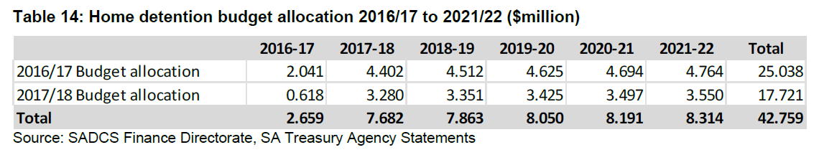
Home detention – program budget
Budget allocation around $8 million per year once established
Program costs significantly below budget, impact of covid restrictions
Total program cost: $31.1 million is substantially below total budget of $42.8 million (for the 6-year study period 2016-17 to 2021-22)

Slide 30
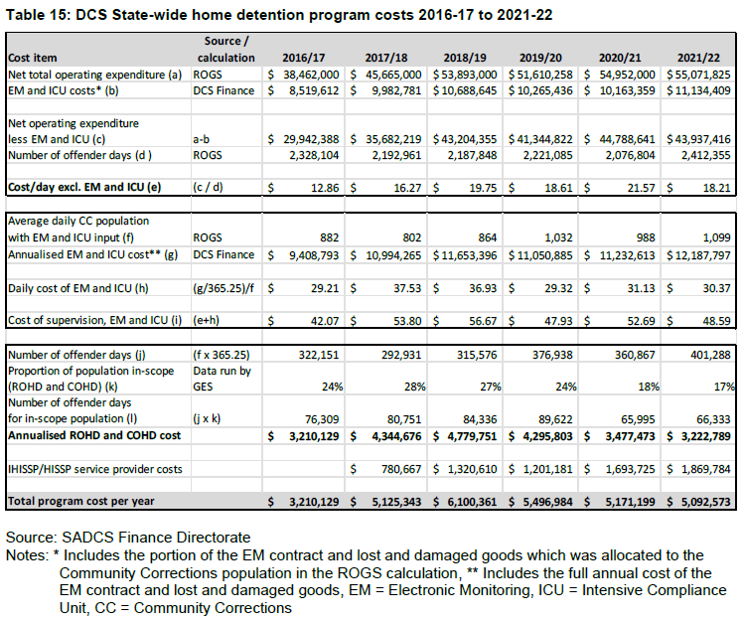
Home detention – program costs
RoGS calculation method
  Estimated daily costs (EM and ICU)
  Number of offender days and in scope ROHD and COHD populations
  IHISSP/HISSP support services
Costs increased from startup in 2016-17
Highest in 2018-19 ($6.1 million)
Decline in following years likely – partially due to COVID-19 restrictions
Later years HD cost down / HISSP up

Slide 31
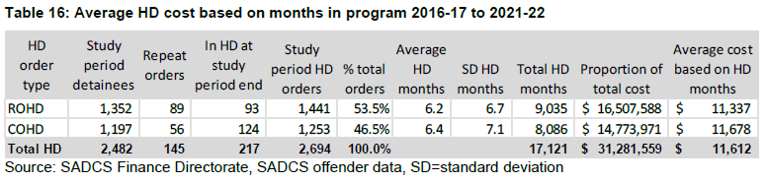
Average cost per HD detainee
The program supported a total of 2,482 HD detainees during the study period
    Estimated average cost per detainee: $11,612 (across average HD sentences of 6.3 months)
    Represents an average HD cost of $1,827 per month (during the study period from 2016-17 to 2021-22)
    On average: ROHD (6.2 months) - estimated average cost per detainee of $11,337
        COHD (6.4 months) - estimated average cost of $11,678
    Average HD sentence annualises to $21,925 which represents around 21% of the annual cost of prison in SA

Slide 32
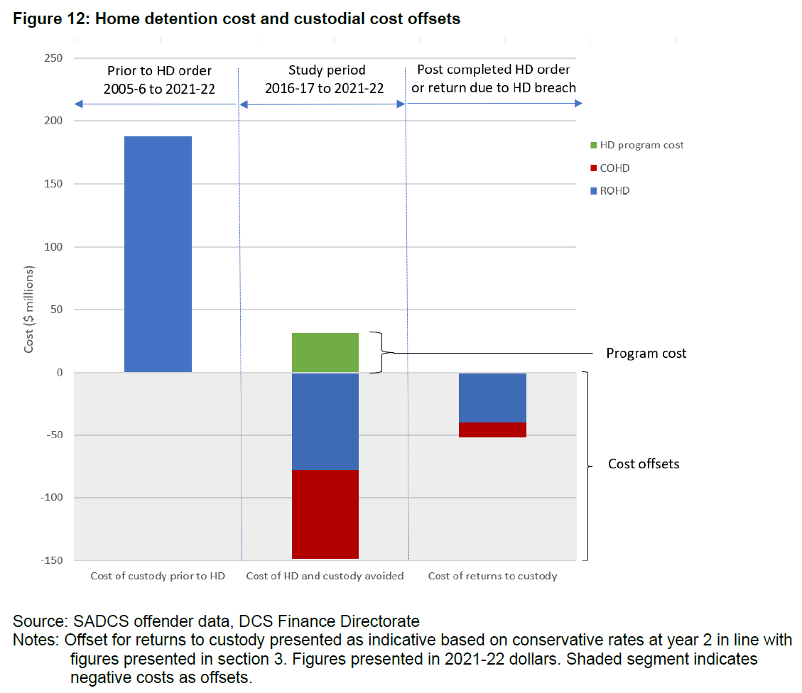
Custodial cost offsets
  Prior prison sentences over previous decade for perspective on scale
  (not directly comparable)
  Relative proportion of HD program cost
  Custodial offsets during study period (shaded lower section)
    multiples of program cost
    (direct measurable offsets)
  And offsets due to reduced post HD program returns to custody

Slide 33
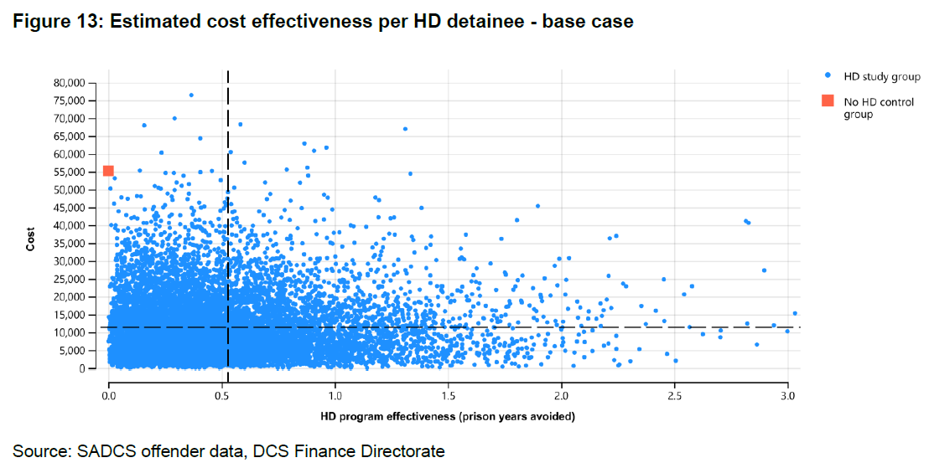
Program cost effectiveness – base case

Slide 34
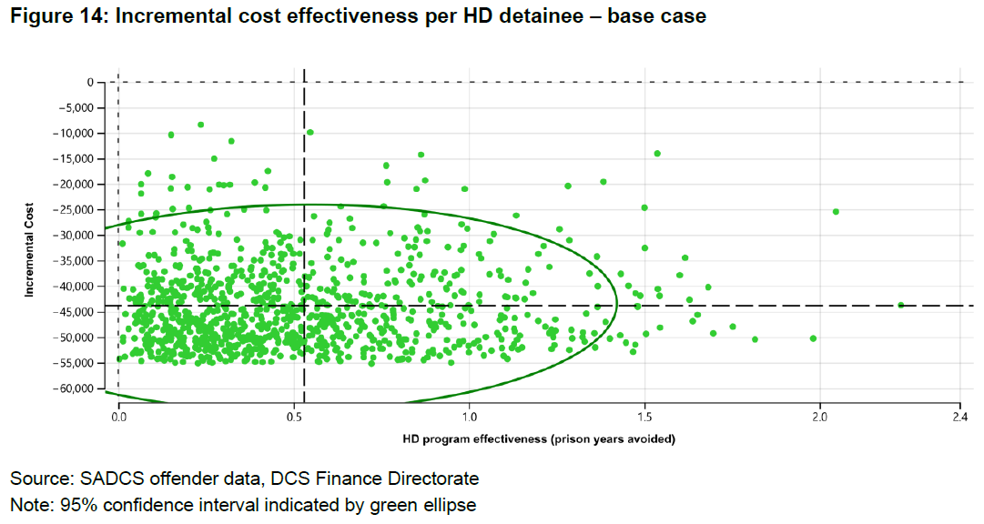
Program cost effectiveness – base case

Slide 35
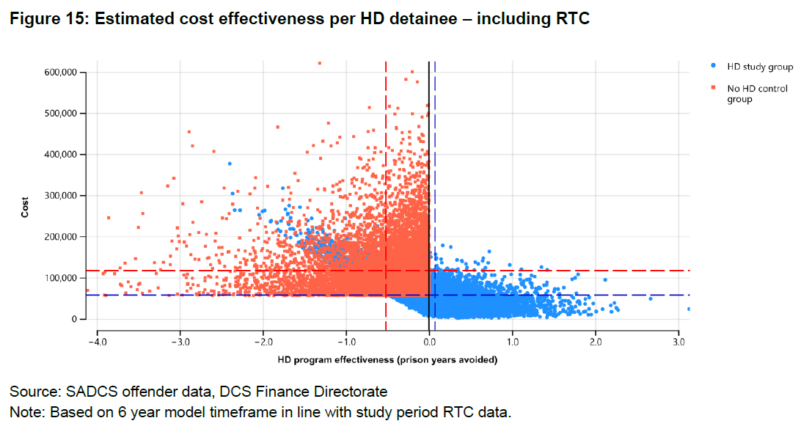
Program cost effectiveness – including RTC

Slide 36
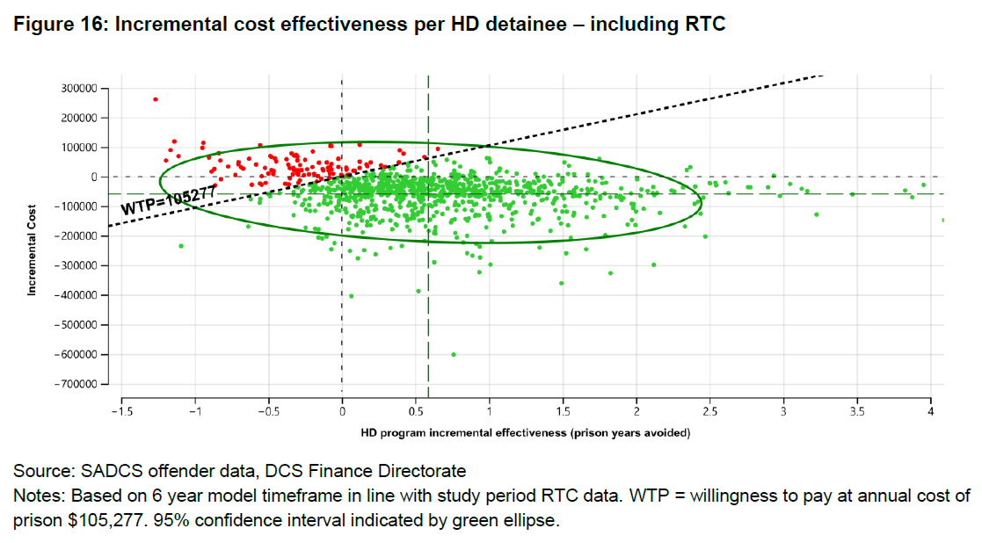
Program cost effectiveness – including RTC

Slide 37
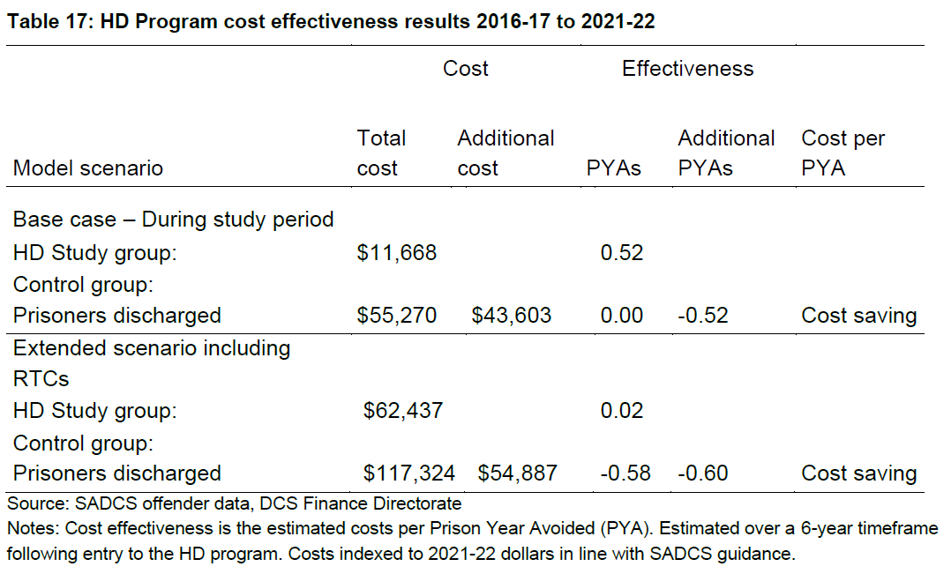
Program cost effectiveness - results

Slide 38
Economic evaluation - summary
Combined, the program cost of $31.3 million is generating $148.7 million of direct prison offsets with high confidence
      plus a further estimated future offset beyond the study timeframe of $51.5 million
    total estimated cost offset of $200.3 million
Per detainee: average HD cost per order of $11,668 is resulting in cost savings of $43,603 per detainee through direct HD prison time avoided
    and $54,887 when including subsequent reduced returns to custody
Exceptional level of cost effectiveness: HD program cost generating multiples in offsets around 4.8 times within the study timeframe
and nearly 6.4 times if future reductions in returns to custody are considered

Slide 39
Thank you!
Jesse Cale j.cale@griffith.edu.au
Fred Zmudzki f.zmudzki@unsw.edu.au
Jane Farrin Jane.Farrin@sa.gov.au
Final Report: https://www.corrections.sa.gov.au/__data/assets/pdf_file/0005/901508/Evaluation-of-HD-in-SA-Final-Report-20230216-CLEAN.pdf
Previous reports: https://www.corrections.sa.gov.au/about/our-research/hd-research-evaluation

