Slide 1
Evaluating the Mandatory Alcohol Interlock Program
Descriptor
Joanne Baker, Research and Evaluation
July 2022
transport.nsw.gov.au

Slide 2
Transport pays respect to Elders past and present, and recognises and celebrates the diversity of Aboriginal peoples and their ongoing cultures and connections to the lands and waters of NSW.
Acknowledgement of Country

Slide 3
Outline of today’s presentation
The need for MAIP
Drink driving and alcohol related road trauma trends
How the program is intended to work
TfNSW approach to evaluating MAIP
Earlier findings
6. Current and future work on MAIP

Slide 4
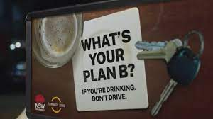
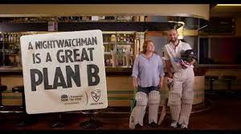
The need for MAIP
Sustained effort in NSW to reduce drink driving since RBT introduced in 1982
Ongoing and more refined education campaigns
Increased enforcement activity
Strengthening of penalties for drink driving
Introduction of a zero-alcohol limit for novice drivers
On the spot licence suspension
Drink driving and alcohol-related road trauma remain stubbornly high

Slide 5
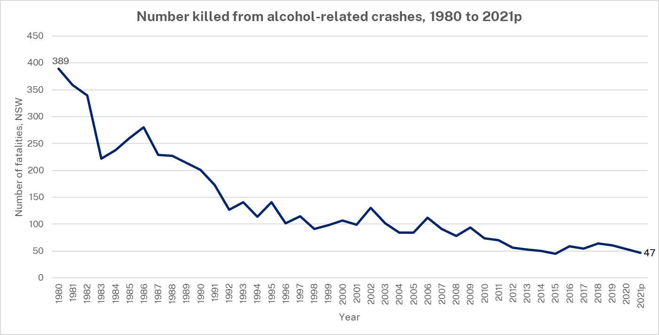
Levels of alcohol-related road trauma remain high

Slide 6
Notes:
\

Slide 7
Drink driving levels remain high

Slide 8
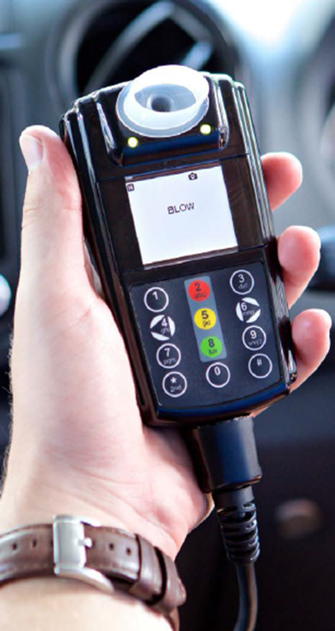
The Mandatory Alcohol Interlock Program
Device prevents the vehicle from starting if alcohol is detected.
Aims to reduce drink driving reoffending and alcohol related road trauma
Are effective in reducing drink driving while installed
Voluntary program in NSW in 2003
Mandatory penalty in 2015 for high range and repeat drink drive offenders
Expanded to first time mid range offences in Dec 2018 and combined offence in 2021

Slide 9
Aims and key principles of MAIP
Aims
Reduce drink driving reoffending and alcohol related road crashes
Keep people in the licensing system
Key principles
Monitor attempts to drink and drive
Incorporates rehabilitation
No additional court workload
User-pays basis ($2,000+ pa), although some financial support is available
Accessible via multiple suppliers, statewide, within 150km of participants

Slide 10
How the program works
Sentenced: Interlock order
Serve disqualification period (1–12 months)*
Remain disqualified for 5 years
Apply for Interlock licence
Complete Interlock period (1–4 years)*, incl 6 months good performance
Return to usual licence
* Dependent on severity of offence

Slide 11
TfNSW approach to evaluating MAIP
Process evaluation
(2019)
TfNSW administrative data
Outcome evaluation
(current)
Future evaluation
Expanded MAIP
Linked and de-identified TfNSW, BOCSAR and Police data drink driving offences
Participant surveys and interviews
Stakeholder surveys and interviews
Implementation of program
Impact on drink driving re-offending / road trauma
Participants experiences, enablers and barriers to the program
Data requirements scoped
Evaluation framework
Designed into the system
Developed during program planning

Slide 12
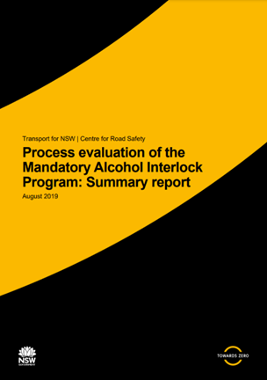
Early findings
Being delivered successfully by key partner agencies – NSW Police Force and the former RMS
Court orders reflect the intent of the legislation
Take up rate was lower than expected (54%)
Some geographic gaps in availability of interlock service providers
Concerns around accessibility of financial support provisions

Slide 13
Feedback from interlock participants
The interlock
is relatively easy to use
helps maintain work responsibilities (64%), family commitments (60%) and
helps to separate drinking and driving
But is
costly
embarrassing
complicated – program information, accessing financial support and licensing process
Limited data from those who did not take up the interlock

Slide 14
Further work is needed to understand the impact of MAIP
Findings to date have been key to informing program improvements
Clearer and more user friendly comms around the program
Reviewed financial support provisions
Improving IT system and business processes
Working more closely with interlock providers
- More work is needed to understand effectiveness, and how to further enhance the program
outcome evaluation
factors associated with take up of the interlock and completion of program
participant experiences, enablers and barriers to the program
- Future evaluation - expanded MAIP

Slide 15
Thank you Any questions?
joanne.baker@transport.nsw.gov.au

