Slide 1

Evaluation of Phase 1 of the Mandatory Alcohol Interlock Program (MAIP)
Sara Rahman
21 July 2022
Notes:
Thanks Amy. Thank you for joining our seminar series today. Before I begin I’d like to acknowledge the Burramattagal people of the Dharug nation on whose land I’m dialing in from today, and acknowledge their elders past, present, and emerging, and any Aboriginal people on the line. Today I’ll be covering our evaluation of Phase 1 of the Mandatory Alcohol interlock program. I’ll cover some background about the program and our evaluation, the data and methods we used, what we found and some of the conclusions and limitations.

Slide 2
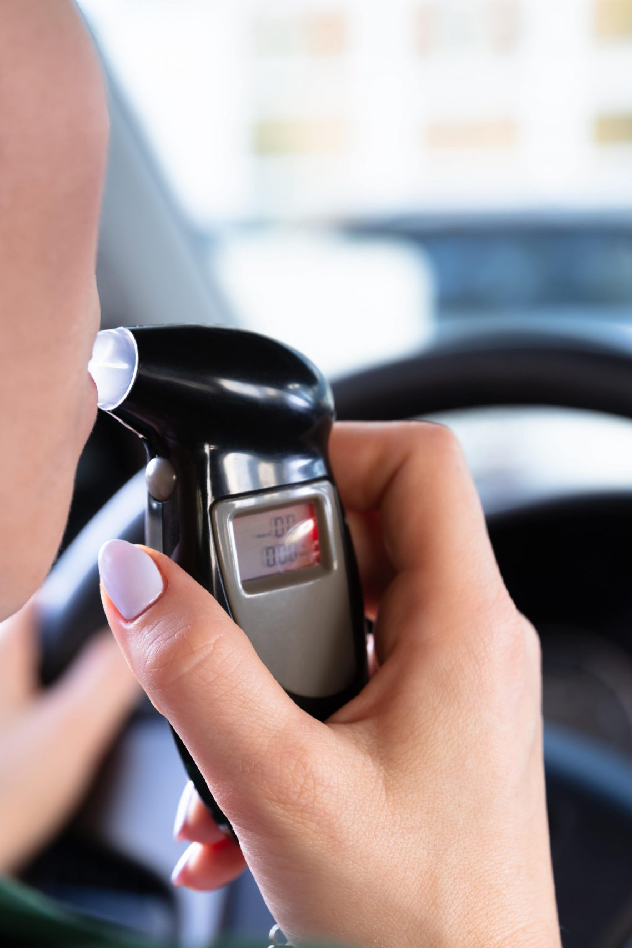
Interlock devices are an alternative penalty for drink drivers
Drink driving is a high volume offence in NSW
Prison does not reduce drink driving offending
Long disqualifications may have unintended consequences
Interlocks provide an alternative to these which enables offenders to return to lawful driving sooner
Notes:
Jo has already mentioned some background but I’ll go a little bit into the history and evidence for interlock devices in drink driving.
Drink driving is a high volume offence – in the three years to July 2019 these offences accounted for 6.4% of all proven charges in NSW criminal courts.
Jo has already noted; being of such high volume, reoffending involving such offences also results in a significant increase in volume for the courts.
An important question for policymakers is what penalties might be most effective in reducing further drink driving offences. International and NSW evidence shows that prison is not an effective sanction in reducing drink driving.
while long disqualifications have been found to be effective, they have the drawback of stopping people from driving entirely. Several reports have highlighted how these lengthy disqualifications essentially snowball for people who drive illegally (possibly out of necessity), exacerbating some existing inequalities in the our criminal justice system.
Interlock devices offer an alternative (or additional option) to these penalties and are often used after a short disqualification period. These devices enable offenders to return to lawful driving sooner while preventing drink driving by immobilising the engine if a person attempts to drink and drive. A unique feature which you've already heard from Jo is that in most jurisidictions the user pays for the device, which is rather unique from a CJS perspective.

Slide 3
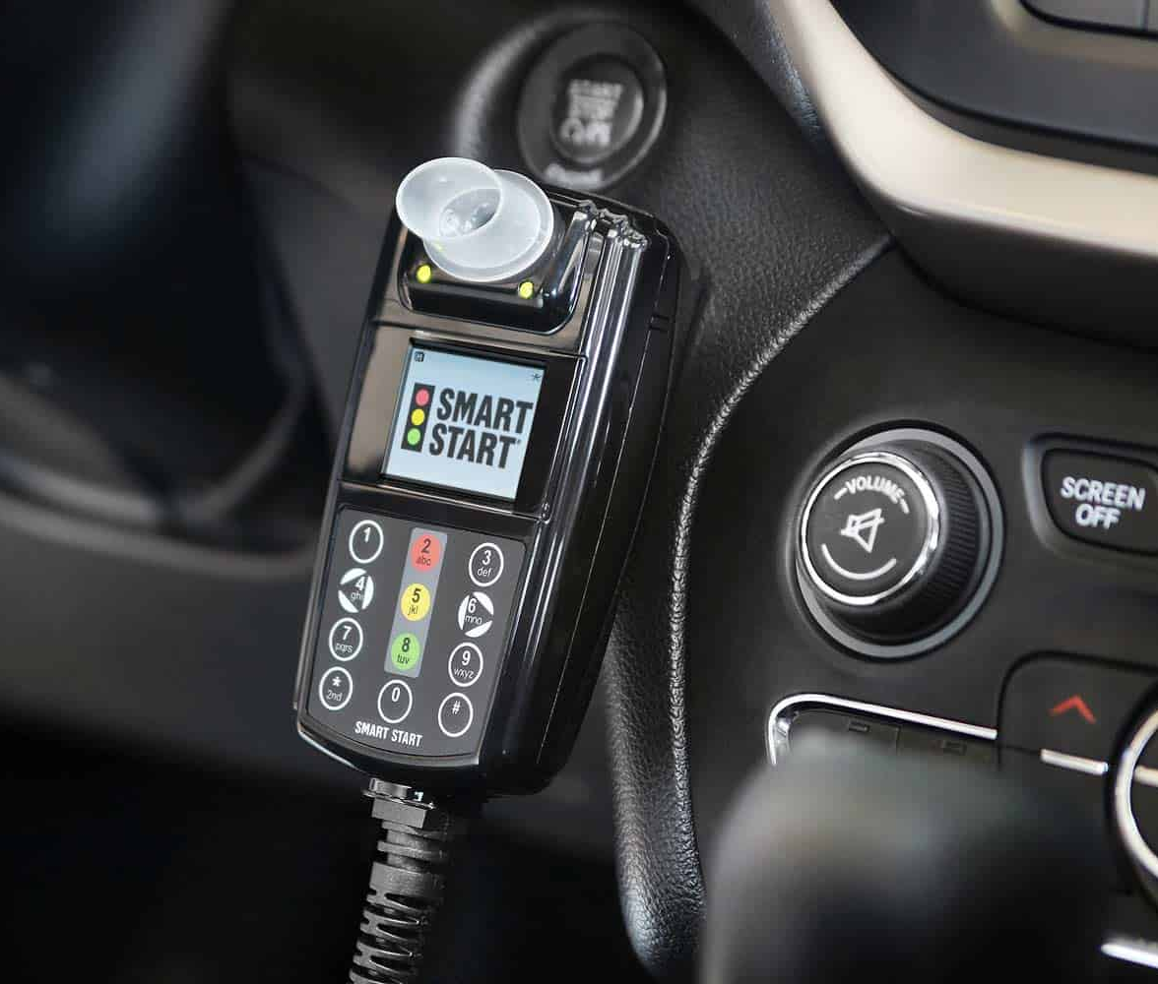
Our evaluation aimed to answer three questions:
1. Has MAIP reduced drink driving related reoffences?
2. Has MAIP reduced driving whilst disqualified and other driving-related infringements?
3. Has MAIP reduced alcohol related road crashes and injuries?
Notes:
Our evaluation covers three questions:
1. Has MAIP reduced drink driving related reoffences?
2. Has MAIP reduced driving whilst disqualified and other driving-related infringements?
3. Has MAIP reduced alcohol related road crashes and injuries?
We only examine the first phase of MAIP which applied to three groups of offender.s Within these groups, offenders have varying lengths of interlock orders, and if they do not take up the devices, they are subject to a five-year automatic disqualification.

Slide 4
Disqualification and interlock periods differed by severity
We only cover the first phase of MAIP, which made interlock orders mandatory for: repeat PCA offenders, high range PCA offenders, and refuse breath test offenders, from 1 February 2015 onwards
There are three penalty lengths under Phase 1 of MAIP:
1-3 month initial disqualification and a 12 month automatic interlock period for those with repeat low range PCA offences
6-9 month disqualification and a 24 month automatic interlock period for repeat mid-range, first time high range, and first time refuse breath test offences
9-12 month disqualification and a 48 month automatic interlock period for repeat high range PCA offenders and repeat refuse breath test offenders
Notes:
Our evaluation covers three questions:
1. Has MAIP reduced drink driving related reoffences?
2. Has MAIP reduced driving whilst disqualified and other driving-related infringements?
3. Has MAIP reduced alcohol related road crashes and injuries?
We only examine the first phase of MAIP which applied to three groups of offender.s Within these groups, offenders have varying lengths of interlock orders, and if they do not take up the devices, they are subject to a five-year automatic disqualification.

Slide 5



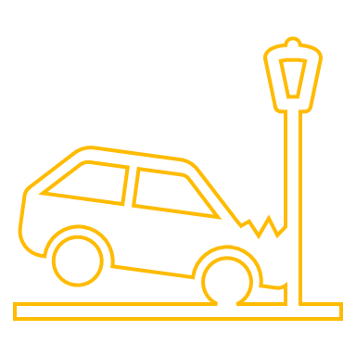


Our dataset included BOCSAR, TfNSW, and police breath testing data
BOCSAR Re-offending database
TfNSW data on Mandatory Alcohol Interlock Orders
Crashlink data
MAIP operational data
Police breath testing data
TfNSW data on other driving infringements and offences
All offenders
98,501 finalisations involving adults with a principal PCA or a refuse breath test offence
after 01 Feb 2012 and finalised by 30 April 2018
First time offenders in Phase 1
43,196 finalisations involving adults with a principal offence of first-time PCA after 01 Feb 2015 and finalised by 30 April 2018
Notes:
We used a unique dataset that combined data from the BOCSAR reoffending database, TfNSW data on Mandatory Alcohol Interlock Orders and data on other driving infringements and offences, CrashLink data on crashes occurring in NSW from the start of our study period to 20 April 2020, MAIP operational data and blood alcohol concentration data from NSW police for the duration of our study period.
This results in a dataset of all offenders convicted of a PCA offence (of any level) or refuse breath test offence in NSW between 01 February 2012 (3 years before the introduction of Phase 1 of MAIP) which were finalised by 30 April 2018, giving us three years’ minimum follow up for all offenders. This results in 98,501 finalisations.
We also use a subset of matters involving first time offenders in the Phase 1 period, specifically 43,196 finalisations involving adults with a principal offence that was a first time PCA offence finalised before 30 April 2018.

Slide 6




We examined both criminal justice and road safety outcomes
Drink driving reoffences
The likelihood of a proven exceed the prescribed content of alcohol or drive under the influence offence
Traffic infringements
The number of infringements which did not result in a criminal proceeding
Driving while disqualified
A proven re-offence classified under ANZSOC 1411, i.e., drive while licence disqualified or suspended
Crashes
Alcohol-related crashes
the offender being detected with a BAC above the legal limit in a crash
A crash involving an injury or fatality
Notes:
We examine four types of outcomes.
The first is further drink driving, defined as a proven exceed the prescribed content of alcohol or drive under the influence offence.
The second is driving while disqualified which is a proven offence where a person drives while their licence is disqualified or suspended
The third is traffic infringements – the number of infringements which did not result in a criminal proceeding. This includes things like speeding, parking infringements, running red lights and the like.
The fourth is crashes – we examine two types of crashes – alcohol-related crash, which we define as any crash where the offender was detected above the legal limit, and a crash involving an injury or fatality.

Slide 7



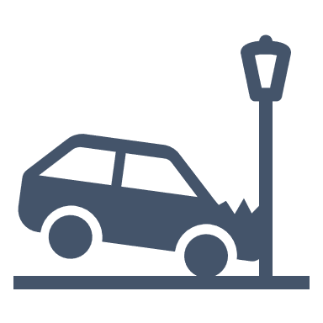
We examined both criminal justice and road safety outcomes
Drink driving reoffences
The likelihood of a proven exceed the prescribed content of alcohol offence
Traffic infringements
Driving while disqualified
The number of infringements which did not result in a criminal proceeding
a proven re-offence classified under ANZSOC 1411, i.e. Drive while licence disqualified or suspended
Crashes
Alcohol-related crashes: the probability of the offender being detected with a BAC above the legal limit in an alcohol-related crash
a crash involving an injury or fatality

Slide 8






In general, eligible and ineligible offenders had similar characteristics
Prior infringements
Age
Regions
On average, offenders were 38 years old
60% were from major cities, 25% from inner regional areas
Approximately 1 prior traffic infringement in the 2 years pre-finalisation
Eligibility
Aboriginality
Gender
Approximately 25% of the sample committed MAIP Phase 1-eligible offences
More than twice the proportion with unknown Aboriginality among ineligible
80% of offenders in both groups were men
Notes:
I’ll go through a few features of the sample I used.
1. Of our 98,000 offenders or so approximately 25% committed MAIP Phase 1-eligible offences, half of these after Phase 1 came into effect (12,353)
2. On average, offenders were 38 years old, with a standard deviation of around 12 years
3. Aboriginality differed between eligible and ineligible offenders. A particular issue we had is that more than twice the proportion with unknown Aboriginality among the ineligible (which are first-time offenders). This is likely a facet of the fact that these people have had no other contact during which Aboriginality may have been recorded. Among eligible 11.3% were Aboriginal, and 5.9% of ineligibles were Aboriginal.
About 60% of the offenders in our sample resided in metro areas with 25% from inner regional areas
80% of the offenders were male
And on average people had one prior infringement in the 24 months before finalisation

Slide 9





In general, eligible and ineligible offenders had similar characteristics
Prior infringements
Age
Regions
On average, offenders were 38 years old
60% were from major cities, 25% from inner regional areas
Approximately 1 prior traffic infringements in the 2 years pre-finalisation
Eligibility
Aboriginality
Gender
Approximately 25% of the sample committed MAIP Phase 1-eligible offences
More than twice the proportion with unknown Aboriginality among ineligible
80% of offenders in both groups were men

Slide 10
Impact of MAIP on installers

Slide 11
We estimate the impact on first time offenders, comparing those just and above the high-range PCA threshold to determine the impact on installers
It compares interlock installers just above the threshold with those just below who likely would have opted into the program
Essentially, we compare offenders within a narrow range (in our case, 0.12-0.18 BAC) such that entry into MAIP can be considered essentially random
This method has three assumptions:
Interlock installation increases after the 0.15 threshold
The BAC readings cannot be manipulated
There should be no ‘jumps’ in other variables at the cutoff
Reoffending
0.15
BAC
Notes:
There are a couple of issues that we faced in evaluating MAIP. The first is that at least the first phase of MAIP rolled out to the most serious drink driving offenders. These offenders probably have characteristics that make them more likely to reoffend that we can't observe or correct for in our data. If you look at this hypothetical chart on the right, if we simply compared all offenders on the side of the 0.15 threshold to those before, even if we observed a reduction (the solid line), we might not find a difference because these offenders are more likely to offend, possibly for reasons we can’t quantify such as alcohol dependence.
The second challenge, as Jo has already noted, is that not all offenders who are given MAIP orders install interlock devices. Literature and some other analysis we have done suggests that a range of factors influence uptake - most of which are not random, such as socioeconomic factors, ability to pay, and an offender’s willingness to risk driving while disqualified. Most of these factors aren’t random, so there is considerable selection bias involved which would invalidate
So what we do to identify the impact of MAIP on first time offenders is we focus on first time offenders within a narrow bandwidth around the BAC cutoff for MAIP, in our case (0.12 to 0.18 most of the time) to determine the impact of MAIP on installers. We focus on the station BAC reading as this forms the basis for prosecution. In essence we compare installers above the threshold with likely installers below the threshold. The argument behind this method is that within such a bandwidth the BAC which a person is detected driving at is essentially random and thus, if we observe a change in outcomes at the threshold, we can attribute it to MAIP. Specifically, this argument can be expressed in terms of three assumptions: the first is that interlock installation increases at the 0.15 threshold, the second is that the BAC readings cannot be manipulated (in which case they would not be random), and the third is that no other variables should exhibit jumps at the threshold, because that would suggest other factors may be driving any observed changes in outcomes at the threshold.

Slide 12
We observe a large increase in installation rates at the 0.15 threshold
65 p.p.
Notes:
The first assumption is clear. Here’s a chart of how the proportion who installed interlock devices (and therefore started MAIP) along the continuum of BAC readings. Within our bandwidth, the increase is 65 p.p.

Slide 13
We find no evidence that readings are ‘manipulated’
Notes:
The second is whether the readings can be manipulated in some way. Historically this is tested by comparing the density of readings on either side of the threshold. We do not find there is a is statistically significant difference in the number of observations on either side of the threshold even though we do observe some dips and troughs along the continuum. We also run some tests in the report to ensure that our findings aren’t biased to this.

Slide 14
No other factors ‘jump’ at the 0.15 cutoff
Notes:
When we plot offenders’ characteristics and do not observe any large ‘jumps’ at the threshold. (I’ll just flag here for those who are interested that the blob at the left side of the age at index contact chart are novice-range drivers, who tend to be very young).
What is missing from this chart that is important to note is that the counterfactual (‘what would have happened without MAIP) penalties do also change at the threshold. Before MAIP for example, those on the left side would have an automatic disqualification for 12 months (which remains in the post-MAIP era) and high range PCA offenders would have received a 3 year automatic disqualification. So its not really a great test for driving while disqualified because the control group has less opportunity to be detected. So we don’t examine that in this analysis but we do in the next one.

Slide 15
Estimated impacts on PCA offending among interlock installers
Interlock installers experience large reductions in PCA offending particularly in the interlock period
All first time PCA offenders
Other outcomes
We also found a statistically significant reduction of 0.345 traffic infringements in the 36 months after finalisation
We found no difference in alcohol-related crashes nor in crashes resulting in an injury
Notes:
What do we find in this analysis? As mentioned earlier the model extrapolates offending along the BAC continuum and compares that to what we observe for those above the threshold, within our bandwidth. This ifnds a 6 percentage point drop in the likelihood of drink driving among all offenders, regardless of installation.
Turning to those who install interlocks, we find that the program reduces drink driving by 2 percentage points in the initial disqualification period, by 11 percentage points during the interlock period, and 3 percentage points after the interlock period. This constitutes an 86% reduction in drink driving during the interlock period.
Looking at our other outcomes, we also found a reduction of 0.3 traffic infringements on average in the 36 months after finalisation
We also found non statistically significant reductions in alcohol-related crashes of 0.2 percentage points , nor in crashes resulting in an injury of 0.6 percentage points

Slide 16
Impact of MAIP on all offenders

Slide 17
We compare eligible and ineligible offenders before and after the introduction of MAIP
Eligible
We compare:
  eligible for MAIP in Phase 1 (high-range, repeat PCA offence, refuse breath test)
  not eligible for MAIP in Phase 1 (first time low-range, mid-range or novice range PCA offence)
This analysis is credible if:
    Trends of each group are likely to be similar absent the reform
    No other changes occur exclusively to either group
Reoffending
Ineligible
MAIP Phase 1, i.e. 2 Feb 2015
Time
Notes:
Our second analysis compares outcomes for successive cohorts of offenders who committed MAIP-eligible and MAIP-ineligible offences before and after the start of MAIP. How this analysis works is it identifies any changes in outcomes following the start of MAIP that are exclusive to those who committed eligible offences as the effect of MAIP. If you take a look at the chart on the right, if the solid purple line is what we observe for those who committed eligible offences, and the solid yellow line is observed reoffending for those committing MAIP ineligible offences, it uses the trends in offending post-MAIP for the ineligible offenders to project what would have happened to eligible offenders if MAIP hadn’t existed. The comparison of the solid purple line and the dotted purple line is the effect of MAIP.
This analysis requires two assumptions to be met. The trends of each group are likely to be similar absent the reform. In other words, the groups’ drink driving is affected by the same factors: alcohol consumption in society, liquor licensing, police RBT activity. We also examine the pre-MAIP trends on all our outcomes and find that they are broadly similar with the exception of alcohol-related crashes. The second assumption is that no other changes occur exclusively to either group. While not testable we suspect this assumption is credible: few other road safety interventions target these specific groups.

Slide 18
PCA outcomes
Other outcomes
MAIP reduces drink driving among all eligible offenders by 43% despite partial uptake
We find large (43%) reductions in PCA offending within 36 and 60 months after finalisation
We find no impact of the MAIP when examining all eligible offenders on driving while disqualified and traffic outcomes
Notes:
I’ll jump to the results, first we will look at PCA offending. We find reductions in PCA offending of 3 percentage points within 36 months, and of 6 percentage points within 60 months. This is a little bit diluted as slightly under 60% of these offenders take up the interlock but also that these offenders also have varying interlock periods based on their type of offence. We don’t find any changes in the other outcomes that we examine. We find no significant effects on driving while disqualified, traffic infringements or crashes.

Slide 19
MAIP has greater impacts on those with longer interlock periods
Interlock period
Repeat low range PCA offenders
Repeat mid range PCA offenders
First time high range offenders, and first time refuse breath test offenders
Repeat high range PCA offenders
Repeat refuse breath tests offenders
Notes:
Finally, one advantage of this analysis is we don’t have to rely on the BAC and we can exmaine the different groups separately. We find that there is little effect of the repeat low range PCA offenders who have the shortest interlock period of 12 months.

Slide 20




MAIP is effective at reducing drink driving, particularly for those who are on longer orders
We also find slight reductions in drink driving after the interlock period
MAIP reduces drink driving, particularly in the interlock period.
It reduces 86% of drink driving reoffending while installed
It reduces 43% of drink driving (in both 3 and 5 years post-finalisation) among all eligible offenders in Phase 1.
Magistrate discretion in imposing disqualification periods and delays in commencement mean that some offenders may still be on the interlock
MAIP also includes therapeutic elements through offender contact with GPs
We do not find any impact on crashes
We observe larger reductions for those with longer interlock periods
We cannot rule out whether this is because of
a lack of power
Opposing forces of less drink driving and increased frequency of driving
We find indicative evidence that this is driven by the length of incapacitation, rather than selection into the offence

Slide 21




MAIP is effective at reducing drink driving, particularly for those who are on longer orders
MAIP reduces drink driving, particularly in the interlock period
It reduces 86% of drink driving reoffending while installed
It reduces 43% of drink driving (in both 3 and 5 years post-finalisation) among all eligible offenders in Phase 1.
We do not find any
impact on crashes
We cannot rule out whether this is because of:
a lack of power
Opposing forces of less drink driving and increased frequency of driving
Drink driving reduces slightly after interlock period
Magistrate discretion in imposing disqualification periods and delays in commencement mean that some offenders may still be on the interlock
MAIP also includes therapeutic elements through offender contact with GPs
We observe larger reductions for those with longer interlock periods
We find indicative evidence that this is driven by the length of incapacitation, rather than selection into the offence

Slide 22
THANK YOU

Slide 23
GET IN TOUCH
10 Darcy St
Parramatta NSW 2150
CONTACT US
(02) 8346 1100
Sara Rahman
sara.rahman@justice.nsw.gov.au
bcsr@justice.nsw.gov.au
https://www.bocsar.nsw.gov.au/
@BOCSAR

