Slide 1
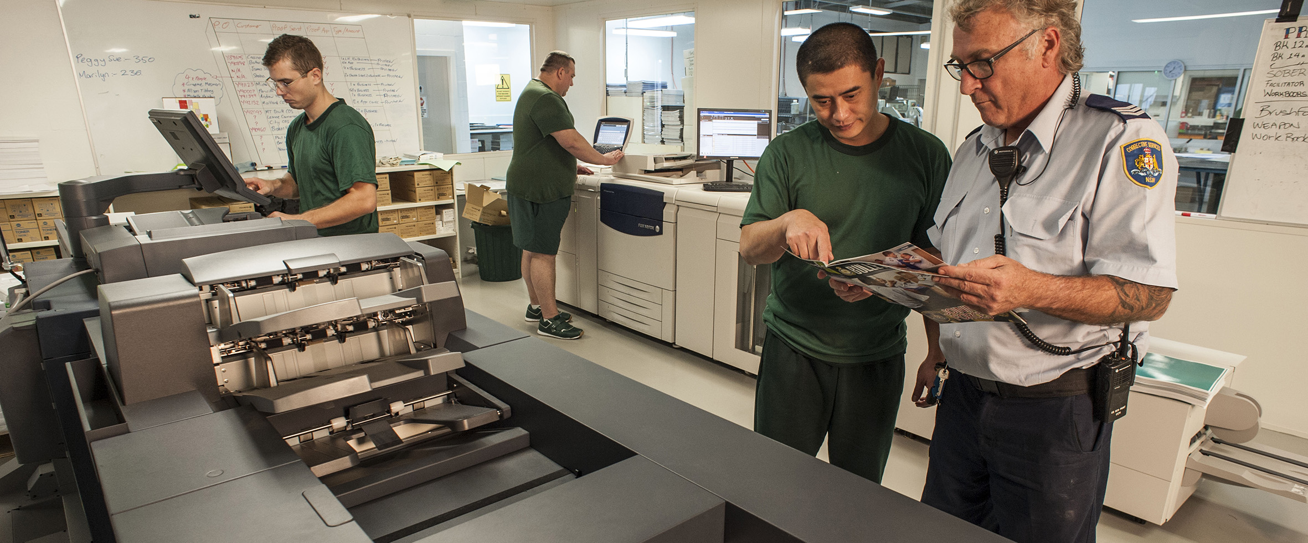
Evaluation of vocational training in custody and pathways to post-release employment
Corrections Research Evaluation and Statistics

Slide 15
QUESTIONS?

